Slide 1


Welcome!
During this session we will be providing tools and exchanging ideas on ILD patient care

Slide 2
Background on IPF and other fibrosing ILDs

Slide 3
Patients with certain types of fibrosing ILDs can develop a progressive phenotype¹
A0
Introduction
1. Wijsenbeek M, Cottin V. Spectrum of fibrotic lung diseases. N Engl J Med. 2020;383(10):958-68.

Slide 4

ILD encompasses a large group of over 200 parenchymal pulmonary disorders, of which the majority are classified as rare¹
A1
ILD
ILD is characterized by inflammation and/or fibrosis²
ILDs are distinguished by their cause and distinct radiological/histological patterns³
Early and accurate diagnosis can be challenging, and it is difficult to predict disease progression¹
Early diagnosis and regular monitoring is essential to optimize patient outcomes^{1,4}
Overall prevalence of ILD in Europe:
76 cases/100,000 people²
1. Cottin V, Hirani NA, Hotchkin DL, et al. Presentation, diagnosis and clinical course of the spectrum of progressive-fibrosing interstitial lung diseases. Eur Respir Rev. 2018;27(150):180076; 2. Wijsenbeek M, Cottin V. Spectrum of fibrotic lung diseases. N Engl J Med. 2020;383(10):958-68; 3. Renzoni EA, Poletti V, Mackintosh JA. Disease pathology in fibrotic interstitial lung disease: is it all about usual interstitial pneumonia? Lancet. 2021;398(10309):1437-49; 4. Wijsenbeek M, Kreuter M, Olson A, et al. Progressive fibrosing interstitial lung diseases: current practice in diagnosis and management. Curr Med Res Opin. 2019;35(11):2015-24.

Slide 5

Clinically significant ILDs are usually characterized by chronic inflammation in the lung and varying degrees of pulmonary fibrosis¹
A2
ILD
ILDs
ILDs
Idiopathic interstitial pneumonias
Autoimmune ILDs
Hypersensitivity pneumonitis
Sarcoidosis
Other ILDs
Lymphangioleiomyomatosis
Langerhans cell histiocytosis
Drug-associated ILD
Other exposure ILDs
Vasculitis/granulomatosis ILDs
Other rare ILDs
Idiopathic pulmonary fibrosis
Systemic sclerosis ILD
Interstitial pneumonia with autoimmune features
Idiopathic non-specific interstital pneumonia
Rheumatoid arthritis ILD
Polymyositis and dermatomyositis ILD
Respiratory bronchiolitis-interstitial lung disease
Idiopatic lymphoid interstitial pneumonia
Mixed connective tissue disease ILD
Rheumatoid arthritis (RA) is…
a chronic autoimmune disease, which primarily affects the synovial joints¹
RA affects up to 1% of the population³
The mean age of diagnosis is ~60 years¹
It is twice as common in women than men³; <75 years, incidence is up to 4 times higher in women¹
Desquamative interstitial pneumonia
Systemic sclerosis (SSc) is…²
a chronic autoimmune disease that may affect many organs
abnormal growth of connective tissue
Reported prevalences for SSc varies from 30 cases/million to 580 cases/million²
The peak onset of SSc is 30-70 years of age¹
Women are 4 times more likely to develop SSc than men¹
Idiopathic pleuroparenchymal fibroelastosis
Sjögren’s syndrome ILD
Cryptogenic organizing pneumonia
Systemic lupus erythematosus ILD
Unclassifiable IIPs
Acute interstitial pneumonia
Other connective tissue disease ILDs
IIPs=Idiopathic Interstitial Pneumonias; 1. Cottin V, Hirani NA, Hotchkin DL, et al. Presentation, diagnosis and clinical course of the spectrum of progressive-fibrosing interstitial lung diseases. Eur Respir Rev. 2018;27(150):180076; 2. Varga J, Denton CP, Wigley FM, et al. Scleroderma: From pathogenesis to comprehensive management: Springer; 2016; 3. England BR, Mikuls TR. Epidemiology of, risk factors for, and possible causes of rheumatoid arthritis. Available at https://www.uptodate.com/contents/epidemiology-of-risk-factors-for-and-possible-causes-of-rheumatoid-arthritis.
Notes:
Focus will be mainly on IPF, SSc-ILD and RA-ILD

Slide 6
Patients with certain types of fibrosing ILDs can develop a progressive phenotype¹
A3
ILD
F-ILD
PPF
ILD
F-ILD
PPF
IPF Consensus Working Group proposal for classification of fibrosing ILDs²
Non-progressive
Progressive but responds to therapy, at least in the short term
Progressive regardless of treatment considered appropriate for individual ILDs
IPF=Idiopathic Pulmonary Fibrosis; 1. Wijsenbeek M, Cottin V. Spectrum of fibrotic lung diseases. N Engl J Med. 2020;383(10):958-68; 2. Wells AU, Brown KK, Flaherty KR, et al. What's in a name? That which we call IPF, by any other name would act the same. Eur Respir J. 2018;51(5):1800692.
Notes:
ILDs can be fibrosing (scar tissue) or non-fibrosing (inflammation or build-up of fluid).
A group of experts in the field of ILD suggested that disease behavior in fibrosing ILDs can be subdivided into three patterns: non-progressive, progressive but responds to therapy (at least in the short-term), and progressive regardless of treatment considered appropriate for individual ILDs, the latter representing patients with the progressive phenotype of fibrosing ILD¹
More than half of all patients with a fibrosing ILD other than IPF have stable, chronic disease, or respond to management considered appropriate for their condition²

Slide 7





Progressive fibrosing ILD is a phenotype in which patients continue to progress despite conventional treatment directed at the underlying diagnosis^{1,2}
A4
PPF
PPF is:
... progressive, reflected by worsening of symptoms and lung function, and increasing fibrosis on chest images^{2,3}
... self-sustaining^{3,4}
... independent of original clinical association or trigger³
... variable and unpredictable in its disease course, ranging from stable to quickly progressing^{2,4-5}
... may ultimately lead to organ malfunction, disruption of gas exchange and death from respiratory failure⁶
1. George PM, Spagnolo P, Kreuter M, et al. Progressive fibrosing interstitial lung disease: clinical uncertainties, consensus recommendations, and research priorities. Lancet Respir Med. 2020;8(9):925-34; 2. Raghu G, Remy-Jardin M, Richeldi L, et al. Idiopathic Pulmonary Fibrosis (an Update) and Progressive Pulmonary Fibrosis in Adults: An Official ATS/ERS/JRS/ALAT Clinical Practice Guideline. Am J Respir Crit Care Med. 2022;205(9):e18-e47; 3. Flaherty KR, Brown KK, Wells AU, et al. Design of the PF-ILD trial: a double-blind, randomised, placebo-controlled phase III trial of nintedanib in patients with progressive fibrosing interstitial lung disease. BMJ Open Respir Res. 2017;4(1):e000212 4. Nambiar AM, Walker CM, Sparks JA. Monitoring and management of fibrosing interstitial lung diseases: a narrative review for practicing clinicians. Ther Adv Respir Dis. 2021;15:17534666211039771; 5. Raghu G, Collard HR, Egan JJ, et al. An official ATS/ERS/JRS/ALAT statement: idiopathic pulmonary fibrosis: evidence-based guidelines for diagnosis and management. Am J Respir Crit Care Med. 2011;183(6):788-824; 6. Wynn TA. Integrating mechanisms of pulmonary fibrosis. J Exp Med. 2011;208(7):1339-50.
Notes:
Despite appropriate management, a proportion of patients will develop progressive and self-sustaining fibrosis in the lung, ultimately resulting in organ failure, worsening respiratory symptoms and exercise capacity, an impaired quality of life and an increased risk of death, similar to the disease course of IPF²

Slide 8
It is estimated that up to 30% of patients with ILD develop a progressive phenotype, which is associated with a worse prognosis^{1,2}
A5
PPF
Fibrosing ILDs that may present a progressive-fibrosing phenotype^{3,4}
ILDs
CTD-ILDs
Exposure related ILDs
HP
Progressive fibrosing ILDs
Sarcoidosis
Non-IPF IIPs
Other ILDs
Idiopathic Pulmonary Fibrosis (IPF) is by definition a progressive fibrosing ILD
IPF
Figure adapted from Kolb and Vašáková. Respir Res. 2019;20(1):57.
CTD=Connective Tissue Disease; HP=Hypersensitivity Pneumonitis; 1. Wijsenbeek M, Kreuter M, Olson A, et al. Progressive fibrosing interstitial lung diseases: current practice in diagnosis and management. Curr Med Res Opin. 2019;35(11):2015-24; 2. Hilberg O, Hoffmann-Vold AM, Smith V, et al. Epidemiology of ILDs and their progressive-fibrosing behaviour in six European countries. ERJ Open Res. 2022;8:00597-2021; 3. Cottin V, Wollin L, Fischer A, et al. Fibrosing interstitial lung diseases: knowns and unknowns. Eur Respir Rev. 2019;28(151):180100; 4. Kolb M, Vašáková M. The natural history of progressive fibrosing interstitial lung diseases. Respir Res. 2019;20(1):57.
Notes:
IPF is the archetypal and most common fibrosing ILD that usually progresses to respiratory failure and death within 3 years^{2,3}

Slide 9
Although each of the individual fibrosing ILDs is rare, collectively they affect a considerable number of patients, representing a substantial burden of disease¹
B0
Epidemiology Fibrosing ILDs
1. Wijsenbeek M, Cottin V. Spectrum of fibrotic lung diseases. N Engl J Med. 2020;383(10):958-68.

Slide 10

Patients with autoimmune disease are at increased risk of developing ILD¹⁻³
B2
CTD-ILD
The prevalence of ILD varies by CTD type, with the highest rate observed in SSc¹
Patients with CTD-ILD can develop a fibrosing phenotype
CTD | Prevalence of ILD (%)
SSc | 70 – 90
Mixed CTD | 20 – 85
PM/DM | 15 – 70
RA | 4 – 68
Sjögren’s syndrome | 10 – 30
SLE | 2 – 10
SSc=Systemic Sclerosis; PM=Polymyositis; DM=Dermatomyositis; RA=Rheumatoid Arthritis; SLE=Systemic Lupus Erythematosus; 1. Wallace B, Vummidi D, Khanna D. Management of connective tissue diseases associated interstitial lung disease: a review of the published literature. Curr Opin Rheumatol. 2016;28(3):236-45; 2. Wijsenbeek M, Cottin V. Spectrum of fibrotic lung diseases. N Engl J Med. 2020;383(10):958-68; 3. Bosello SL, Beretta L, Del Papa N, et al. Interstitial Lung Disease Associated With Autoimmune Rheumatic Diseases: Checklists for Clinical Practice. Front Med (Lausanne). 2021;8:732761.

Slide 11
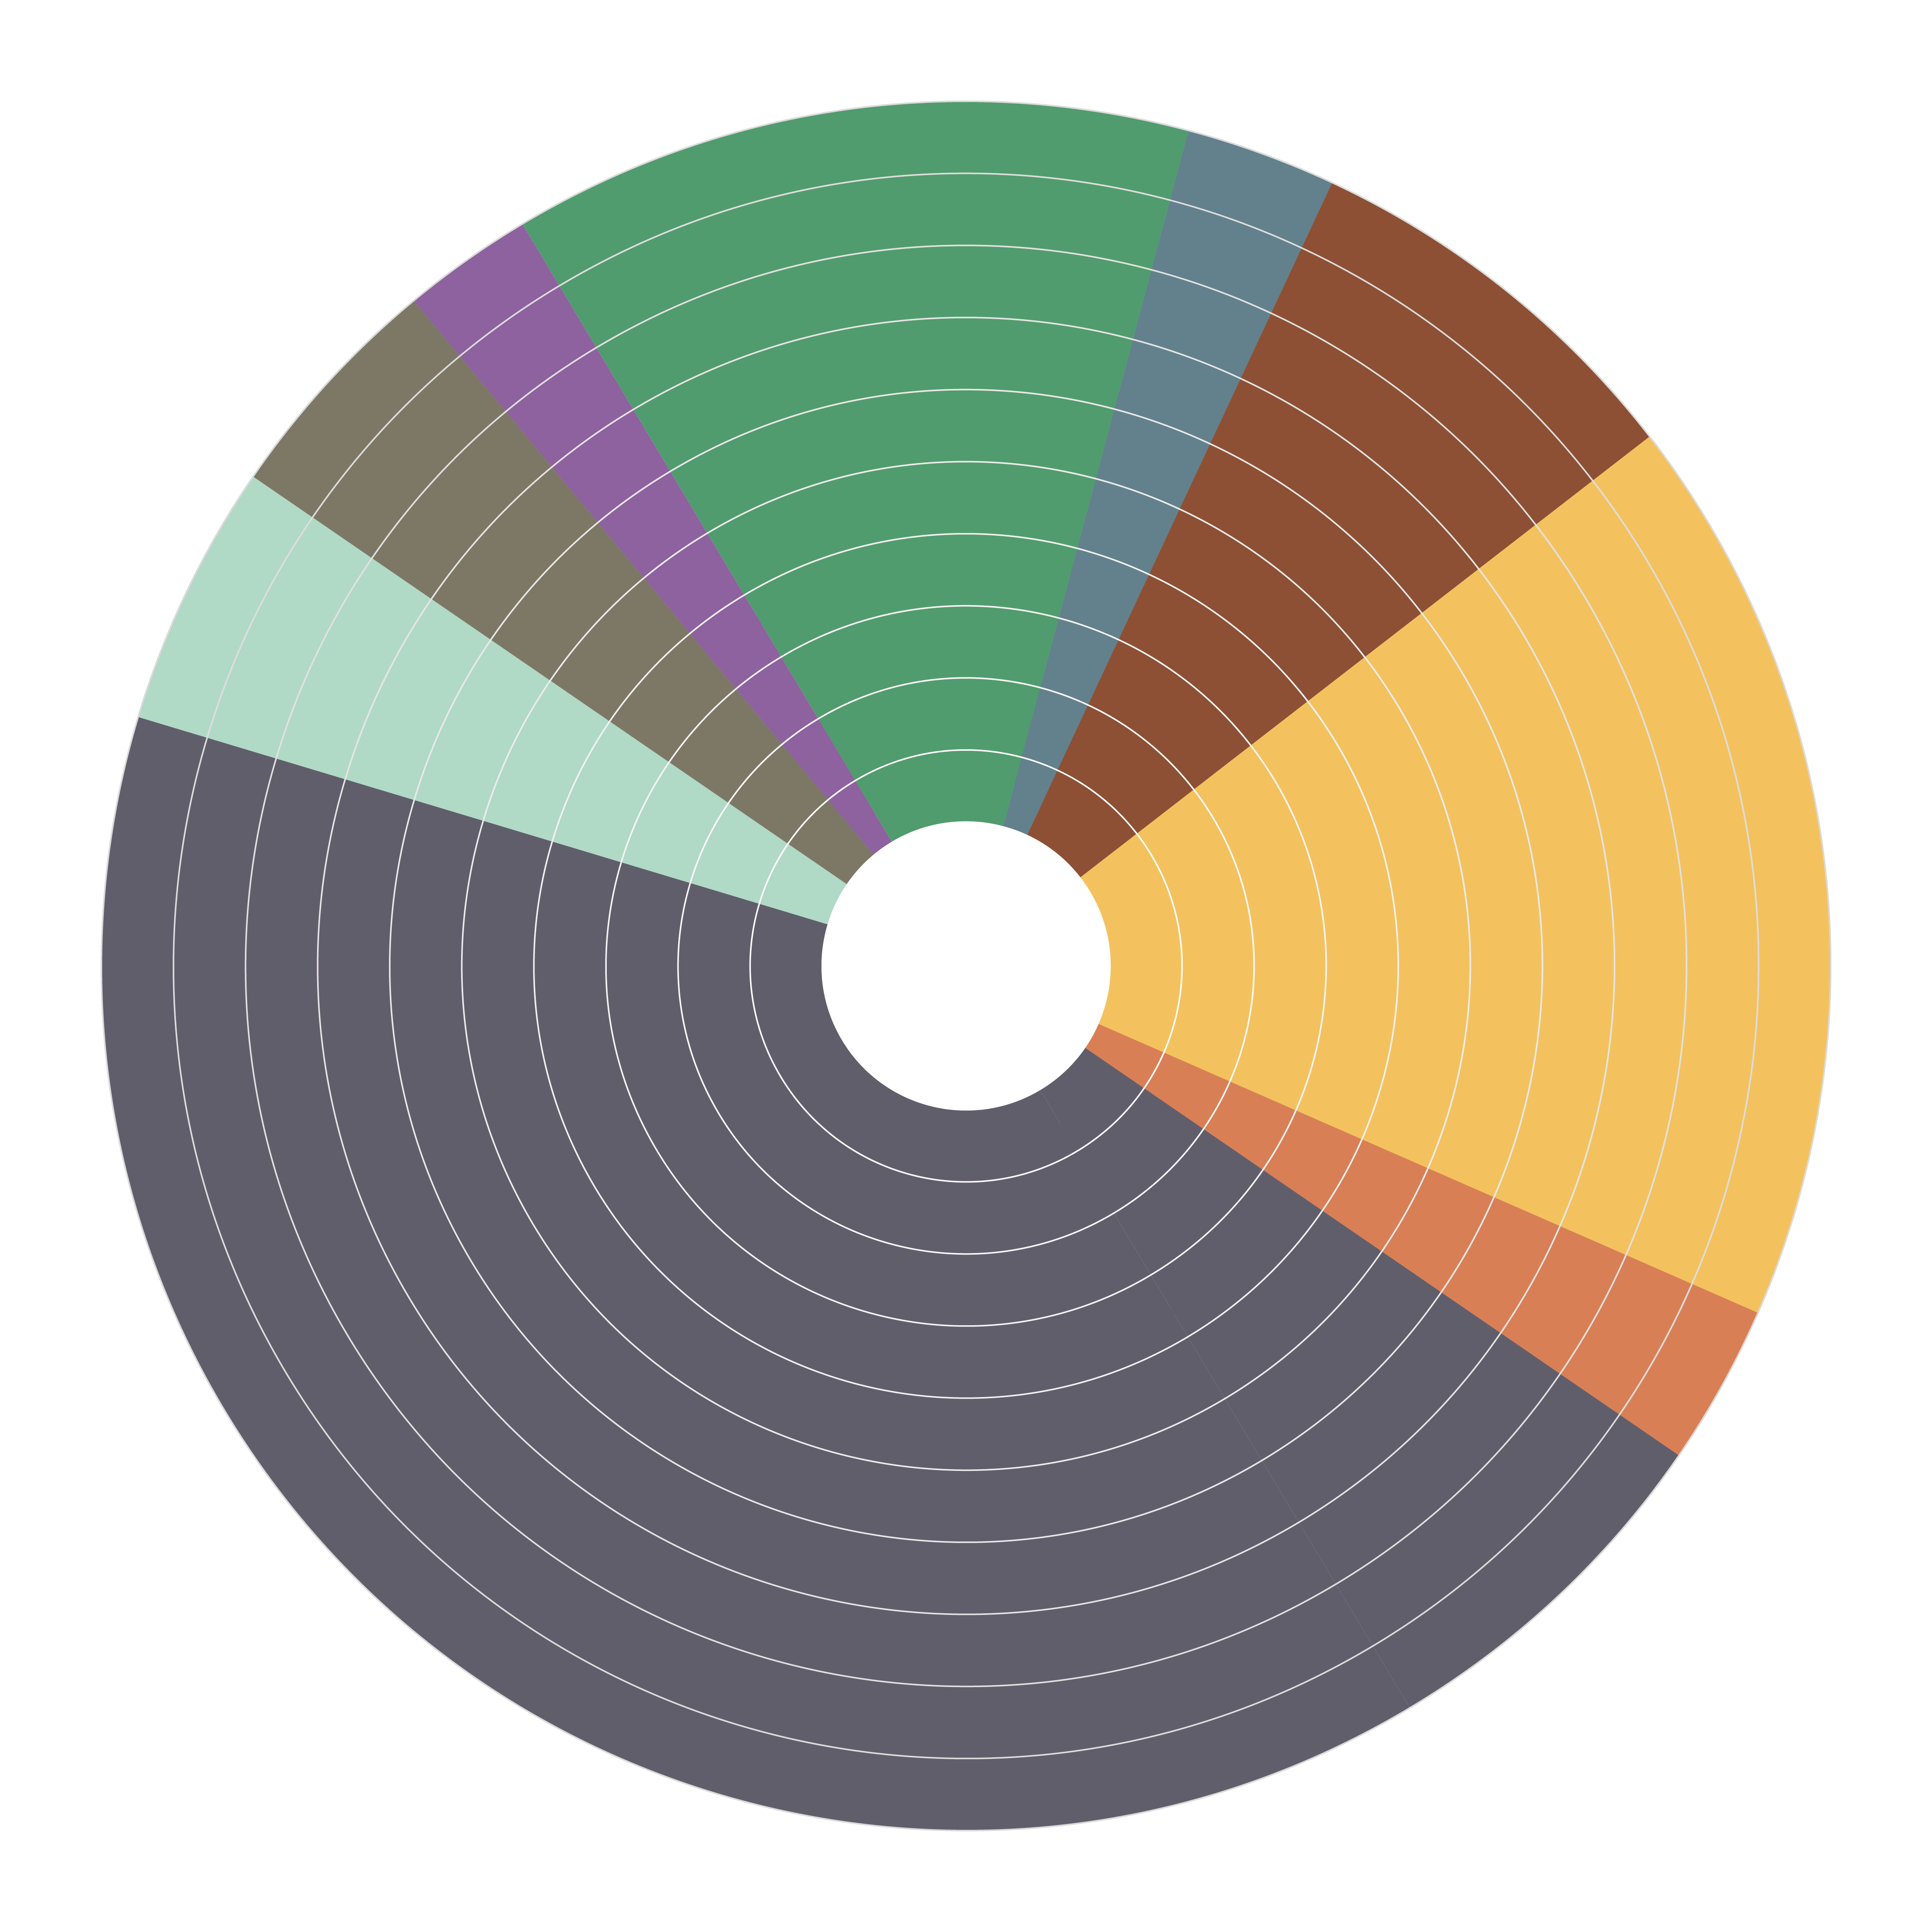
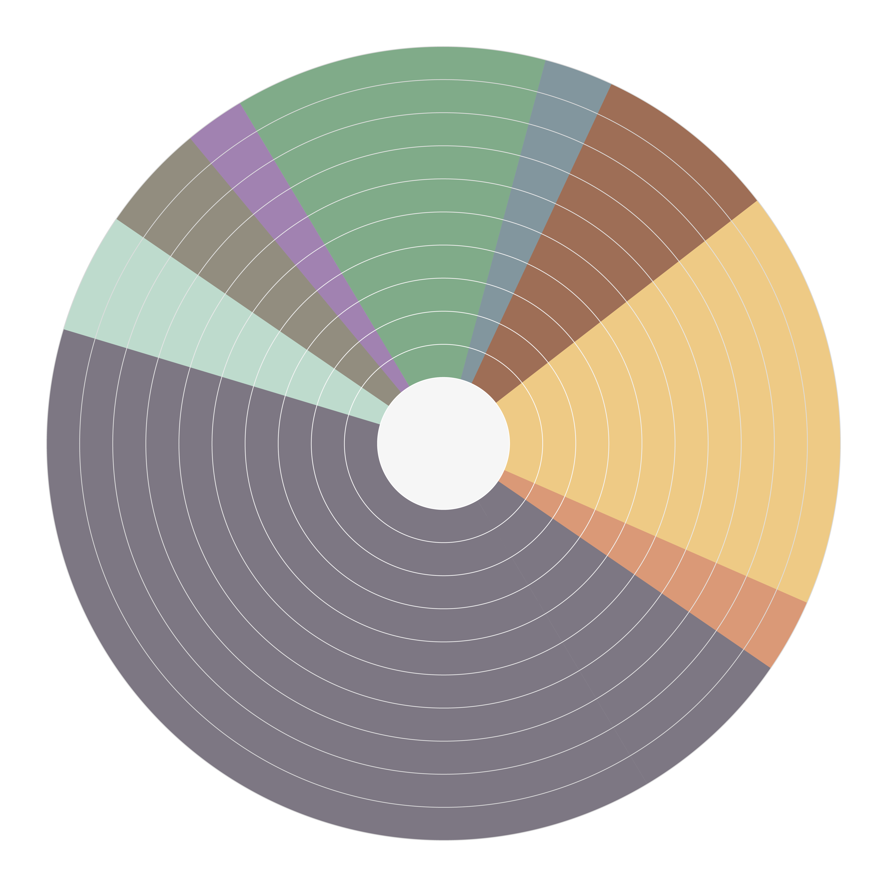
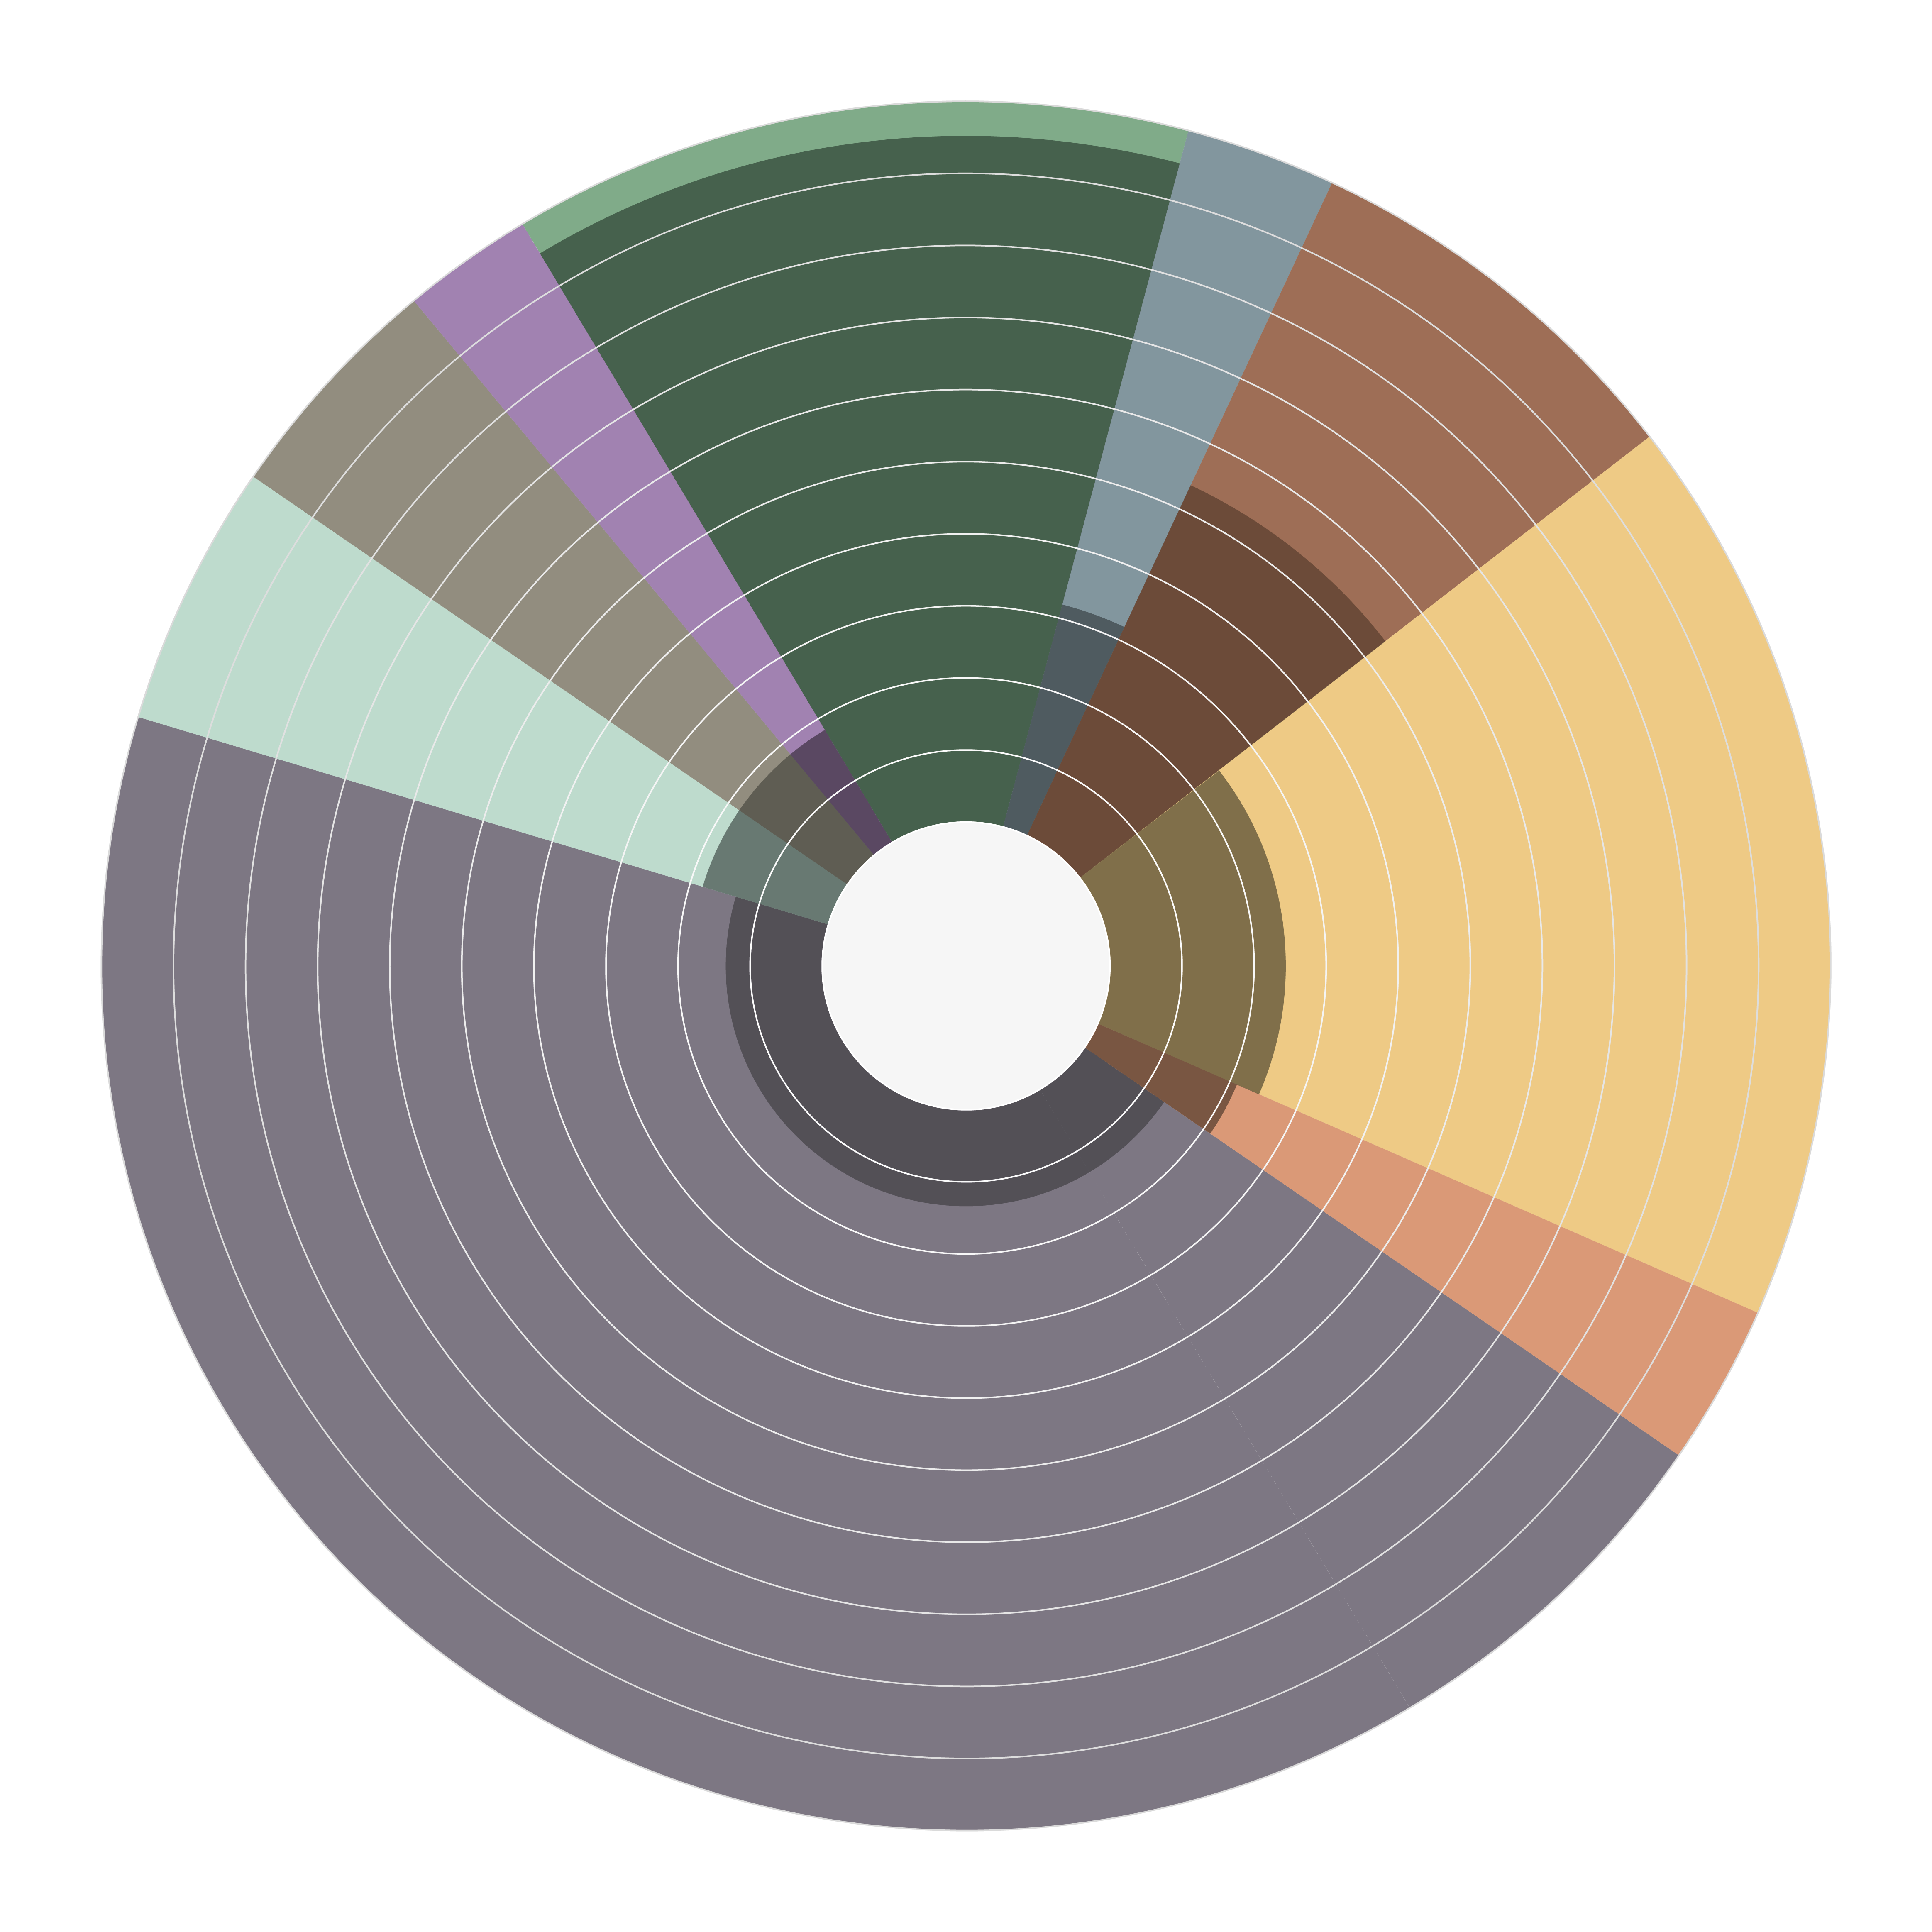
Prevalences of fibrosing interstitial lung disease (F-ILD)
B3
F-ILD
The most common F-ILDs^{1,2}
Prevalence of progressive fibrosis¹⁻³
Other ILDs
2% | Prgr: 18%
12% | Prgr: 95%
IPF
Drug-induced ILD
4% | Prgr: 18%
Pneumoconiosis
5% | Prgr: 18%
3% | Prgr: 32%
Idiopathic NSIP
8% | Prgr: 53%
Unclassifiable ILD
Almost 40% of SSc-ILD and RA-ILD patients develop a progressive phenotype.³
After IPF, a progressive fibrotic phenotype is most common in patients with unclassifiable ILD, CTD-ILDs and HP.^{1,2}
18% | Prgr: 24%
CTD-ILD
Sarcoidosis
45% | Prgr: 13%
3% | Prgr: 21%
cHP
These data denote the prevalence of ILDs in Europe and the USA, adapted from Wijsenbeek et al. 2020.¹ Prevalence of ILD varies and depends on the study methodology/diagnostic criteria used.
Outer circle and percentages denote prevalence of ILDs;
Inner circle and percentages denote the proportion of each ILD estimated to develop the progressive phenotype of fibrosing ILD¹
NSIP=Non-Specific Interstitial Pneumonia; Prgr=Progression; 1. Wijsenbeek M, Cottin V. Spectrum of fibrotic lung diseases. N Engl J Med. 2020;383(10):958-68; 2. Duchemann B, Annesi-Maesano I, Jacobe de Naurois C, et al. Prevalence and incidence of interstitial lung diseases in a multi-ethnic county of Greater Paris. Eur Respir J. 2017;50(2):1602419; 3. Hilberg O, Hoffmann-Vold AM, Smith V, et al. Epidemiology of ILDs and their progressive-fibrosing behaviour in six European countries. ERJ Open Res. 2022;8:00597-2021.

Slide 12

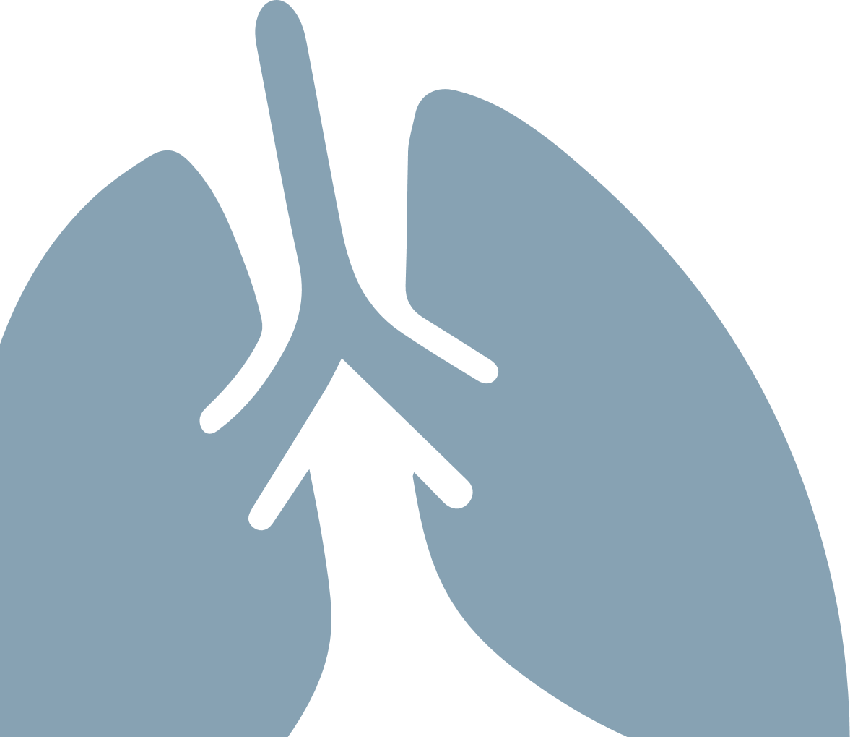

IPF is the archetypal and most common fibrotic ILD¹
B5
IPF
IPF is considered as the most lethal form of progressive pulmonary fibrosis and is characterized by a histologic and radiological pattern of usual interstitial pneumonia (UIP)^{1,2}
Typical age^{1,2} >60
Gender ratio¹ 3:7 (women-men)
Median Survival^{1,3-5} 2-5 years (without antifibrotic treatment)
1. Wijsenbeek M, Cottin V. Spectrum of fibrotic lung diseases. N Engl J Med 2020;383(10):958-68; 2. Raghu G, Remy-Jardin M, Richeldi L, et al. Idiopathic Pulmonary Fibrosis (an Update) and Progressive Pulmonary Fibrosis in Adults: An Official ATS/ERS/JRS/ALAT Clinical Practice Guideline. Am J Respir Crit Care Med. 2022;205(9):e18-e47; 3. Torrisi SE, Pavone M, Vancheri A, et al. When to start and when to stop antifibrotic therapies. Eur Respir Rev. 2017;26(145):170053; 4. Robalo-Cordeiro C, Campos P, Carvalho L, et al. Idiopathic pulmonary fibrosis in the era of antifibrotic therapy: Searching for new opportunities grounded in evidence. Revista Portuguesa de Pneumologia (English Edition). 2017;23(5):287-93. 5. Molina-Molina M, Aburto M, Acosta O, et al. Importance of early diagnosis and treatment in idiopathic pulmonary fibrosis. Expert Rev Respir Med. 2018;12(7):537-9.
Notes:
IPF is characterized by an imaging and pathological pattern of UIP without an identifiable cause.

Slide 13




Compared to IPF, other fibrosing ILDs are generally characterized by a younger age at presentation and a more balanced sex ratio¹
B6
IPF
F-ILD
IPF
Other F-ILDs
a younger mean age at presentation
> 60 years
20-60 years
a more balanced sex ratio
1. Wijsenbeek M, Cottin V. Spectrum of fibrotic lung diseases. N Engl J Med. 2020;383(10):958-68.

Slide 14
“I mean, the emotional terror that you go through. The not being able to sleep at night and not being able to breathe and not being able to envision a future” - IPF-patient¹
C0
Comorbidities
1. Morisset J, Dubé B-P, Garvey C, et al. The unmet educational needs of patients with interstitial lung disease. Setting the stage for tailored pulmonary rehabilitation. Ann Am Thorac Soc. 2016;13(7):1026-33.

Slide 15
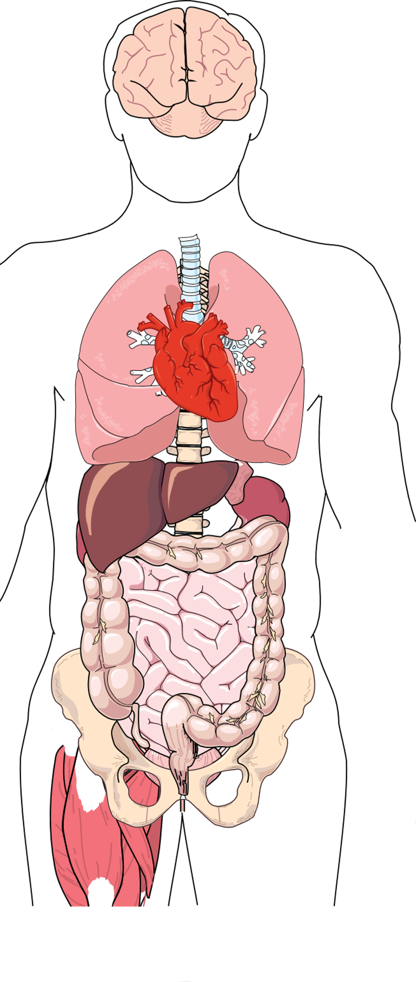

Comorbidities are common in ILD¹
C1
ILD
ILD can severely impact the functional and emotional well-being of patients and their carers²⁻⁶
Depression¹
>20% in ILDs
11-50% in IPF
+
Obstructive sleep apnoea¹
60-90% in IPF
50% in SSc-ILD
65% in sarcoidosis
+
+
Gastro-oesophageal reflux¹
0-94% in IPF
+
Cardiac disease¹
60% in IPF
20% in sarcoidosis
Pulmonary hypertension¹
32-85% in IPF
5-74% in sarcoidosis;
5-12% in SSc
Lungcancer¹
4.4-10% in IPF
Pulmonary embolism¹
+
1. Margaritopoulos GA, Antoniou KM, Wells AU. Comorbidities in interstitial lung diseases. Eur Respir Rev. 2017;26(143):160027; 2. Mittoo S, Frankel S, LeSage D, et al. Patient perspectives in OMERACT provide an anchor for future metric development and improved approaches to healthcare delivery in connective tissue disease related interstitial lung disease (CTD-ILD). Curr Respir Med Rev. 2015;11(2):175-83; 3. Morisset J, Dubé B-P, Garvey C, et al. The unmet educational needs of patients with interstitial lung disease. Setting the stage for tailored pulmonary rehabilitation. Ann Am Thorac Soc. 2016;13(7):1026-33; 4. Ryerson CJ, Arean PA, Berkeley J, et al. Depression is a common and chronic comorbidity in patients with interstitial lung disease. Respirol. 2012;17(3):525-32; 5. Holland AE, Fiore Jr JF, Bell EC, et al. Dyspnoea and comorbidity contribute to anxiety and depression in interstitial lung disease. Respirol. 2014;19(8):1215-21; 6. Carvajalino S, Reigada C, Johnson MJ, et al. Symptom prevalence of patients with fibrotic interstitial lung disease: a systematic literature review. BMC Pulm Med. 2018;18(1):78.
+
Infections¹
Notes:
Comorbidities can be confounding when it comes to detection of ILD as well as detection of progression. Furthermore, comorbidities can decrease survival.

Slide 16
Common pathogenic pathways to fibrosis are shared among different types of ILD^{1,2}
D0
Pathogenesis of pulmonary fibrosis
1. Wijsenbeek M, Cottin V. Spectrum of fibrotic lung diseases. N Engl J Med. 2020;383(10):958-68; 2. Kolb M, Vašáková M. The natural history of progressive fibrosing interstitial lung diseases. Respir Res. 2019;20(1):57.

Slide 17
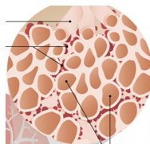
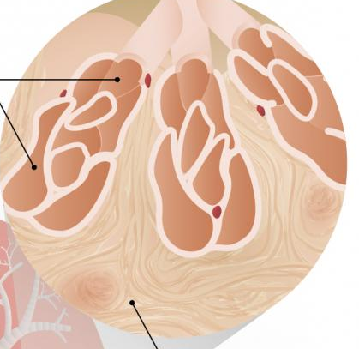
D1
F-ILD
Development of pulmonary fibrosis
Normal lungs⁴
several triggers may cause chronic or repetitive injury
Bronchioles
Capillary network
Pulmonary fibrosis may be idiopathic or seen in the context of systemic diseases, allergic reactions or chronic inflammation^{1,2}
Inflammation and fibrosis can co-exist³
alveolar epithelial cells constantly attempt to repair themselves
Alveoli
the functional lung parenchyma is gradually destructed…
Fibrosing ILD⁴
Damaged bronchioles
Damaged alveoli
…and replaced by deposits of non-functional connective tissue
1. Wijsenbeek M, Cottin V. Spectrum of fibrotic lung diseases. N Engl J Med. 2020;383(10):958-68; 2. Wynn TA, et al. Cellular and molecular mechanisms of fibrosis. J Pathol 2008;214(2):199–210; 3. Wells AU, Denton CP. Interstitial lung disease in connective tissue disease--mechanisms and management. Nat Rev Rheumatol. 2014;10(12):728-39; 4. Glassberg MK. Overview of idiopathic pulmonary fibrosis, evidence-based guidelines, and recent developments in the treatment landscape. Am J Manag Care. 2019;25(11 Suppl):S195-s203.
Fibrosis

Slide 18
Patients with CTD at early disease stages may be asymptomatic with regards to their ILD ¹
E0
Screening Risk factors in asymptomatic patients
1. Jeganathan N, Sathananthan M. Connective tissue disease-related interstitial lung disease: prevalence, patterns, predictors, prognosis, and treatment. Lung. 2020;198(5):735-59.

Slide 19

Respiratory symptoms are not specific for ILD, and in case they are, might not always reflect the severity of ILD¹
E1
CTD-ILD
As the degree of dyspnea might not always reflect the severity of ILD, active screening for ILD in patients with CTD is important¹
A physiology-based screening for ILD outperforms use of ILD symptoms and may detect ILD at an earlier stage¹
Patients with CTD at early disease stages may be asymptomatic with regards to their ILD or have symptoms that are non-specific²⁻⁴
Fatigue
Such symptoms can be the result of underlying ILD, other pulmonary manifestations, or extra‑pulmonary causes, e.g. muscoskeletal limitations^{1,3,4}
Cough
Dyspnea on exertion
1. Spagnolo P, Ryerson CJ, Putman R, et al. Early diagnosis of fibrotic interstitial lung disease: challenges and opportunities. Lancet Respir Med. 2021;9(9):1065-76; 2. Ley B, Collard HR, King Jr TE. Clinical course and prediction of survival in idiopathic pulmonary fibrosis. Am J Respir Crit Care Med. 2011;183(4):431-40; 3. Jeganathan N, Sathananthan M. Connective tissue disease-related interstitial lung disease: prevalence, patterns, predictors, prognosis, and treatment. Lung. 2020;198(5):735-59; 4. Wallace B, Vummidi D, Khanna D. Management of connective tissue diseases associated interstitial lung disease: a review of the published literature. Curr Opin Rheumatol. 2016;28(3):236-45.

Slide 20






General risk factors for fibrosis
E2
Risk factors may be used to guide screening techniques and screening frequency for patients with CTD or ILD^{1,2}
Older age³
Age-related processes diminish the regenerative capacity of the lung
Genetic susceptibility⁴
DNA repair, HLA, host defence, telomere length, cell-cell adhesion, MUC5B
Comorbidities⁴
Obstructive sleep apnoea syndrome and gastro-oesophageal reflux disease due to mechanical stress
Environmental and behavioural factors⁴
Smoking, farming, rearing livestock, wood-dust and stone/sand inhalation
Viral infections:
Epstein-Barr virus and Herpes simplex virus⁴
Autoimmune disease⁵
ILD may precede the development of systemic manifestations due to the CTD¹
HLA=Human Leukocyte Antigen; MUC5B=Mucin 5B, Oligomeric Mucus/gel-forming; 1. Esposito AJ, Chu SG, Madan R, et al. Thoracic Manifestations of Rheumatoid Arthritis. Clin Chest Med. 2019;40(3):545-60; 2. Nambiar AM, Walker CM, Sparks JA. Monitoring and management of fibrosing interstitial lung diseases: a narrative review for practicing clinicians. Ther Adv Respir Dis. 2021;15:17534666211039771; 3. Messina R, Guggino G, Benfante A, et al. Interstitial Lung Disease in Elderly Rheumatoid Arthritis Patients. Drugs Aging. 2020;37(1):11-8; 4. Knudsen L, Ruppert C, Ochs M. Tissue remodelling in pulmonary fibrosis. Cell Tissue Res. 2017;367(3):607-26; 5. Wijsenbeek M, Cottin V. Spectrum of fibrotic lung diseases. N Engl J Med. 2020;383(10):958-68.
Notes:
Older age: Age-related processes, such as dysfunction of the immune system and inflammation diminish the regenerative capacity of the lung and play a central role in pulmonary fibrosis¹
Comorbities: GERD: high trans-thoracical pressure gradients may cause mechanical stress and contribute to ongoing or repetitive lung injury²

Slide 21

Risk factors for IPF
E2 (Back-up)
IPF
Patient-related risk factors^{1,2}
Older age
Male gender
Cigarette smoking
Certain viruses
Gastro-oesophageal reflux disease
Genetic polymorphisms
Environment-related risk factors^{1,2}
Raising birds or livestock
Vegetable/animal dust
Metal dust
Stone cutting/polishing
Hairdressing
1. Knudsen L, Ruppert C, Ochs M. Tissue remodelling in pulmonary fibrosis. Cell Tissue Res. 2017;367(3):607-26; 2. Raghu G, Collard HR, Egan JJ, et al. An official ATS/ERS/JRS/ALAT statement: idiopathic pulmonary fibrosis: evidence-based guidelines for diagnosis and management. Am J Respir Crit Care Med. 2011;183(6):788-824.

Slide 22



Risk factors for SSc-ILD¹
E3
CTD-ILD
40-60% of SSc-patients develop ILD¹
Shorter disease duration
Diffuse cutaneous SSc
Presence of anti-Scl-70 antibodies Absence of anti-centromere antibodies
Patient-related risk factors¹
Older age
African American race
1. DeMizio DJ, Bernstein EJ. Detection and classification of systemic sclerosis-related interstitial lung disease: a review. Curr Opin Rheumatol. 2019;31(6):553-60.
Notes:
shorter disease duration → most patients who develop ILD do so within the first 5 years following the onset of SSc symptoms (vonk 2021)

Slide 23
All patients with SSc should be screened for ILD due to their high risk^{1,2}
E4
CTD-ILD
Screen all patients with SSc for ILD using HRCT
FVC and DL_{CO} should be performed at baseline and regular intervals Every patient should receive an ILD-related physical examination
Evidence-based consensus statements for screening and monitoring in SSc-ILD¹
All patients with SSc should be screened for ILD at baseline using HRCT
Once SSc-ILD is diagnosed, management options should be considered, with patients then monitored for ILD progression
Positive
Negative
Diagnose ILD using HRCT Assess ILD severity using multiple methods
HRCT is the primary tool for diagnosis; FVC, DL_{CO} and clinical symptoms are supportive. Use HRCT, FVC, DL_{CO} and exercise-induced blood oxygen desaturation, clinical symptoms and QoL to assess ILD severity
Continue monitoring for ILD
Frequency of screening and use of HRCT should be guided by risk of ILD, in combination with lung function and symptoms
Positive
Negative
Decide whether pharmacological therapy is required
Assess ILD progression using multiple methods
Use HRCT (depending on clinical need), FVC, DL_{CO,} exercise-induced blood oxygen desaturation, and clinical symptoms to assess ILD progression
HRCT=High-Resolution Computed Tomography; DL_{CO}=Diffusing Capacity of the Lungs for Carbon Monoxide; FVC=Forced Vital Capacity; PFT=Pulmonary Function Test; QoL=Quality of Life; 1. Hoffmann-Vold A-M, Maher TM, Philpot EE, et al. The identification and management of interstitial lung disease in systemic sclerosis: evidence-based European consensus statements. The Lancet Rheumatology. 2020;2(2):e71-e83; 2. Bosello SL, Beretta L, Del Papa N, et al. Interstitial Lung Disease Associated With Autoimmune Rheumatic Diseases: Checklists for Clinical Practice. Front Med (Lausanne). 2021;8:732761.

Slide 24
Risk factors for RA-ILD¹
E5
CTD-ILD
ILD may precede the development of articular manifestations¹
7.7-67% of RA-patients develop ILD¹
ACPA
MUC5B HLA alleles
IL-18, IL-33, MMP-7, PARC, SP-D
Patient-related risk factors¹
Older age
Male gender
Cigarette smoking
ACPA=Anti-Cyclic Citrullinated Peptide Antibodies; MMP=Matrix Metalloproteinase-7; PARC=Pulmonary and Activation-Regulated Chemokine; SP-D=Surfactant Protein D; 1. Dai Y, Wang W, Yu Y, et al. Rheumatoid arthritis-associated interstitial lung disease: an overview of epidemiology, pathogenesis and management. Clin Rheumatol. 2021;40(4):1211-20.

Slide 25
There is limited evidence to guide optimal screening for RA-ILD, however, patients with RA should regularly be assessed for signs of ILD^{1,2}
E6
CTD-ILD
Suggested algorithm to identify ILD in RA-patients at high risk¹
Diagnosis of RA
History and physical
Risk factors may be used to guide screening techniques and frequency of screening¹
It has been suggested that all patients with RA should be evaluated for ILD at presentation and periodically thereafter¹
HRCT and full PFTs
Yes
Clinical symptoms (unexplained dyspnea or cough) and/or rales on pulmonary exam
No
Eligible for lung cancer screening
Age >55 years
Current smoker or quit within last 15 years
History of at least 30 pack‑years
Yes
Low-dose chest CT
Abnormal
No
HRCT and full PFTs
Risk factors for RA-ILD
Older age
Male gender
Ever smoker
Anti-CCP+ and/or high-titer RF
Clinically severe RA
HRCT and full PFTs
Yes
Normal
Annual spirometry
Abnormal
Spirometry ± DL_{CO}
CT=Computed Tomography; RF=Rheumatoid Factor; 1. Esposito AJ, Chu SG, Madan R, et al. Thoracic Manifestations of Rheumatoid Arthritis. Clin Chest Med. 2019;40(3):545-60; 2. Bosello SL, Beretta L, Del Papa N, et al. Interstitial Lung Disease Associated With Autoimmune Rheumatic Diseases: Checklists for Clinical Practice. Front Med (Lausanne). 2021;8:732761.
Notes:
Risk factors, such as older age, smoking history, clinically severe RA, anti-CCP and/or high-titer RF may be used to guide screening techniques and frequency of screening¹

Slide 26
Be aware of initial symptoms of ILD and integrate diagnostic data in a multidisciplinary team assessment to come to an ILD diagnosis¹
G0
Diagnostics
1. Wijsenbeek M, Cottin V. Spectrum of fibrotic lung diseases. N Engl J Med. 2020;383(10):958-68.

Slide 27
Accurate ILD diagnosis by a multidisciplinary team is crucial to inform prognosis and determine optimal management approaches
G3
ILD
F-ILD
The management of patients with fibrosing ILDs requires a multidisciplinary and individualized approach¹
Key
Manage inflammation
Identify/avoid
Manage fibrosis
EXPOSURE
INFLAMMATION
FIBROSIS
Inflammation and fibrosis can also co-exist²
Exposure, inflammation and fibrosis profiles in fibrosing ILDs
IPF
CTD-ILD
Diagnosis enables management of non-ILD manifestations³
HP
Diagnosis enables identification and removal of the suspected inciting antigen^{3,4}
1. Nambiar AM, Walker CM, Sparks JA. Monitoring and management of fibrosing interstitial lung diseases: a narrative review for practicing clinicians. Ther Adv Respir Dis. 2021;15:17534666211039771; 2. Wells AU, Denton CP. Interstitial lung disease in connective tissue disease--mechanisms and management. Nat Rev Rheumatol. 2014;10(12):728-39; 3. Wells AU, Flaherty KR, Brown KK, et al. Nintedanib in patients with progressive fibrosing interstitial lung diseases—subgroup analyses by interstitial lung disease diagnosis in the INBUILD trial: a randomised, double-blind, placebo-controlled, parallel-group trial. Lancet Respir Med. 2020;8(5):453-60; 4. Wongkarnjana A, Scallan C, Kolb MRJ. Progressive fibrosing interstitial lung disease: treatable traits and therapeutic strategies. Curr Opin Pulm Med. 2020;26(5):436-42.

Slide 28
Diagnosis of fibrosing ILD is typically achieved through multidisciplinary team assessment of clinical, radiologic and histopathologic features¹
G4
F-ILD
Symptoms
Clinical course
Chest auscultation
Risk factors (including family history and environmental exposures)
Serologies (auto-antibodies)
Chest X-ray
Pulmonary function tests (e.g. FVC, DL_{CO})
MDT assessment¹⁻³
Integration of all available data to formulate a diagnosis
A working diagnosis may be formulated if a patient does not meet diagnostic criteria for any specific ILD
Distinctive radiological features and their distribution inform differential diagnosis
Essential component of diagnosis of ILDs
A bronchoscope is passed through the mouth/nose, saline fluid is flushed into a small part of the lung and then collected for examination
Lymphocytic, eosinophilic and neutrophilic cellular patterns aid the diagnosis of some forms of ILD
Clinical evaluation and history^{2–6}
Transbronchial biopsy with a cryoprobe to sample lung parenchyma
Usually taken from involved lung parenchyma or areas adjacent to abnormal lung
Distinctive histopathological features (e.g. granuloma, fibroblastic foci) inform differential diagnosis
+
+
HRCT^{2,3,5}
+
+
Cryobiopsy^{3,4}
+
+
BAL^{2–5,8}
+
+
Surgical lung biopsy^{2–5}
+
+
BAL=Bronchoalveolar Lavage; MDT=Multidisciplinary Team; 1. Bosello SL, Beretta L, Del Papa N, et al. Interstitial Lung Disease Associated With Autoimmune Rheumatic Diseases: Checklists for Clinical Practice. Front Med (Lausanne). 2021;8:732761; 2. Raghu G, Collard HR, Egan JJ, et al. An official ATS/ERS/JRS/ALAT statement: idiopathic pulmonary fibrosis: evidence-based guidelines for diagnosis and management. Am J Respir Crit Care Med. 2011;183(6):788-824; 3. Raghu G, Remy-Jardin M, Myers JL, et al. Diagnosis of idiopathic pulmonary fibrosis. An official ATS/ERS/JRS/ALAT clinical practice guideline. Am J Respir Crit Care Med. 2018;198(5):e44-e68; 4. Lynch DA, Sverzellati N, Travis WD, et al. Diagnostic criteria for idiopathic pulmonary fibrosis: a Fleischner Society White Paper. Lancet Respir Med. 2018;6(2):138-53; 5. Raj R, Raparia K, Lynch DA, et al. Surgical Lung Biopsy for Interstitial Lung Diseases. Chest. 2017;151(5):1131-40; 6. Cottin V, Cordier JF. Velcro crackles: the key for early diagnosis of idiopathic pulmonary fibrosis? Eur Respir J. 2012;40(3):519-21; 7. Walsh SLF, Maher TM, Kolb M, et al. Diagnostic accuracy of a clinical diagnosis of idiopathic pulmonary fibrosis: an international case-cohort study. Eur Respir J. 2017;50(2):1700936; 8. Kowal-Bielecka O, Kowal K, Highland KB, et al. Bronchoalveolar lavage fluid in scleroderma interstitial lung disease: technical aspects and clinical correlations: review of the literature. Semin Arthritis Rheum. 2010;40(1):73-88.

Slide 29
Early diagnosis of F-ILD is important to slow down irreversible lung function decline as much as possible^{1,2}
H0
Update on IPF diagnosis
1. Wijsenbeek M, Kreuter M, Olson A, et al. Progressive fibrosing interstitial lung diseases: current practice in diagnosis and management. Curr Med Res Opin. 2019;35(11):2015-24; 2. Maher TM, Strek ME. Antifibrotic therapy for idiopathic pulmonary fibrosis: time to treat. Respir Res. 2019;20(1):205.

Slide 30
Pathways to a confident multidisciplinary working diagnosis of IPF¹
H1
IPF
Patient suspected to have IPF
Potential cause/associated condition
Yes
No
UIP or probable UIP
Chest HRCT pattern
No
Confirmation of specific diagnosis (including with HRCT)
Indeterminate for UIP or alternate diagnosis
Yes
MDD
BAL ± TBLC
Surgical lung biopsy
IPF
MDD
Alternative diagnosis
MDD=Multidisciplinary Diagnosis; TBLC=Transbronchial Lung Cryobiopsy; 1. Raghu G, Remy-Jardin M, Richeldi L, et al. Idiopathic Pulmonary Fibrosis (an Update) and Progressive Pulmonary Fibrosis in Adults: An Official ATS/ERS/JRS/ALAT Clinical Practice Guideline. Am J Respir Crit Care Med. 2022;205(9):e18-e47.
Notes:
Points:
-An IPF diagnosis can be confidently made in a patient with a typical clinical context of IPF and a CT pattern of typical or probable UIP. Patients with a radiological
pattern of probable usual interstitial pneumonia (UIP) can receive a diagnosis of IPF after multidisciplinary discussion (MDD) without
confirmation by lung biopsy in the appropriate clinical setting (e.g., 60 yr old, male, smoker).
-A multidisciplinary diagnosis is appropriate to inform the decision to proceed with biopsy or other diagnostic assessments BAL may be appropriate in some patients with a probable UIP pattern. †BAL may be performed before MDD in some patients evaluated in experienced centers. ‡Transbronchial lung cryobiopsy. A subsequent SLB may be justified in some patients with nondiagnostic findings on TBLC.
-Multidisciplinary assessment can yield a working diagnosis of IPF when not all of the diagnostic criteria are met, particularly if diagnostic tissue is not available

Slide 31
“I was told … ‘you’ve got this illness and there’s no cure.’... So, I Googled and up came this site saying life expectation 2-5 years. ... And I knew I’d had it, now for a few years. And I thought ‘oh my god I’m going to die this year!’ It was very, very scary” – IPF Patient, UK¹
I0
Prognosis
1. Schoenheit G, Becattelli I, Cohen A. Living with idiopathic pulmonary fibrosis. Chron Respir Dis. 2011;8(4):225–31.

Slide 32
The natural course of untreated IPF is characterized by progression to respiratory failure^{1,2} (slide 1 of 2)
I2
IPF
PPF
IPF progression to death may be…
Onset of disease
rapid (line A)
moderate (line C)
slow (line D)
mixed (curve B)…
…with periods of relative stability interposed with periods of acute decline (stars)³
Subclinical period
Onset of symptoms
Pre-diagnosis period
Diagnosis
A
B
C
D
Disease progression
Post-diagnosis period
Death
1
2
3
4
5
6
Time (years)
1. Raghu G, Collard HR, Egan JJ, et al. An official ATS/ERS/JRS/ALAT statement: idiopathic pulmonary fibrosis: evidence-based guidelines for diagnosis and management. Am J Respir Crit Care Med. 2011;183(6):788-824; 2. Maher TM, Strek ME. Antifibrotic therapy for idiopathic pulmonary fibrosis: time to treat. Respir Res. 2019;20(1):205; 3. Ley B, Collard HR, King Jr TE. Clinical course and prediction of survival in idiopathic pulmonary fibrosis. Am J Respir Crit Care Med. 2011;183(4):431-40.

Slide 33
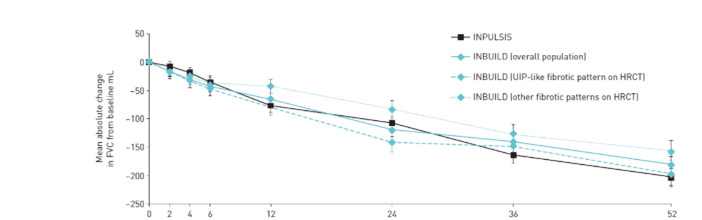
The natural course of untreated IPF is characterized by progression to respiratory failure^{1,2} (slide 2 of 2)
I3
IPF
PF-ILD
The decline in FVC is similar between IPF and other PF-ILDs³
INPULSIS (IPF; n=417)
INBUILD (PF-ILD overall population; n=325)
INBUILD (PF-ILD with UIP-like pattern on HRCT; n=202)
INBUILD (PF-ILD with other fibrotic patterns on HRCT; n=123)
50
(IPF; n=417)
0
(PF-ILD; n=325)
-50
(PF-ILD; n=202)
(PF-ILD; n=123)
Mean absolute change in FVC
from baseline mL
-100
-150
-200
-250
0
2
4
6
12
24
36
52
PF-ILD=Progressive Fibrosing ILD; 1. Raghu G, Collard HR, Egan JJ, et al. An official ATS/ERS/JRS/ALAT statement: idiopathic pulmonary fibrosis: evidence-based guidelines for diagnosis and management. Am J Respir Crit Care Med. 2011;183(6):788-824; 2. Maher TM, Strek ME. Antifibrotic therapy for idiopathic pulmonary fibrosis: time to treat. Respir Res. 2019;20(1):205; 3. Brown KK, Martinez FJ, Walsh SLF, et al. The natural history of progressive fibrosing interstitial lung diseases. Eur Respir J. 2020:2000085.

Slide 34
ILD leads to early mortality in patients with SSc and RA^{1,2}
I4
CTD-ILD
Percent cumulative survival rate from onset of SSc in patients grouped according to their lowest FVC³
Percent survival rate from diagnosis in patients with RA-ILD and RA overall²
100
100
The presence of ILD increases death by 3-fold⁵
Median survival RA-ILD: 3 years⁶ RA without ILD: 10 years⁵
90
ILD and PAH are the leading causes of death in SSc⁴
80
Patients with RA
(overall)
P <0.01
60
80
Cumulative survival (%)
Survival (%)
70
40
Pulmonary fibrosis:
Minimal (n=467)
Moderate (n=213)
Severe (n=116)
20
60
Patients with RA-ILD
0
HR 2.86 (95% CI 1.98–4.12)
50
1
2
3
4
5
6
7
8
9
10
0
2
4
6
8
10
Years from disease onset
Years from ILD diagnosis
Patients with SSc with severe restrictive lung disease (FVC ≤50% predicted) have the poorest prognosis³
Patients with RA-ILD have significantly lower survival than patients with RA only²
HR=Hazard Ratio; CI=Confidence Interval; PAH=Pulmonary Arterial Hypertension; 1. Hoffmann-Vold A-M, Maher TM, Philpot EE, et al. The identification and management of interstitial lung disease in systemic sclerosis: evidence-based European consensus statements. Lancet Rheumatol. 2020;2(2):e71-e83; 2. Bongartz T, Nannini C, Medina‐Velasquez YF, et al. Incidence and mortality of interstitial lung disease in rheumatoid arthritis: a population‐based study. Arthritis Rheum. 2010;62(6):1583-91; 3. Steen VD, Conte C, Owens GR, et al. Severe restrictive lung disease in systemic sclerosis. Arthritis Rheum. 1994;37(9):1283-9; 4. Fischer A, Patel NM, Volkmann ER. Interstitial Lung Disease in Systemic Sclerosis: Focus on Early Detection and Intervention. Open Access Rheumatol. 2019;11:283-307; 5. Yunt ZX, Solomon JJ. Lung disease in rheumatoid arthritis. Rheum Dis Clin North Am. 2015;41(2):225-36; 6. Koduri G, Norton S, Young A, et al. Interstitial lung disease has a poor prognosis in rheumatoid arthritis: results from an inception cohort. Rheumatology (Oxford). 2010;49(8):1483-9.
Notes:
Figure left: In order to identify risk factors for developing severe restrictive lung disease and to determine the time of onset and rate of progression in patients with SSc, patients in the University of Pittsburgh Scleroderma databank were grouped according to their lowest FVC value
Patients with severe restrictive lung disease (defined as FVC ≤50% predicted) had the poorest prognosis; 40% of these patients had died from a cause directly attributed to restrictive lung disease
Figure right:
In a population-based study comparing survival in patients with RA, with or without ILD, survival was significantly poorer among patients with RA-ILD versus patients with RA only (HR 2.86; 95% CI 1.98–4.12)
In studies to determine the 5-year mortality of CTD-ILDs, estimates range from 36–39% in patients with RA-ILD^{3,4}; 10–18% in patients with SSc-ILD⁵; and 12–16% patients with pSjS^{6–8}

Slide 35
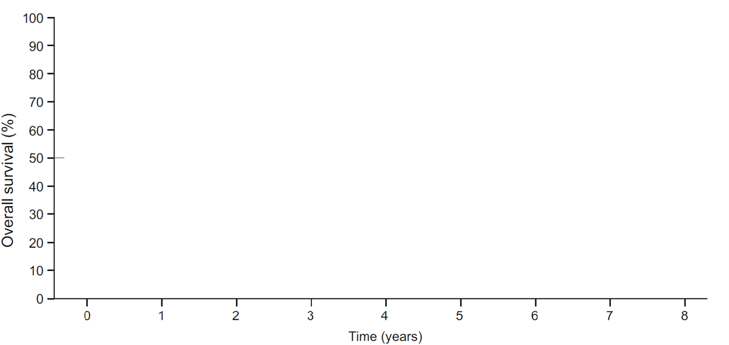
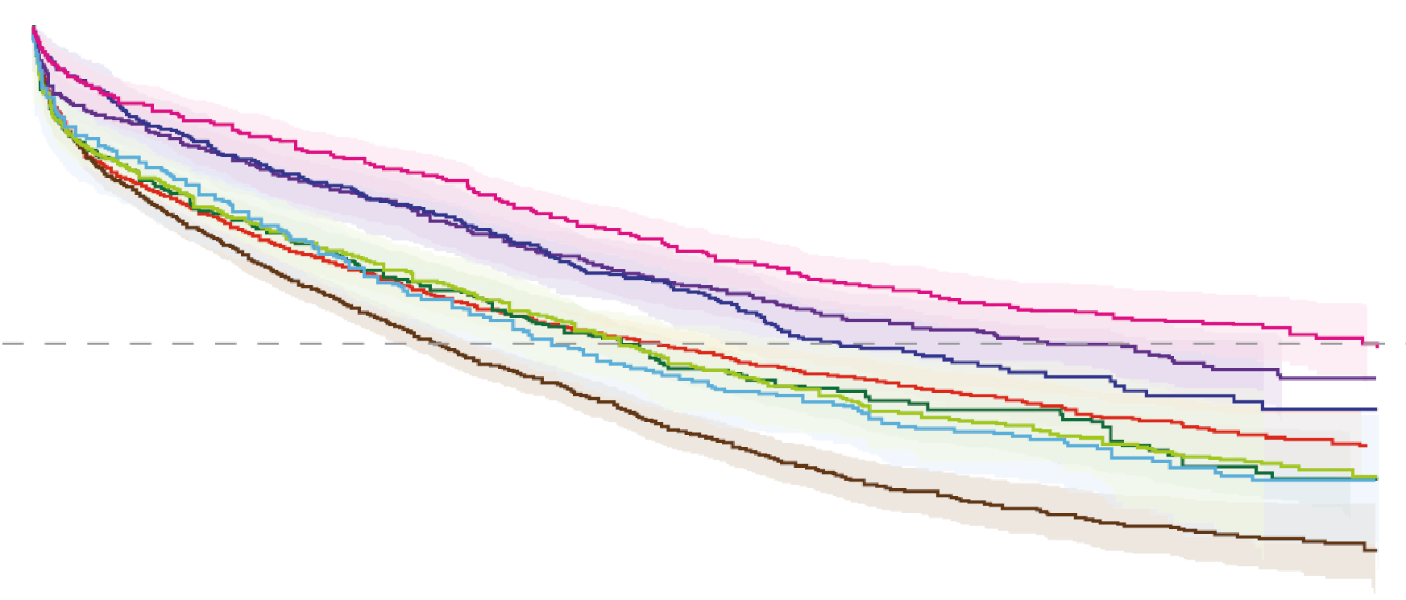

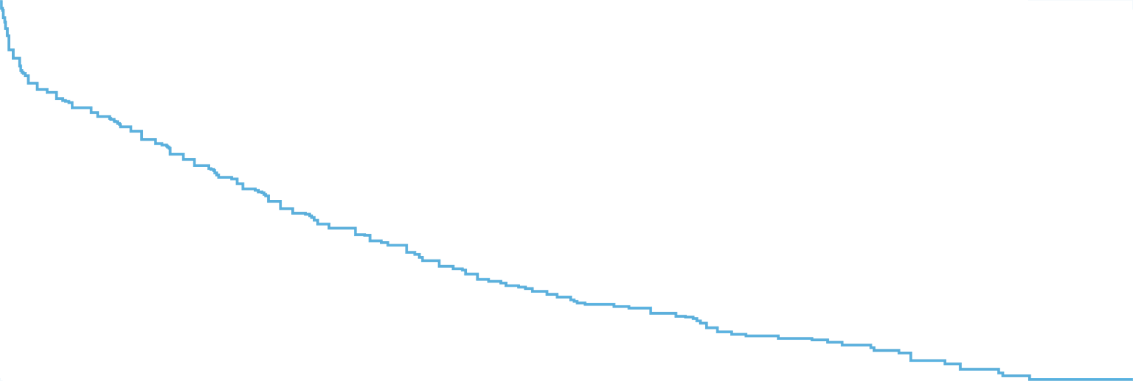
Progressive fibrosing ILDs have poor prognosis and high mortality¹
I5
PF-ILD
Survival of progressive fibrosing ILD patients is similar to that of IPF patients, with a mean of 3-4 years from diagnosis.² One of the clinical objectives for PF-ILD patients is to increase survival.³
Hypersensitivity pneumonitis
Idiopathic interstitial pneumonia
MCTD-ILD
Other exposure-related ILD
Other autoimmune
RA-ILD
SSc-ILD
Sarcoidosis-ILD
MCTD-ILD=Mixed Connective Tissue Disease-associated ILD; 1. Nasser M, Larrieu S, Boussel L, et al. Estimates of epidemiology, mortality and disease burden associated with progressive fibrosing interstitial lung disease in France (the PROGRESS study). Respir Res. 2021;22(1):162; 2. Wijsenbeek M, Cottin V. Spectrum of fibrotic lung diseases. N Engl J Med. 2020;383(10):958-68; 3. Wuyts WA, Papiris S, Manali E, et al. The Burden of Progressive Fibrosing Interstitial Lung Disease: A DELPHI Approach. Adv Ther. 2020;37(7):3246-64.

Slide 36
Patients with fibrosing ILDs require close monitoring to ensure that disease progression is identified promptly¹
J0
Monitoring for progression
1. Nambiar AM, Walker CM, Sparks JA. Monitoring and management of fibrosing interstitial lung diseases: a narrative review for practicing clinicians. Ther Adv Respir Dis. 2021;15:17534666211039771.

Slide 37




Once diagnosis of ILD is confirmed, patients should be monitored for ILD progression
J1
F-ILD
Regular monitoring is needed to detect progressive fibrosis early and slow down loss of lung function as much as possible¹⁻⁶
Monitoring should involve regular assessment of symptoms, physiology (e.g. pulmonary function and six-minute walk testing) and, where appropriate, HRCT^{3,5}
Identification of ILD with a progressive phenotype as early as possible
Honeycombing, traction bronchiectasis and a greater extent of fibrotic changes are associated with increased mortality⁶
Pulmonary Function test (PFT): Includes FVC and DL_{CO}
Every 3-6 months in F-ILDs⁵
HRCT
At baseline for ILD patients with high risk of developing PPF and repeated when lung function or respiratory symptoms worsen^{6,7}
Every 12-18 months in F-ILDs⁵
Appropriate treatment to stabilize or slow disease progression and irreversible loss of lung function
1. Cottin V, Hirani NA, Hotchkin DL, et al. Presentation, diagnosis and clinical course of the spectrum of progressive-fibrosing interstitial lung diseases. Eur Respir Rev. 2018;27(150):180076; 2. Walsh SL, Devaraj A, Enghelmayer JI, et al. Role of imaging in progressive-fibrosing interstitial lung diseases. Eur Respir Rev. 2018;27(150):180073; 3. Roofeh D, Jaafar S, Vummidi D, et al. Management of systemic sclerosis-associated interstitial lung disease. Curr Opin Rheumatol. 2019;31(3):241-9; 4. Wells AU, Flaherty KR, Brown KK, et al. Nintedanib in patients with progressive fibrosing interstitial lung diseases—subgroup analyses by interstitial lung disease diagnosis in the INBUILD trial: a randomised, double-blind, placebo-controlled, parallel-group trial. Lancet Respir Med. 2020;8(5):453-60; 5. Nambiar AM, Walker CM, Sparks JA. Monitoring and management of fibrosing interstitial lung diseases: a narrative review for practicing clinicians. Ther Adv Respir Dis. 2021;15:17534666211039771; 6. Raghu G, Remy-Jardin M, Richeldi L, et al. Idiopathic Pulmonary Fibrosis (an Update) and Progressive Pulmonary Fibrosis in Adults: An Official ATS/ERS/JRS/ALAT Clinical Practice Guideline. Am J Respir Crit Care Med. 2022;205(9):e18-e47; 7. Elicker BM, Kallianos KG, Henry TS. The role of high-resolution computed tomography in the follow-up of diffuse lung disease: Number 2 in the Series “Radiology” Edited by Nicola Sverzellati and Sujal Desai. Eur Respir Rev. 2017;26(144):170008;
Notes:
Close monitoring can facilitate identification of ILD with a progressive phenotype, ensuring that patients receive appropriate treatment to stabilize or slow disease progression^{1,2} interval of monitoring should be individually assessed.
Raghu 2022 PPF guidelines:
Consider pulmonary function testing andthe 6-minute-walk test every 4–6 months orsooner if clinically indicated. Consider annual HRCT if there is clinical suspicion of worsening or risk of lung cancer. Consider an HRCT if there is concern for an acute exacerbation

Slide 38

Risk factors for progressive pulmonary fibrosis in CTD-ILD
J2
PPF
SSc-ILD
dcSSc
<7 years since diagnosis
Male sex
Black race
Anti–Scl-70 antibody positivity
Disease extent on CT >20%
Reduced FVC and DL_{CO}
RA-ILD
Older age
Male sex
Disease extent on CT >20%
Honeycombing or a UIP pattern on CT
FVC <70%
Risk factors for progressive fibrosis or death¹
dcSSc=Diffuse Cutaneous Systemic Sclerosis; MDA5=Melanoma Differentiation-Associated Protein 5; 1. Wijsenbeek M, Cottin V. Spectrum of fibrotic lung diseases. N Engl J Med. 2020;383(10):958-68.
Notes:
The risk of progressive ILD depends on the underlying autoimmune condition¹
Risk factors for progressive fibrosis or death in SSc-ILD include diffuse cutaneous involvement, a disease duration of <7 years, male sex, black race, the presence of anti–Scl-70 antibodies, a disease extent of >20% on CT and decreased lung function (ie reduced FVC and DL_{CO})¹
Risk factors for progressive fibrosis or death in RA-ILD include older age, male sex, a disease extent of >20% on CT, presence of honeycombing or a UIP pattern on CT and decreased lung function (ie FVC <70%)¹
Risk factors for progressive fibrosis or death in patients with ILD associated with idiopathic inflammatory myopathy (eg polymyositis and dermatomyositis) include anti-MDA5 antibodies and a UIP pattern on CT¹
Honeycombing on CT is a risk factor for progressive fibrosis or death in patients with ILD associated with primary Sjögren’s syndrome¹

Slide 39
Early diagnosis and prompt initiation of treatment slows down lung function decline as much as possible^{1,2}
K0
Treatment
1. Wijsenbeek M, Kreuter M, Olson A, et al. Progressive fibrosing interstitial lung diseases: current practice in diagnosis and management. Curr Med Res Opin. 2019;35(11):2015-24; 2. Maher TM, Strek ME. Antifibrotic therapy for idiopathic pulmonary fibrosis: time to treat. Respir Res. 2019;20(1):205.

Slide 40






Based on the inevitably progressive nature of IPF, diagnosis may prompt immediate intervention accompanied by regular monitoring¹⁻³
K1
IPF
Guidelines are available that describe the treatment options for patients with IPF¹
Antifibrotic therapy should be immediately initiated upon diagnosis of IPF
Nintedanib or pirfenidone
Non-pharmacological
Oxygen supplementation (if hypoxemic)
Pulmonary rehabilitation
Consider comorbidities
Symptom control
Palliative care
‘Watchful waiting’ is not advised due to its inevitably progressive nature^{2,3}
Regular monitoring with PFTs is recommended⁴
1. Raghu G, Remy-Jardin M, Richeldi L, et al. Idiopathic Pulmonary Fibrosis (an Update) and Progressive Pulmonary Fibrosis in Adults: An Official ATS/ERS/JRS/ALAT Clinical Practice Guideline. Am J Respir Crit Care Med. 2022;205(9):e18-e47; 2. Maher TM, Strek ME. Antifibrotic therapy for idiopathic pulmonary fibrosis: time to treat. Respir Res. 2019;20(1):205; 3. Torrisi SE, Pavone M, Vancheri A, et al. When to start and when to stop antifibrotic therapies. Eur Resp Rev. 2017;26(145):170053; 4. Cottin V, Hirani NA, Hotchkin DL, et al. Presentation, diagnosis and clinical course of the spectrum of progressive-fibrosing interstitial lung diseases. Eur Respir Rev. 2018;27(150):180076.
Notes:
Clinical practice guidelines offer treatment recommendations for IPF, some of which support the initiation of treatment from the time of diagnosis; experts advise against watchful waiting based on the inevitably progressive nature of the condition
Regular monitoring of patients with IPF is recommended to identify disease progression, the onset of an acute exacerbation, and needs for supportive care, such as non-pharmacologic therapies or patient counselling

Slide 41
Algorithm for the treatment of fibrosing ILDs¹
K2
F-ILD
PPF
Treat the underlying systemic disease
Regularly monitor the disease course
Antifibrotic therapy is recommended for SSc-ILD and patients with PPF who fail standard management, and should be initiated immediately in IPF
Non-pharmacological treatment should be considered throughout the disease course
SSc-ILD
RA-ILD
Sarcoidosis
Chronic hypersensitivity pneumonitis
Idiopathic NSIP
Unclassifiable ILD
IPF
Antigen activation
Consider immunomodulation treatment or observation
Glucocorticoids
Glucocorticoids
Glucocorticoids
Glucocorticoids
Glucocorticoids
MMF, CPM, TCK (AZA, RTX)
RTX, ABA, MMF
MTX (AZA, IFX, ADA)
MMF (AZA)
MMF, AZA, or other immunosuppressants
Consider antifibrotic agents (nintedanib)
Antifibrotic agents (nintedanib or pirfenidone)
Non-pharmacological treatment
Supplemental oxygen, psychosocial support, smoking cessation, rehabilitation, symptom palliation, end-of-life care
Reconsider management
Regular Follow-up
Monitoring of Disease Course
Disease progression
Stable disease
Ameliorization
*Please note that most drugs mentioned in this algorithm have not been licensed for the treatment of these fibrosing ILDs. Nintedanib is recommended for the treatment of PPF in patients which have failed standard management of fibrotic ILD. MMF=Mycophenolate Mofetil; CPM=Cyclophosphamide; TCL=Tocilizumab; AZA=Azathioprine; RTX=Rituximab; ABA=Abatacept; MTX=Methotrexate; IFX=Infliximab; ADA=Adalimumab; 1. Wijsenbeek M, et al. Spectrum of fibrotic lung diseases. N Engl J Med 2020;383(10):958-68.
Notes:
Patients with IPF should be offered prompt treatment with an approved antifibrotic therapy (nintedanib or pirfenidone) to slow the progression of their disease
Treatment guidelines for CTD-ILD are lacking, with the exception of SSc-ILD

Slide 42

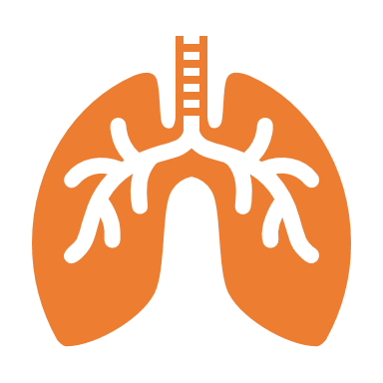


Non-pharmacological interventions are effective in the management of fibrosing ILDs¹
K3
F-ILD
Avoid exposure¹
Smoking cessation
Avoid triggers, e.g. pollutants
Stop medication that cause ILD
Lung transplant²
May be an option to patients younger than 65 years without relevant comorbidities
Vaccination²
To avoid infections that may worsen pulmonary fibrosis
Supporting therapies^{1,2}
Oxygen therapy
Physiotherapy
Pulmonary rehabilitation
Advance care planning/palliative care¹
1. Nambiar AM, Walker CM, Sparks JA. Monitoring and management of fibrosing interstitial lung diseases: a narrative review for practicing clinicians. Ther Adv Respir Dis. 2021;15:17534666211039771; 2. Cottin V, Crestani B, Valeyre D, et al. Diagnosis and management of idiopathic pulmonary fibrosis: French practical guidelines. Eur Respir Rev. 2014;23:193-214.

Slide 43
L0
Summary

Slide 44






Key messages
L1
Poor outcomes
for PPF¹
Diagnostic delay¹
Patients at risk
should be screened for ILD^{2,3}
Progressive pulmonary fibrosis is associated with poor outcomes
The diagnosis of fibrosing ILDs and progressive disease is often delayed
Patients with CTD and ILAs should be screened for development of ILD
MDTs are important⁵
Early diagnosis and screening for progression
is essential^{2,4}
Start early
with antifibrotics⁶
Early diagnosis of (fibrosing) ILD and screening for disease progression is essential to slow down lung function decline
Antifibrotic treatment started early in the disease course can slow down progression in different fibrosing ILDs
MDTs play an important role in the diagnosis and management of fibrosing ILDs
1. Wijsenbeek M, Kreuter M, Olson A, et al. Progressive fibrosing interstitial lung diseases: current practice in diagnosis and management. Curr Med Res Opin. 2019;35(11):2015-24; 2. Nambiar AM, Walker CM, Sparks JA. Monitoring and management of fibrosing interstitial lung diseases: a narrative review for practicing clinicians. Ther Adv Respir Dis. 2021;15:17534666211039771; 3. Bosello SL, Beretta L, Del Papa N, et al. Interstitial Lung Disease Associated With Autoimmune Rheumatic Diseases: Checklists for Clinical Practice. Front Med (Lausanne). 2021;8:732761; 4. Molina-Molina M, Aburto M, Acosta O, et al. Importance of early diagnosis and treatment in idiopathic pulmonary fibrosis. Expert Rev Respir Med. 2018;12(7):537-9; 5. Wijsenbeek M, Cottin V. Spectrum of fibrotic lung diseases. N Engl J Med. 2020;383(10):958-68; 6. Maher TM, Strek ME. Antifibrotic therapy for idiopathic pulmonary fibrosis: time to treat. Respir Res. 2019;20(1):205.

Slide 45

Ofev® (nintedanib) mjuk kapsel 100 mg och 150 mg, Rx, F. Proteinkinashämmare. Indikationer: Avsett för behandling av idiopatisk lungfibros (IPF), andra kroniska fibrotiserande interstitiella lungsjukdomar (ILD-sjukdomar) med en progressiv fenotyp och systemisk sklerosassocierad interstitiell lungsjukdom (SSc-ILD) hos vuxna. Kontraindikationer: Graviditet. Överkänslighet mot nintedanib, jordnötter eller soja. Varningar och försiktighet: Diarré kan förekomma och ska behandlas vid första tecken. Kontrollera leverfunktionen före insättning och under behandling, med täta kontroller under de första tre månaderna. Blödning och tromboemboliska händelser. Amning ska avbrytas. Boehringer Ingelheim AB, tel: 08-721 21 00. För ytterligare information samt pris se www.fass.se. Datum för översyn av produktresumén: 07/2023
PC-SE-103810 Oct.2023

