Slide 1


Welcome!
During this session we will be providing tools and exchanging ideas on ILD patient care

Slide 2
Diagnosis of fibrosing ILD

Slide 3
Time is of the essence when it comes to diagnosing fibrosing ILDs¹
A0
Introduction
1. Wijsenbeek M, Kreuter M, Olson A, et al. Progressive fibrosing interstitial lung diseases: current practice in diagnosis and management. Curr Med Res Opin. 2019;35(11):2015-24; 2. Nambiar AM, Walker CM, Sparks JA. Monitoring and management of fibrosing interstitial lung diseases: a narrative review for practicing clinicians. Ther Adv Respir Dis. 2021;15:17534666211039771.

Slide 4
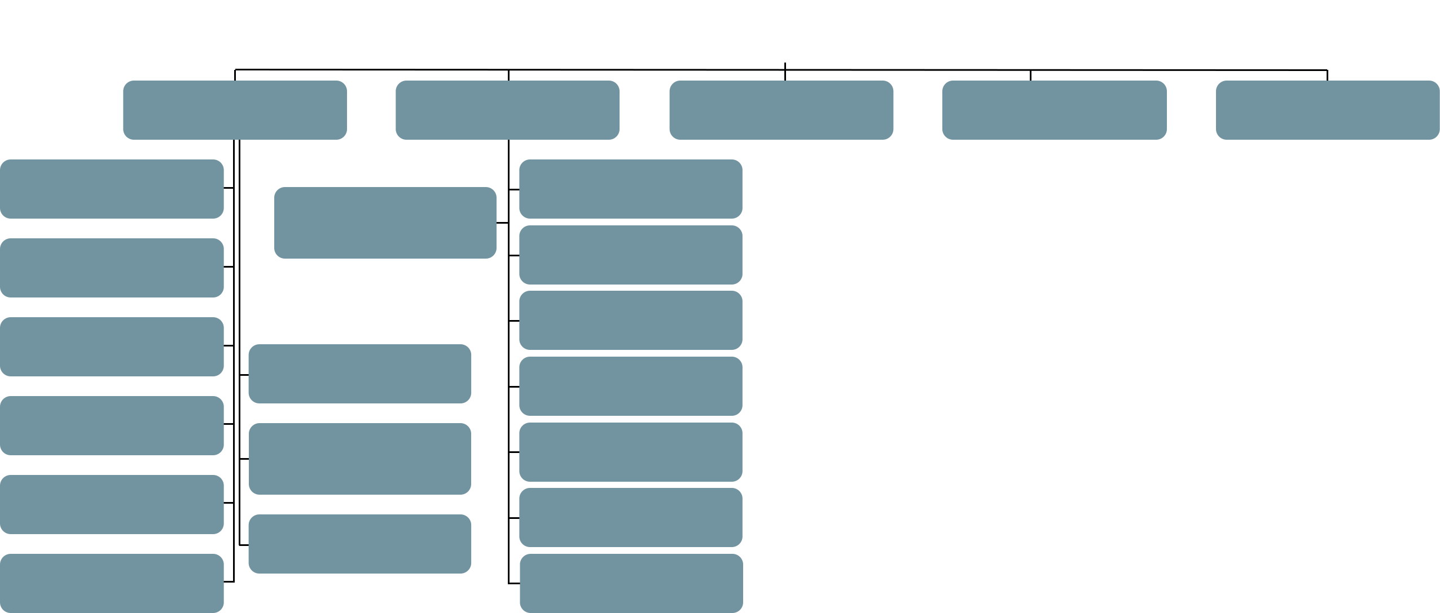
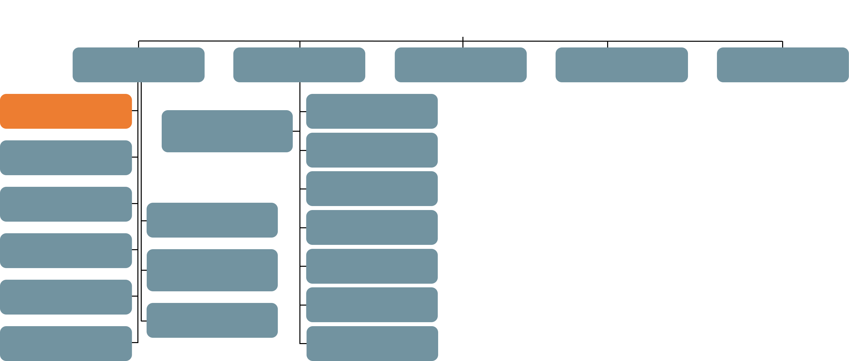
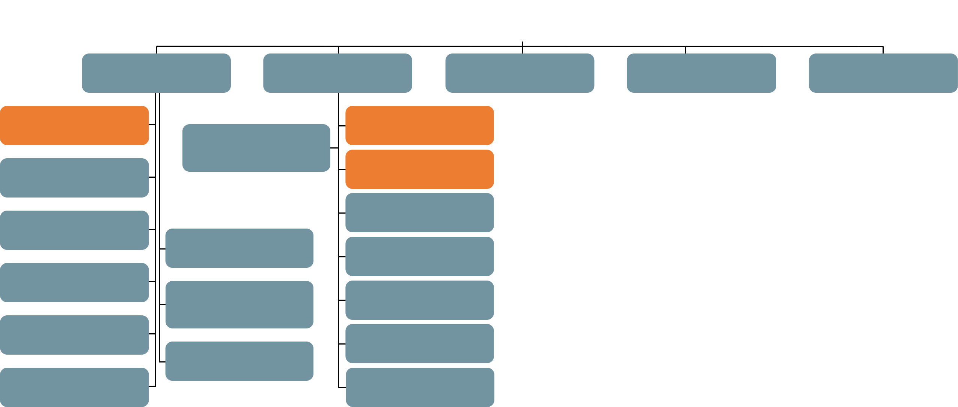

Overview of ILDs
A1
ILD
Clinically significant ILDs are usually characterized by chronic inflammation in the lung and varying degrees of pulmonary fibrosis¹
ILDs
Idiopathic interstitial pneumonias
Autoimmune ILDs
Hypersensitivity pneumonitis
Sarcoidosis
Other ILDs
Idiopathic pulmonary fibrosis
Systemic sclerosis ILD
Lymphangioleiomyomatosis
Langerhans cell histiocytosis
Drug-associated ILD
Other exposure ILDs
Vasculitis/granulomatosis ILDs
Other rare ILDs
Interstitial pneumonia with autoimmune features
Idiopathic non-specific interstital pneumonia
Rheumatoid arthritis ILD
Polymyositis and dermatomyositis ILD
Respiratory bronchiolitis-interstitial lung disease
Idiopatic lymphoid interstitial pneumonia
Mixed connective tissue disease ILD
Desquamative interstitial pneumonia
Idiopathic pleuroparenchymal fibroelastosis
Sjörgen’s syndrome ILD
Cryptogenic organizing pneumonia
Systemic lupus erythematosus ILD
Unclassifiable IIPs
The diagnosis of F-ILD is often delayed due to lack of specific symptoms¹⁻³
Acute interstitial pneumonia
Other connective tissue disease ILDs
ILD=Interstitial Lung Disease; IIPs=Idiopathic Interstitial Pneumonias; F-ILD=Fibrosing ILD; 1. Cottin V, Hirani NA, Hotchkin DL, et al. Presentation, diagnosis and clinical course of the spectrum of progressive-fibrosing interstitial lung diseases. Eur Respir Rev. 2018;27(150):180076; 2. Wijsenbeek M, Kreuter M, Olson A, et al. Progressive fibrosing interstitial lung diseases: current practice in diagnosis and management. Curr Med Res Opin. 2019;35(11):2015-24; 3. Jeganathan N, Sathananthan M. Connective tissue disease-related interstitial lung disease: prevalence, patterns, predictors, prognosis, and treatment. Lung. 2020;198(5):735-59.

Slide 5



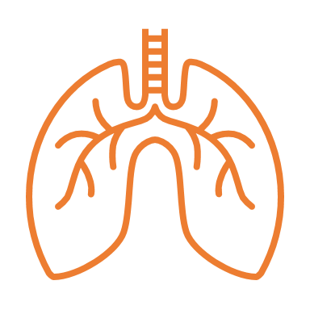

It is estimated that up to 30% of patients with non-IPF ILDs develop progressive pulmonary fibrosis^{1,2}
A2
PPF
After IPF, progressive pulmonary fibrosis (PPF) is most common in patients with unclassifiable ILD, CTD-ILDs and HP³
PPF can place a substantial burden on patients’ daily lives, severely impacting their functional and emotional well-being^{4,5}
Worsening repiratory symptoms⁵
Reduced quality of life^{4,5}
Deterioration of lung function⁵
Early Mortality^{4,5}
IPF=Idiopathic Pulmonary Fibrosis; CTD=Connective Tissue Disease; HP=Hypersensitivity Pneumonitis; PPF=Progressive Pulmonary Fibrosis; 1. Wijsenbeek M, Kreuter M, Olson A, et al. Progressive fibrosing interstitial lung diseases: current practice in diagnosis and management. Curr Med Res Opin. 2019;35(11):2015-24; 2. Hilberg O, Hoffmann-Vold AM, Smith V, et al. Epidemiology of ILDs and their progressive-fibrosing behaviour in six European countries. ERJ Open Res. 2022;8(1):00597-2021; 3. Wijsenbeek M, Cottin V. Spectrum of fibrotic lung diseases. N Engl J Med 2020;383(10):958-68; 4. Swigris JJ, et al. Patients’ perceptions and patient-reported outcomes in progressive-fibrosing interstitial lung diseases. Eur Respir Rev 2018;27(150):180075; 5. Cottin V, et al. Presentation, diagnosis and clinical course of the spectrum of progressive-fibrosing interstitial lung diseases. Eur Respir Rev 2018;27(150):180076.

Slide 6


ILD journey
ILD
associated condition
Risk factors for ILD
Screening for ILD^{1,2}
Symptoms may lead to suspicion of ILD
Diagnosis of ILD
Holistic care⁴
F-ILD
ASSESS
BACKING
Risk factors for
ILD Progression
Monitoring for progression^{1,3}
Symptoms may lead to suspicion of progression
COMORBIDITIES
AND
COMFORT CARE
Disease-
modifying
treatment
Detection of progression
PPF
End-of-life
care
Progression
Monitoring progression^{1,3}
1. Nambiar AM, Walker CM, Sparks JA. Monitoring and management of fibrosing interstitial lung diseases: a narrative review for practicing clinicians. Ther Adv Respir Dis. 2021;15:17534666211039771; 2. Bosello SL, Beretta L, Del Papa N, et al. Interstitial Lung Disease Associated With Autoimmune Rheumatic Diseases: Checklists for Clinical Practice. Front Med (Lausanne). 2021;8:732761; 3. Wijsenbeek M, Kreuter M, Olson A, et al. Progressive fibrosing interstitial lung diseases: current practice in diagnosis and management. Curr Med Res Opin. 2019;35(11):2015-24; 4. van Manen MJ, Geelhoed JJ, Tak NC, et al. Optimizing quality of life in patients with idiopathic pulmonary fibrosis. Ther Adv Respir Dis. 2017;11(3):157-69.
Notes:
This series of presentations focuses on the ILD journey from screening for ILD in patients at high risk, such as patients with systemic sclerosis and rheumatoid arthritis, to screening for progression of ILD in patients who have developed fibrosing ILD to monitoring progression in patients who have progressive pulmonary fibrosis. Across this whole patient journey, holistic care, focusing on the needs of the patients and their caregivers, is essential. In session 4 this latter topic will be covered in detail.

Slide 7
The presence of risk factors may strengthen the suspicion of ILD¹
B0
Screening – Risk factors for ILD
1. Bosello SL, Beretta L, Del Papa N, et al. Interstitial Lung Disease Associated With Autoimmune Rheumatic Diseases: Checklists for Clinical Practice. Front Med (Lausanne). 2021;8:732761.c

Slide 8


Certain risk factors may strengthen the suspicion of IPF
B1
IPF
Patient-related risk factors^{1,2}
Older age
Male gender
Cigarette smoking
Certain viruses
gastro-oesophageal reflux disease
Genetic polymorphisms
Environment-related risk factors^{1,2}
Raising birds or livestock
Vegetable/animal dust
Metal dust
Stone cutting/polishing
Hairdressing
1. Ley B, Collard HR, King Jr TE. Clinical course and prediction of survival in idiopathic pulmonary fibrosis. Am J Respir Crit Care Med. 2011;183(4):431-40; 2. Raghu G, Collard HR, Egan JJ, et al. An official ATS/ERS/JRS/ALAT statement: idiopathic pulmonary fibrosis: evidence-based guidelines for diagnosis and management. Am J Respir Crit Care Med. 2011;183(6):788-824.

Slide 9



Risk factors for SSc-ILD guide screening techniques and frequency^{1,2}
B2
CTD-ILD
40-60% of SSc patients develop ILD¹
Shorter disease duration
Diffuse cutaneous SSc
Presence of anti-Scl-70 antibodies Absence of anti-centromere antibodies
Patient-related risk factors^{1,3-5} Older age African American race Male sex History of smoking
1. DeMizio DJ, Bernstein EJ. Detection and classification of systemic sclerosis-related interstitial lung disease: a review. Curr Opin Rheumatol. 2019;31(6):553-60; 2. Bosello SL, Beretta L, Del Papa N, et al. Interstitial Lung Disease Associated With Autoimmune Rheumatic Diseases: Checklists for Clinical Practice. Front Med (Lausanne). 2021;8:732761; 3. Taha R, Feteih M. in Skills in rheumatology. Springer 2021; 4. Cottin V, Brown KK. Interstitial lung disease associated with systemic sclerosis (SSc-ILD). Respir Res. 2019;18;20(1):13; 5. Hoffmann-Vold AM, Allanore Y, Alves M, et al. Progressive interstitial lung disease in patients with systemic sclerosis-associated interstitial lung disease in the EUSTAR database. Ann Rheum Dis. 2021;80(2):219-27.
Notes:
Older age at disease onset. However, none of these risk factors is absolute. (Cottin 2019)

Slide 10


Risk factors for RA-ILD guide screening techniques and frequency^{1,2}
B3
CTD-ILD
ILD may precede the development of articular manifestations³
7.7-67% of RA patients develop ILD³
ACPA/Anti-CCP antibodies
MUC5B HLA alleles
IL-18, IL-33, MMP-7, PARC, SP-D
Patient-related risk factors³⁻⁵
Older age
Male sex
History of smoking
Longer disease duration
Higher disease activity
Elevated ESR
Prednisone use
Rheumatoid nodules
ACPA=Anti-Cyclic Citrullinated Peptide Antibodies; CCP=Cyclic Citrullinated Peptide; MUC5B=Mucin 5B, Oligomeric Mucus/gel-forming; HLA=Human Leukocyte Antigen; MMP=Matrix Metalloproteinase-7; PARC=Pulmonary and Activation-Regulated Chemokine; SP-D=Surfactant Protein D; ESR=Erythrocyte Sedimentation Rate; 1. Esposito AJ, Chu SG, Madan R, et al. Thoracic Manifestations of Rheumatoid Arthritis. Clin Chest Med. 2019;40(3):545-60; 2. Bosello SL, Beretta L, Del Papa N, et al. Interstitial Lung Disease Associated With Autoimmune Rheumatic Diseases: Checklists for Clinical Practice. Front Med (Lausanne). 2021;8:732761; 3. Dai Y, Wang W, Yu Y, et al. Rheumatoid arthritis-associated interstitial lung disease: an overview of epidemiology, pathogenesis and management. Clin Rheumatol. 2021;40(4):1211-20; 4. Taha R, Feteih M. in Skills in rheumatology. Springer 2021; 5. Huang S, Kronzer VL, Dellaripa PF, et al. Rheumatoid arthritis-associated interstitial lung disease: Current update on prevalence, risk factors, and pharmacologic treatment. Curr Treatm Opt Rheumatol. 2020;6(4):337-53.
Notes:
Several clinical RA factors are associated with RA-ILD. Elevation of rheumatoid factor (RF) and anti-citrullinated protein antibodies are risk factors for RA-ILD[6, 30, 31, 34]. Seropositivity for these antibodies portends a more severe articular course and higher risk of extra-articular manifestations including RA-ILD. RA severity factors including prednisone use [31, 35, 36] and rheumatoid nodules[33] are associated with increased RA-ILD risk, as have elevated erythrocyte sedimentation rate (ESR)[31–33] and longer RA duration[37] are additional RA-ILD risk factors. Articular disease activity was recently associated with incident RA-ILD in a prospective study[19]. Specifically, moderate to high disease activity was associated with 2-fold increased risk for RA-ILD compared to low disease activity or remission[19].

Slide 11
Predictive scores have been developed to identify patients at risk for RA-ILD
B4
CTD-ILD
Juge et al. developed and validated a risk score for subclinical RA-ILD, which allows the identification of RA patients with high risk for ILD^{1,2}
 | Prospective cross-sectional RA 10 yr duration + no symptoms Consecutive recruitment France | Prospective cross-sectional RA <2 yr duration Consecutive recruitment Argentina | Pooled analysis of 2 studies
Risk factor included in predictive model | Juge 2021¹ | Paulin 2021³ | Juge 2022²
Sex | ✓ | ✓ | ✓
Smoking |  | ✓
Age
Age at RA onset | ✓ |  | ✓
MUC5B allele | ✓ |  | ✓
Extra-articular manifestations |  | ✓
Disease activity indices (DAS28 or CDAI) | ✓ | ✓ | ✓
Other markers of disease activity (CCP, RF, ESR) |  | ✓
Number with ILD | 19% of 163 | 7.5% of 83 | 19% of 163; 16.9% of 89
DAS 28=Disease Activity Score 28; CDAI=Crohn’s Disease Activity Index; RF=Rheumatoid Factor; 1. Juge PA, Granger B, Debray MP, et al. Developing a score to predict preclinical interstitial lung disease in patients with rheumatoid arthritis – a cross-sectional study from the ESPOIR cohort. Poster POS0095; 2. Juge PA, Granger B, Debray MP, et al. A Risk Score to Detect Subclinical Rheumatoid Arthritis-Associated Interstitial Lung Disease [published online ahead of print]. Arthritis Rheumatol. 2022;10.1002/art.42162. doi:10.1002/art.42162; 3. Paulin F, Doyle TJ, Mercado JF, et al. Development of a risk indicator score for the identification of interstitial lung disease in patients with rheumatoid arthritis. Reumatol Clin (Engl Ed). 2021;17(4):207-11.

Slide 12
A multidisciplinary approach including rheumatologists and pulmonologists facilitates early recognition of CTD-ILD¹
C0
Signs and symptoms of ILD and CTD
1. Bosello SL, Beretta L, Del Papa N, et al. Interstitial Lung Disease Associated With Autoimmune Rheumatic Diseases: Checklists for Clinical Practice. Front Med (Lausanne). 2021;8:732761.

Slide 13

Respiratory symptoms are not specific for ILD, and in case they are, might not always reflect the severity of ILD¹
C2
As the degree of dyspnea might not always reflect the severity of ILD, active screening for ILD in patients with CTD is important¹
A physiology-based screening for ILD outperforms use of ILD symptoms and may detect ILD at an earlier stage¹
Patients with CTD at early disease stages may be asymptomatic with regards to their ILD or have symptoms that are non-specific²⁻⁴
Fatigue
Such symptoms can be the result of underlying ILD, other pulmonary manifestations, or extra‑pulmonary causes, e.g. muscoskeletal limitations^{1,3,4}
Cough
Dyspnea on exertion
1. Spagnolo P, Ryerson CJ, Putman R, et al. Early diagnosis of fibrotic interstitial lung disease: challenges and opportunities. Lancet Respir Med. 2021;9(9):1065-76; 2. Ley B, Collard HR, King Jr TE. Clinical course and prediction of survival in idiopathic pulmonary fibrosis. Am J Respir Crit Care Med. 2011;183(4):431-40; 3. Jeganathan N, Sathananthan M. Connective tissue disease-related interstitial lung disease: prevalence, patterns, predictors, prognosis, and treatment. Lung. 2020;198(5):735-59; 4. Wallace B, Vummidi D, Khanna D. Management of connective tissue diseases associated interstitial lung disease: a review of the published literature. Curr Opin Rheumatol. 2016;28(3):236-45.

Slide 14

Findings that raise suspicion of ILD¹
C4
Clinical symptoms
Unexplained breathlessness and dry cough in middle-aged or elderly patients
History of environmental and drug exposure
Presumptive obstructive lung disease or congestive heart failure and failure to benefit from regular therapy
Finger clubbing
Clinical tests
Reduced FVC
Oxygen desaturation with only minimal exertion
Inspiratory ‘crackles’ in lung auscultation
Imaging
Non-specific chest X-ray
Interstitial lung abnormalities on HRCT
Differential features of ILD and COPD
Particularly those who are more breathless than expected based on FVC
 | ILD | COPD
Physical examination | ✓ | X
Inspiratory crackles | X | ✓
Wheezing | ✓ | X
Finger clubbing
Spirometry
Reduction in TLC | ✓ | X
Reduced FEV₁/FVC ratio | X | ✓
Resonse to bronchodilators | X | ✓
Chest radiographs | Show specific patterns of abnormality | Largely normal
Spirometry results may be normal in early phases of ILD¹
Consistently at end inspiration, originating from basal areas of the lung and progressing to upper zones
FVC=Forced Vital Capacity; COPD=Chronic Obstructive Pulmonary Disease; 1. Zibrak JD, Price D. Interstitial lung disease: raising the index of suspicion in primary care. NPJ Prim Care Respir Med. 2014;24:14054; 2. Bosello SL, Beretta L, Del Papa N, et al. Interstitial Lung Disease Associated With Autoimmune Rheumatic Diseases: Checklists for Clinical Practice. Front Med (Lausanne). 2021;8:732761.
Notes:
Once non-respiratory causes of
breathlessness have been excluded, PCPs should consider the
possibility of ILD in all middle-aged or elderly patients who
present with unexplained chronic dyspnoea on exertion, particularly
those who are more breathless than would be expected
based on their lung function and other contributory factors such
as obesity, or who have a cough of more than several months’
duration.
Unlike the crackles occasionally heard in
healthy elderly subjects, which disappear after several deep
breaths, these fine crackles are heard consistently at end
inspiration and originate from the basal areas of the lung,
progressing to the upper zones as disease becomes more
severe.21 Although higher in frequency,21 crackles associated with
ILD may be confused with the crackles heard in patients with heart
failure.

Slide 15

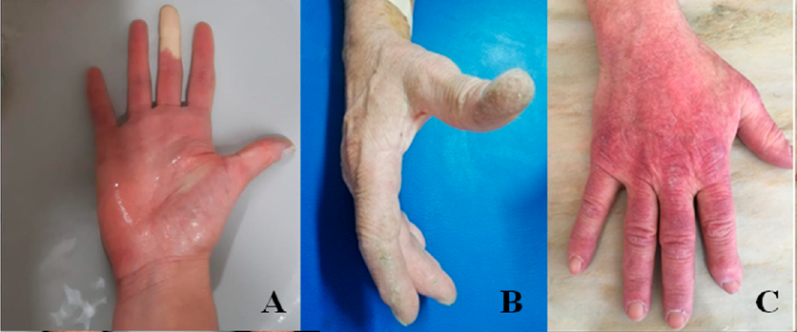
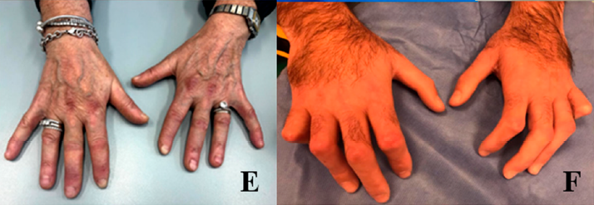
ILD may precede the development of CTD manifestations^{1,2}
C6
Signs and symptoms suggestive of CTD^{3,4}:
Skin manifestations (A,B,C)
Raynaud’s phenomenon (D)
Digital ulcers and telangiectasias, alone or in combination
Positivity to anti-nuclear antibodies with significant titer (>1/160)
Presence of muscle weakness associated with an increase in CPK
Arthralgia, joint swelling or swelling of the hands, morning stiffness
Dry eyes and dry mouth
Sicca syndrome and Glandular swelling
A
B
A. Mechanics hands, B. Gottron papules C. sclerodactyly with clawed shape in systemic sclerosis
A. Mechanics hands, B. Gottron papules C. sclerodactyly with clawed shape in systemic sclerosis, D. Raynaud’s phenomenon in ischemic phase during a provocation test
C
D
CPK=Creatinine Phosphokinase; 1. Dai Y, Wang W, Yu Y, et al. Rheumatoid arthritis-associated interstitial lung disease: an overview of epidemiology, pathogenesis and management. Clin Rheumatol. 2021;40(4):1211-20; 2. Fischer A, Brown KK. Interstitial lung disease in undifferentiated forms of connective tissue disease. Arthritis Care Res (Hoboken). 2015;67(1):4-11; 3. Bosello SL, Beretta L, Del Papa N, et al. Interstitial Lung Disease Associated With Autoimmune Rheumatic Diseases: Checklists for Clinical Practice. Front Med (Lausanne). 2021;8:732761; 4. Sambataro D, Sambataro G, Pignataro F, et al. Patients with Interstitial Lung Disease Secondary to Autoimmune Diseases: How to Recognize Them? Diagnostics (Basel). 2020;10(4).
Notes:
The hands in patients with Interstitial Lung Disease (ILD) secondary to rheumatic conditions.
(A): Raynaud’s phenomenon in ischemic phase during a provocation test; (B): mechanic’s hands; (E): Gottron papules; (F): sclerodactyly with clawed shape in systemic sclerosis;

Slide 16
“I think all GPs should have a recording of the lungs of a person with pulmonary fibrosis and if they hear that noise, they should send you to the chest clinic as the first port of call” - IPF patient¹
D0
Referral to specialists
1. Schoenheit G, Becattelli I, Cohen A. Living with idiopathic pulmonary fibrosis. Chron Respir Dis. 2011;8(4):225–31.

Slide 17
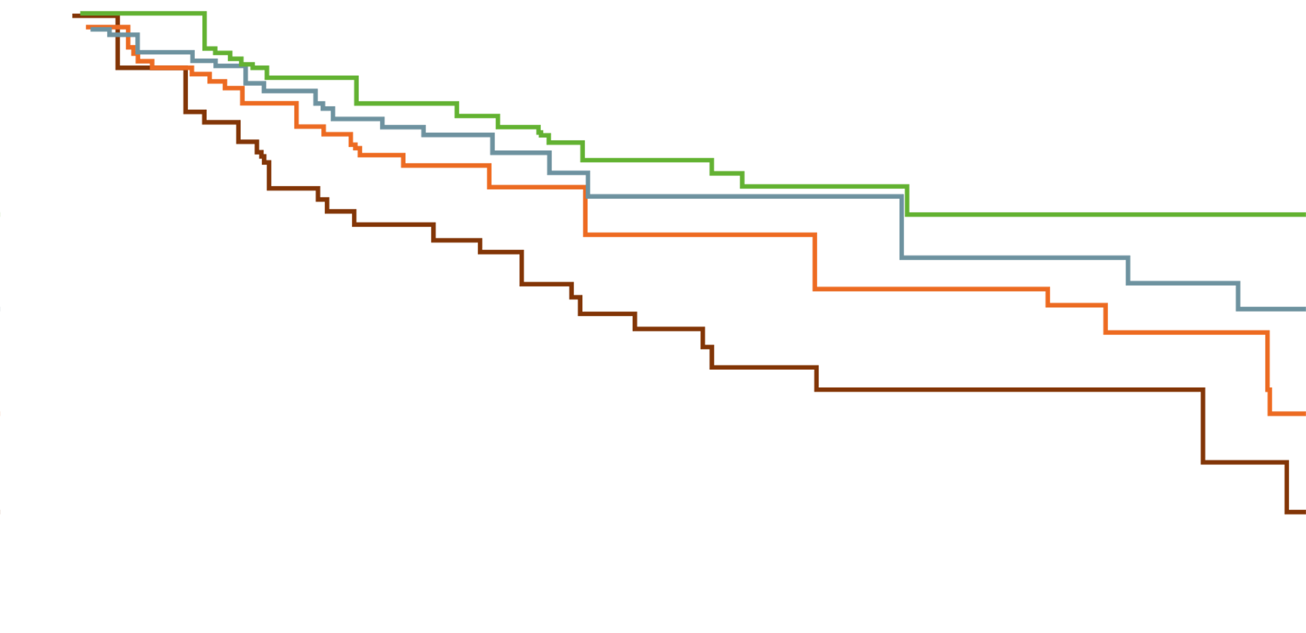
Survival of IPF patients decreases as the delay in referral increases¹
D1
IPF
< 1 year
1.0
1-2 years
2-4 years
0.8
>4 years
0.6
Survival
0.4
0.2
P for trend=0.03
0.0
0
1
2
3
4
5
Time (years)
1. Lamas D, Kawut SM, Bagiella E, et al. Delayed Access and Survival in Idiopathic Pulmonary Fibrosis. Am J Respir CritCare Med. 2011;184(7):842-47.

Slide 18
When to refer patients to specialists in ILD?
D2
ILD
Clinicians should promptly refer patients with a suspected ILD or IPF to experts in the diagnosis of ILDs¹⁻⁵
Why is prompt referral needed?
Inappropriate treatment due to misdiagnosis may be harmful
Early diagnosis and treatment slows down lung function decline
Early identification of fibrosis has become increasingly important due to the availability of antifibrotic therapy that can slow down progression
Due to the lack of specific symptoms and complexity, diagnosis and management of ILD requires a multidisciplinary and individualized approach
In the decision how patients with ILD should be managed, the MDT considers:⁵
severity of ILD
evidence of progression
other disease manifestations and comorbidities
patient’s preferences
1. Quinn C, Wisse A, Manns ST. Clinical course and management of idiopathic pulmonary fibrosis. Multidiscip Respir Med. 2019;14:35; 2. Zibrak JD, Price D. Interstitial lung disease: raising the index of suspicion in primary care. NPJ Prim Care Respir Med. 2014;24:14054; 3. Alhamad EH, Cal JG, Alrajhi NN, et al. Clinical characteristics, comorbidities, and outcomes in patients with idiopathic pulmonary fibrosis. Ann Thorac Med. 2020;15(4):208-14; 4. Purokivi M, Hodgson U, Myllärniemi M, et al. Are physicians in primary health care able to recognize pulmonary fibrosis? Eur Clin Respir J. 2017;4(1):1290339; 5. Nambiar AM, Walker CM, Sparks JA. Monitoring and management of fibrosing interstitial lung diseases: a narrative review for practicing clinicians. Ther Adv Respir Dis. 2021;15:17534666211039771.
Notes:
Diagnosis of IPF is challenging and requires specialist expertise to exclude other conditions that have a similar clinical and radiological presentation, such as chronic hypersensitivity pneumonitis or ILDs related to autoimmune diseases
When IPF is suspected, promptly referring patients to specialized centers experienced in the diagnosis and management of IPF is of paramount importance. Many types of ILD significantly overlap with IPF and resources, including serological tests, HRCT, and other tests needed to establish the diagnosis of IPF, are not readily available in every hospital. In addition, identifying and managing comorbidities and discussing every ILD case in a multidisciplinary meeting that involves experts in various specialties can be very challenging for clinicians not experienced in managing ILD cases.

Slide 19



Organisation around ILD diagnosis
D3
ILD
Physicians agreed that sensitivity and attention to the suspicion of ILD can be increased by¹
creating a network between different centers where information is shared
peripheral centers can consult specialised centers
increased opportunity for meeting with experts with simulation of MDT on paradigmatic cases
Specialised center
1. Bosello SL, Beretta L, Del Papa N, et al. Interstitial Lung Disease Associated With Autoimmune Rheumatic Diseases: Checklists for Clinical Practice. Front Med (Lausanne). 2021;8:732761.
Notes:
1. Bosello

Slide 20
The diagnosis of ILD requires a multidisciplinary and individualized approach¹
E0
Diagnostics
1. Wijsenbeek M, et al. Spectrum of fibrotic lung diseases. N Engl J Med 2020;383(10):958-68.

Slide 21
The diagnostic process of F-ILD involves many aspects that need evaluation in the MDT¹⁻⁴
E1
F-ILD
Clinical evaluation^{1,5,6}
Symptoms
Clinical course
Chest auscultation
Risk factors (e.g. family history and environmental exposures)
Serologies
Chest X-ray
Biopsy^{1,5,6}
Usually taken from involved lung parenchyma or areas adjacent to abnormal lung
Distinct histopathological features (e.g. granuloma, fibroblastic foci) inform differential diagnosis
Clinical data
Biopsy results
First-choice
diagnosis
Alternative diagnosis
HRCT of the chest
Possible need for biopsy
Multi-disciplinary discussion
Diagnostic confidence
HRCT^{1,5,6}
Imaging of lung parenchyma and small airways
Distinctive radiological features and their distribution inform differential diagnosis
Broncho-alveolar lavage
Potential for disease progression
Lung function test (FVC, DL_{co})
Bronchoalveolar lavage^{1,5-7}
A bronchoscope is passed through the mouth/nose, saline fluid is flushed into a small part of the lung and then collected for examination
Lymphocytic, eosinophilic and neutrophilic cellular patterns aid the diagnosis of some forms of ILD
Prognosis
Biologic features autoimmunity
e.g. Serological data, immunological test, inflammatory markers, renal and liver function tests
DL_{CO}=Diffusing Capacity of the Lungs for Carbon Monoxide; 1. Wijsenbeek M, Cottin V. Spectrum of Fibrotic Lung Diseases. N Engl J Med. 2020;383(10):958-68; 2. Raghu G, Collard HR, Egan JJ, et al. An official ATS/ERS/JRS/ALAT statement: idiopathic pulmonary fibrosis: evidence-based guidelines for diagnosis and management. Am J Respir Crit Care Med. 2011;183(6):788-824; 3. Raghu G, Remy-Jardin M, Myers JL, et al. Diagnosis of Idiopathic Pulmonary Fibrosis. An Official ATS/ERS/JRS/ALAT Clinical Practice Guideline. American Journal of Respiratory and Critical Care Medicine. 2018;198(5):e44-e68; 4. Walsh SLF, Maher TM, Kolb M, et al. Diagnostic accuracy of a clinical diagnosis of idiopathic pulmonary fibrosis: an international case-cohort study. Eur Respir J. 2017;50(2):1700936; 5. Cosgrove GP, Bianchi P, Danese S, et al. Barriers to timely diagnosis of interstitial lung disease in the real world: the INTENSITY survey. BMC Pulm Med. 2018;18(1):9; 6. Lynch DA, Sverzellati N, Travis WD, et al. Diagnostic criteria for idiopathic pulmonary fibrosis: a Fleischner Society White Paper. Lancet Respir Med. 2018;6(2):138-53; 7. Stanzel F. Bronchoalveolar Lavage. Principles and Practice of Interventional Pulmonology. 2013

Slide 22









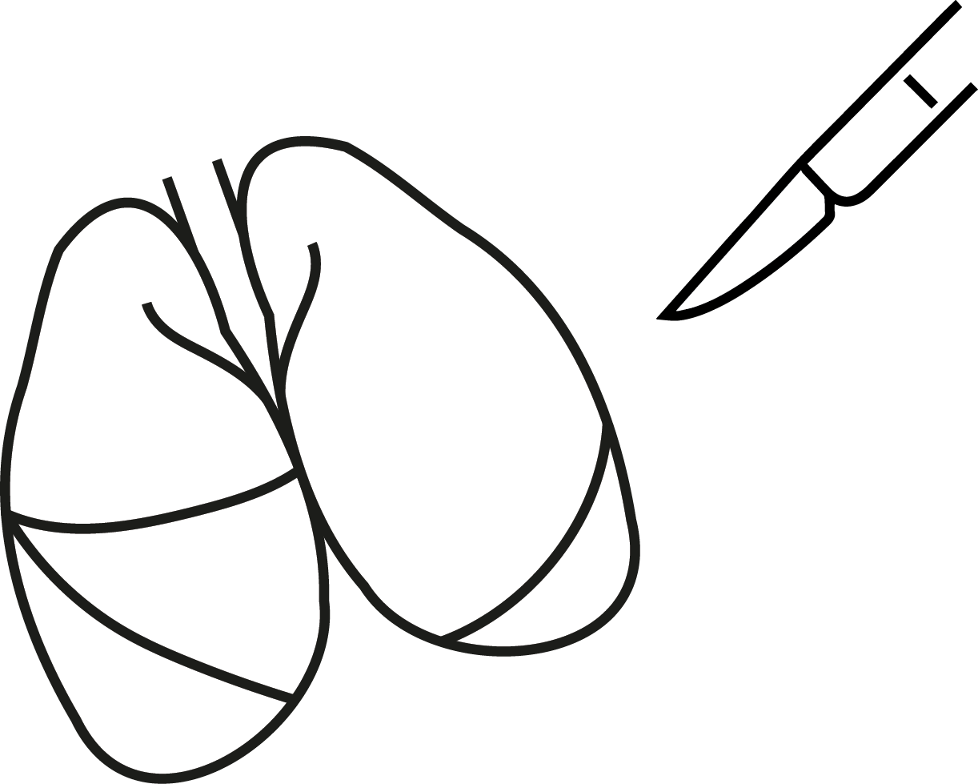
Journey of an IPF patient¹
E2
IPF
Patient with IPF
Multidisciplinary Discussion
Middle-aged/ elderly
Chronic breathlessness
Dry cough
Radiologist
Pulmonologist
Diagnosis
Nurse practitioner
Physician Assistant
Pulmonologist
and team
Pathologist
(if needed)
Rheumalotogist
(if needed)
No diagnosis
Evaluating for lung transplant
Primary Care
Pulmonologist
Radiologist
Medical history
Chest auscultation
PFTs
Medical history
Chest auscultation
PFTs
Laboratory work-up
Exposure history
HRCT scan
Consider surgical lung biopsy
Pharmacist
Respiratory Therapist
Patient education
Antifibrotic therapy
Pulmonary rehab
Supportive/ palliative care
Monitoring
Working diagnosis
Surgical lung biopsy
PFTs=Pulmonary Function Tests; 1. Quinn C, Wisse A, Manns ST. Clinical course and management of idiopathic pulmonary fibrosis. Multidiscip Respir Med. 2019;14:35.
Notes:
Patients are often delayed in receiving a diagnosis of IPF, as its non-specific symptoms are easily mistaken for those of more common diseases such as chronic obstructive pulmonary disease (COPD), gastroesophageal reflux disease (GERD), or heart disease [11, 12]. It is important that healthcare professionals consider IPF as a potential diagnosis in middle-aged/elderly patients who present with unexplained chronic dyspnea and/or cough.
Bilateral inspiratory crackles that sound like “Velcro” being torn apart on chest auscultation are an early sign of IPF and should increase a clinician’s index of suspicion for this disease [13]. Patients with a suspected ILD should be promptly referred to a pulmonologist with expertise in the diagnosis of ILDs. Making a diagnosis of IPF is challenging and requires specialist expertise to exclude other conditions that have a similar clinical and radiological presentation, such as chronic hypersensitivity pneumonitis or ILDs related to autoimmune diseases [14]. Multidisciplinary discussion, involving a pulmonologist, radiologist and, when appropriate, a pathologist and/or rheumatologist, is recommended to enable the most accurate diagnosis to be made.

Slide 23
The MDT plays an essential role in the diagnosis of ILD¹
F0
Multidisciplinary Team (MDT)
1. Wijsenbeek M, et al. Spectrum of fibrotic lung diseases. N Engl J Med 2020;383(10):958-68.

Slide 24
What is the purpose of MDT evaluation in ILD?
F3
ILD
MDT plays a central role in the diagnosis of ILD¹⁻⁵
Disease characterisation
Integration of all available data to formulate a diagnosis
A working diagnosis may be formulated if a patient does not meet diagnostic criteria for any specific ILD
Assessing longitudinal disease behaviour
1. Wijsenbeek M, Cottin V. Spectrum of Fibrotic Lung Diseases. N Engl J Med. 2020;383(10):958-68; 2. Raghu G, Collard HR, Egan JJ, et al. An official ATS/ERS/JRS/ALAT statement: idiopathic pulmonary fibrosis: evidence-based guidelines for diagnosis and management. Am J Respir Crit Care Med. 2011;183(6):788-824; 3. Raghu G, Remy-Jardin M, Myers JL, et al. Diagnosis of Idiopathic Pulmonary Fibrosis. An Official ATS/ERS/JRS/ALAT Clinical Practice Guideline. American Journal of Respiratory and Critical Care Medicine. 2018;198(5):e44-e68; 4. Walsh SLF, Maher TM, Kolb M, et al. Diagnostic accuracy of a clinical diagnosis of idiopathic pulmonary fibrosis: an international case-cohort study. Eur Respir J. 2017;50(2):1700936; 5. George PM, Spagnolo P, Kreuter M, et al. Progressive fibrosing interstitial lung disease: clinical uncertainties, consensus recommendations, and research priorities. Lancet Respir Med. 2020;8(9):925-34.

Slide 25






Essential considerations for MDT discussions¹
F4
ILD
Frequency
Communication
Patient selection
Documentation
Participants
Goals
Format
1. Lynch DA, Sverzellati N, Travis WD, et al. Diagnostic criteria for idiopathic pulmonary fibrosis: a Fleischner Society White Paper. Lancet Respir Med. 2018;6(2):138-53.
Notes:
Document results and communicate, not only to patients and their family, but to all collaborating individuals that manage the care of the patient Figure displays the considerations for MDT discussions in general. This not only applies to ILD but to many diseases.

Slide 26

Although MDT is recommended for ILD diagnosis, there are no guidelines on how meetings should be conducted
F5
ILD
What do you think?
How often should an MDT meet?
How is a MDT meeting
governed?
What is the purpose of MDT evaluation of ILD?
Who are the
requisite
participants?
Do all cases of ILD require MDT
characterisation?
Notes:
Interactive element to provoke discussion. Answers to the questions are clarified in the next slides

Slide 27
Outcomes of MDT for a patient with suspected ILD¹⁻³
F12
ILD
MDT reached consensus diagnosis in 76% of patients with unclassifiable ILD referred to a tertiary center¹
Multidisciplinary discussion
Diagnosis
Initiate pharmacological therapy?
Confident diagnosis
Working diagnosis
Unclassifiable ILD
Not ILD
FVC every 3-6 months
DL_{CO} every 3-6 months
Symptoms and HRQL every 3-6 months
6-minute walk test every 6-12 months
HRCT every 12-18 months or as indicated
No
Yes
Individualized decision for patient, based on:
Disease severity
Evidence of progression
Risk factors for progression
Other disease manifestations
Comorbidities
Patient preferences
Multidisciplinary discussion
Monitor
Monitor
Evidence/risk of progression?
Evidence/risk of progression?
Yes
No
Yes
No
Change/escalate treatment
HRQL=Health-Related Quality of Life; 1. Chaudhuri N, Spencer L, Greaves M, et al. A Review of the Multidisciplinary Diagnosis of Interstitial Lung Diseases: A Retrospective Analysis in a Single UK Specialist Centre. J Clin Med. 2016;5(8):66; 2. Nambiar AM, Walker CM, Sparks JA. Monitoring and management of fibrosing interstitial lung diseases: a narrative review for practicing clinicians. Ther Adv Respir Dis. 2021;15:17534666211039771; 3. Ryerson CJ, Corte TJ, Lee JS, et al. A Standardized Diagnostic Ontology for Fibrotic Interstitial Lung Disease. An International Working Group Perspective. Am J Respir Crit Care Med. 2017;196(10):1249-54.

Slide 28
HRCT is an essential component of the diagnostic process¹
G0
High-Resolution Computed Tomography (HRCT)
1. Sverzellati N. Highlights of HRCT imaging in IPF. Respir Res. 2013;14 Suppl 1(Suppl 1):S3.
Notes:
Sverzellati N. Highlights of HRCT imaging in IPF. Respir Res. 2013;14 Suppl 1(Suppl 1):S3.

Slide 29
High-resolution computed tomography (HRCT) is an essential component of F-ILD diagnosis¹⁻³
G1
F-ILD
Clinical data
HRCT data can improve diagnostic accuracy and may change the clinician’s first-choice diagnosis in half of the cases^{4*}
Biopsy results
First-choice
diagnosis
Alternative diagnosis
HRCT of the chest
Possible need for biopsy
Multi-disciplinary discussion
Diagnostic confidence
Broncho-alveolar lavage
Potential for disease progression
Lung function test (FVC, Dl_{co})
Prognosis
* HRCT is indicated at baseline for patients with ILD who have high risk of developing PPF, and repeated when lung function or respiratory symptoms worsen^{5,6}
Biologic features autoimmunity
1. Wijsenbeek M, Cottin V. Spectrum of Fibrotic Lung Diseases. N Engl J Med. 2020;383(10):958-68; 2. Cosgrove GP, Bianchi P, Danese S, et al. Barriers to timely diagnosis of interstitial lung disease in the real world: the INTENSITY survey. BMC Pulm Med. 2018;18(1):9; 3. Sverzellati N. Highlights of HRCT imaging in IPF. Respir Res. 2013;14 Suppl 1(Suppl 1):S3; 4. Walsh SLF, Maher TM, Kolb M, et al. Diagnostic accuracy of a clinical diagnosis of idiopathic pulmonary fibrosis: an international case-cohort study. Eur Respir J. 2017;50(2):170002; 5. Raghu G, Remy-Jardin M, Richeldi L, et al. Idiopathic Pulmonary Fibrosis (an Update) and Progressive Pulmonary Fibrosis in Adults: An Official ATS/ERS/JRS/ALAT Clinical Practice Guideline. Am J Respir Crit Care Med. 2022;205(9):e18-e47; 6. Elicker BM, Kallianos KG, Henry TS. The role of high-resolution computed tomography in the follow-up of diffuse lung disease: Number 2 in the Series “Radiology” Edited by Nicola Sverzellati and Sujal Desai. Eur Respir Rev. 2017;26(144):170008.
Notes:
In 51% of the cases the clinicians changed their mind about the diagnosis when looking at the HRCT data.

Slide 30
For accurate ILD diagnosis, CT images should be of high quality
G4
ILD
Necessary conditions:
Thin sections (≤1.5 mm) and high spatial resolution construction^{1,2}
Full inspiration is needed
Expiratory scans can identify air trapping (common in HP)²
Additional conditions:
MinIP:
optimizes detection of subtle hypo-attenuated lesions (cysts, bronchiectasis)¹
MIP:
optimizes detection of (micro)nodules¹
MIP=Maximum Intensity Projection; MinIP=Minimal Intensity Projection; 1. Raghu G, Remy-Jardin M, Myers JL, et al. Diagnosis of Idiopathic Pulmonary Fibrosis. An Official ATS/ERS/JRS/ALAT Clinical Practice Guideline. Am J Respir Crit Care Med. 2018;198(5):e44-e68; 2. Lynch DA, Sverzellati N, Travis WD, et al. Diagnostic criteria for idiopathic pulmonary fibrosis: a Fleischner Society White Paper. Lancet Respir Med. 2018;6(2):138-53.
Notes:
Full inspiration is needed, as inadequate inspiration can lead to a misinterpretation of findings
Expiratory scans can identify air trapping, a feature that commonly occurs in hypersensitivity pneumonitis²

Slide 31

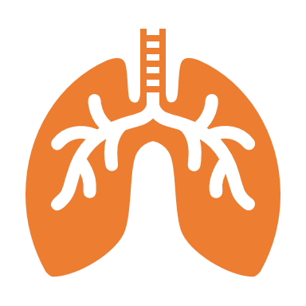

A systematic analysis of HRCT scans narrows down the differential diagnosis of ILD¹
G5
ILD
Is the HRCT normal or abnormal?
Normal
Abnormal
ILD
Interstitial – are there features of a fibrosing lung disease?
F-ILD
diagnosis
Define fibrotic pattern to aid F-ILD diagnosis
1. Jacob J, Hansell DM. HRCT of fibrosing lung disease. Respirology. 2015;20(6):859-72.

Slide 32
A systematic approach to analyze HRCT scans can narrow down the differential diagnosis of ILD^{1,2}
H0
How to define the HRCT pattern
1. Sverzellati N. Highlights of HRCT imaging in IPF. Respir Res. 2013;14 Suppl 1(Suppl 1):S3; 2. Jacob J, Hansell DM. HRCT of fibrosing lung disease. Respirology. 2015;20(6):859-72.

Slide 33

Approach to define the HRCT pattern
H1
F-ILD
Ancillary findings
Loss of volume
Bronchiectasis
Honeycombing
Pattern
Nodular pattern
Increased attenuation
Decreased attenuation
Reticulations
Distribution
Basal, apical, middle
Central vs peripheral
Diffuse
Diagnosis
Disease pattern or disease
Exclude alternative diagnoses
Notes:
There are 4 pillars to identify the HRCT pattern that could aid diagnosis: Determing the pattern, ancillary findings, distribution and finally exclude alternative diagnosis.

Slide 34
HRCT pattern recognition: assessing disease features
H2
F-ILD
Increased attenuation
Decreased attenuation
Nodules
Ground-glass
Reticular pattern
Consolidation
Cystic pattern
Mosaic perfusion
Random
Perilymphatic
Centrilobular
Crazy paving
Interlobular septa
Intralobular lines
Air trapping
No air trapping
Tree-in-bud
Non-tree-in-bud
Airways disease
Vascular disease
Metastases
Miliary tuberculosis
Sarcoidosis
Carcinomatous lymphangitis
Pneumocon-iosis
Lymphocytic interstitial pneumonia (LIP)
Infectious bronchiolitis
Hypersensitivity pneumonitis
Infection
Respiratory bronchiolitis
Follicular bronchiolitis
Lymphocytic interstitial pneumonia (LIP)
Edema
Hemorrhage
Hypersensitivity pneumonitis
Infection
Nonspecific interstitial pneumonia (NSIP)
Desquamative interstitial pneumonia (DIP)
Edema
Hemorrhage
Infection
Alveolar proteinosis
Bronchiolo-alveolar carcinoma (BAC)
Edema
Carcinomatous lymphangitis
Lymphocytic interstitial pneumonia (LIP)
Fibrosis
Idiopathic pulmonary fibrosis (IPF)
Usual interstitial pneumonia (UIP)
Nonspecific interstitial pneumonia (NSIP)
Chronic hypersensitivity pneumonitis (cHP)
Lobar pneumonia
Eosinophilic pneumonia
Organizing pneumonia (OP)
Malignancy
Lymphangio- leiomyomatosis (LAM)
Langerhans cell histiocytosis
Lymphocytic interstitial pneumonia (LIP)
Emphysema
Cystic bronchiectasis
Honeycombing
Obliterative bronchiolitis
Cystic fibrosis
Hypersensitivity pneumonitis
Bronchiectasis
Asthma
Chronic pulmonary embolism
Adapted from a poster created in 2021 in collaboration with Fredrik Ahlfors, radiologist and ILD expert Telemedicine Clinic
Notes:
These are patterns belonging to increased and decreased attenuation. The pattern can tell something about the underlying disease. … ground glass and reticulations are important signs that there may be fibrosis. We will focus on these in the next slides.

Slide 35
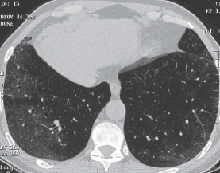
Define HRCT-pattern
H4
F-ILD
Ground glass or reticulations may be signs of a fibrosing lung disease, but it is no proof of fibrosis¹
Ground glass
Area slightly increased attenuation
Vessels and structures can still be discerned
Ground-glass opacity associated with intralobular reticulations and traction bronchiolectasis in a patient with NSIP associated with systemic sclerosis
Traction bronchiolectasis
1. Jacob J, Hansell DM. HRCT of fibrosing lung disease. Respirology. 2015;20(6):859-72.

Slide 36
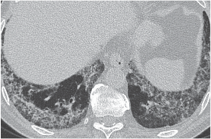
Define HRCT-pattern
H5
F-ILD
Ground glass or reticulations may be signs of a fibrosing lung disease, but it is no proof of fibrosis¹
Reticulations
Small linear opacities - slightly increased attenuation - caused by thickened interlobular or intralobular septa (lines)
Vessels and structures can still be discerned
Marked intralobular reticulations (without honeycombing) in a patient with NSIP associated with systemic sclerosis
Intralobular reticulations
1. Jacob J, Hansell DM. HRCT of fibrosing lung disease. Respirology. 2015;20(6):859-72.
Notes:
There are two types of reticular (linear) patterns. A coarser pattern, formed by thickened interlobular septa, and a finer pattern formed by intralobular lines. Visible interlobular septa result from thickened interstitium, lymph vessels or veins that run in the periphery of the lobules. Intralobular lines consist of thickening of the interstitium and form a fine reticular network.

Slide 37
Approach to define the HRCT pattern
H6
F-ILD
Ancillary findings
Loss of volume
Bronchiectasis
Honeycombing
Pattern
Nodular pattern
Increased attenuation
Decreased attenuation
Reticulalations
Distribution
Basal, apical, middle
Central vs peripheral
Diffuse
Diagnosis
Disease pattern or disease
Exclude alternative diagnoses

Slide 38
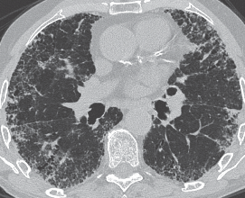
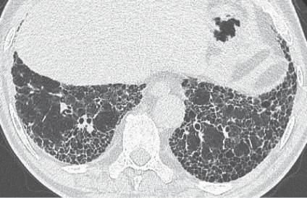
Ancillary findings
H7
F-ILD
Besides ground glass and reticular abnormalities, there may be other signs of fibrosis, such as
Loss of volume¹
May be indicated by movement of the fissure to posterior
Honeycombing²
Cluster of thick-walled cystic airspaces with sharp well-defined borders
Bronchiectasis and bronchiolectasis¹
Irreversible enlargement of bronchi that may be caused by mechanical traction from fibrosis
Honeycombing is proof of fibrosis^{1,2}
1. Jacob J, Hansell DM. HRCT of fibrosing lung disease. Respirology. 2015;20:859-72; 2. Lynch DA, Sverzellati N, Travis WD, et al. Diagnostic criteria for idiopathic pulmonary fibrosis: a Fleischner Society White Paper. Lancet Respir Med. 2018;6(2):138-53.
Notes:
Bronchiectasis and bronchiolectasis may also occur in bronchial diseases, which signifies to look for other signs of fibrosis in the lung parenchyma. Loss of volume may indicate fibrosos. Honeycombing is the most important feature of fibrosis

Slide 39
Ancillary findings: Loss of volume
H8
F-ILD
Besides ground glass and reticular abnormalities, there may be other signs of fibrosis, such as
Loss of volume¹
May be indicated by movement of the fissure to posterior (arrows)
1. Jacob J, Hansell DM. HRCT of fibrosing lung disease. Respirology. 2015;20:859-72.
Notes:
Loss of volume may indicate fibrosis.

Slide 40
Ancillary findings: Honeycombing
H9
F-ILD
Besides ground glass and reticular abnormalities, there may be other signs of fibrosis, such as
Honeycombing^{1,2}
Cluster of thick-walled cystic airspaces with sharp well-defined borders
Honeycombing is proof of fibrosis^{1,2}
1. Jacob J, Hansell DM. HRCT of fibrosing lung disease. Respirology. 2015;20(6):859-72; 2. Lynch DA, Sverzellati N, Travis WD, et al. Diagnostic criteria for idiopathic pulmonary fibrosis: a Fleischner Society White Paper. Lancet Respir Med. 2018;6(2):138-53.
Notes:
Honeycombing is the most important feature of fibrosis

Slide 41
Ancillary findings: Bronchiectasis and bronchiolectasis
H10
F-ILD
Besides ground glass and reticular abnormalities, there may be other signs of fibrosis, such as
Bronchiectasis and bronchiolectasis^{1,2}
Irreversible enlargement of bronchi that may be caused by mechanical traction from fibrosis
Traction bronchiolectasis
Traction bronchiectasis
1. Jacob J, Hansell DM. HRCT of fibrosing lung disease. Respirology. 2015;20(6):859-72; 2. Lynch DA, Sverzellati N, Travis WD, et al. Diagnostic criteria for idiopathic pulmonary fibrosis: a Fleischner Society White Paper. Lancet Respir Med. 2018;6(2):138-53.
Notes:
Bronchiectasis and bronchiolectasis may also occur in bronchial diseases, which signifies to look for other signs of fibrosis in the lung parenchyma.

Slide 42
Approach to define the HRCT pattern
H11
F-ILD
Ancillary findings
Loss of volume
Bronchiectasis
Honeycombing
Pattern
Nodular pattern
Increased attenuation
Decreased attenuation
Reticulalations
Distribution
Basal, apical, middle
Central vs peripheral
Diffuse
Diagnosis
Disease pattern or disease
Exclude alternative diagnoses

Slide 43



Distribution
H12
F-ILD
The distribution of HRCT findings identifies the radiological pattern
Usual intersitial pneumonia
Basal and subpleural predominance
Distribution often heterogenous
Non-specific interstitial pneumonia
Basal and subpleural predominance
Subpleural sparing
Distribution usually homogenous
Fibrotic granulomatous diseases
Upper lobe and peribronchovascular predominance
1. Jacob J, Hansell DM. HRCT of fibrosing lung disease. Respirology. 2015;20(6):859-72; 2. Lynch DA, Sverzellati N, Travis WD, et al. Diagnostic criteria for idiopathic pulmonary fibrosis: a Fleischner Society White Paper. Lancet Respir Med. 2018;6(2):138-53.
Notes:
There are two types of reticular (linear) patterns. A coarser pattern, formed by thickened interlobular septa, and a finer pattern formed by intralobular lines. Visible interlobular septa result from thickened interstitium, lymph vessels or veins that run in the periphery of the lubules. Intralobular lines consist of thickening of the interstitium and form a fine reticular network.

Slide 44
Approach to define the HRCT pattern
H13
F-ILD
Ancillary findings
Loss of volume
Bronchiectasis
Honeycombing
Pattern
Nodular pattern
Increased attenuation
Decreased attenuation
Reticulalations
Distribution
Basal, apical, middle
Central vs peripheral
Diffuse
Diagnosis
Disease pattern or disease
Exclude alternative diagnoses

Slide 45
Exclude alternative diagnoses¹
H14
ILD
F-ILD
Findings suggestive of another diagnosis are:
Cysts
Marked mosaic attenuation
Predominant GGO
Profuse micronodules
(Centrilobular) nodules
Consolidation
Predominant distribution:
Peribronchovascular
Perilymphatic
Upper or mid-lung
CT pattern, ancillary findings, distribution and absence of changes that suggest other diagnoses need to be evaluated to obtain a diagnosis of F-ILD or disease pattern
GGO=Ground-glass Opacity; 1. Lynch DA, Sverzellati N, Travis WD, et al. Diagnostic criteria for idiopathic pulmonary fibrosis: a Fleischner Society White Paper. Lancet Respir Med. 2018;6(2):138-53.
Notes:
Sharepoint poster
There are two types of reticular (linear) patterns. A coarser pattern, formed by thickened interlobular septa, and a finer pattern formed by intralobular lines. Visible interlobular septa result from thickened interstitium, lymph vessels or veins that run in the periphery of the lubules. Intralobular lines consist of thickening of the interstitium and form a fine reticular network.

Slide 46
UIP is the hallmark pattern for IPF¹
I0
Relevant HRCT patterns in ILD
1. Lynch DA, Sverzellati N, Travis WD, et al. Diagnostic criteria for idiopathic pulmonary fibrosis: a Fleischner Society White Paper. Lancet Respir Med. 2018;6(2):138-53.

Slide 47
I2
F-ILD
For prognosis and treatment it is important to know whether a fibrotic ILD shows a (probable) UIP pattern or a pattern associated with an alternative diagnosis
UIP
Subpleural and basal distribution
Often heterogeneous, occassionally diffuse, may be assymetric
Honeycombing with or without traction bronchiectasis/ bronchiolectasis
Irregular thickening of interlobular septa
Usually superimposed with a reticular pattern, mild GGO
Probable UIP
Comparable to UIP except that honeycombing is absent
Absence of subpleural sparing
Indeterminate for UIP
Distribution of fibrotic characteristics variable or diffuse, without subpleural predominance
not-fitting an alternative diagnosis
Alternative diagnosis
Distribution may be more upper or mid-lung,or peribronchovascular with subpleural sparing
Extensive ground-glass, nodules or consolidations, mosaic attenuation and air trapping may be present
Many HRCT findings may be classified as indeterminate for UIP or are
suggestive of an alternative diagnosis
1. Raghu G, Remy-Jardin M, Richeldi L, et al. Idiopathic Pulmonary Fibrosis (an Update) and Progressive Pulmonary Fibrosis in Adults: An Official ATS/ERS/JRS/ALAT Clinical Practice Guideline. Am J Respir Crit Care Med. 2022;205(9):e18-e47; 2. Lynch DA, Sverzellati N, Travis WD, et al. Diagnostic criteria for idiopathic pulmonary fibrosis: a Fleischner Society White Paper. Lancet Respir Med. 2018;6(2):138-53.

Slide 48
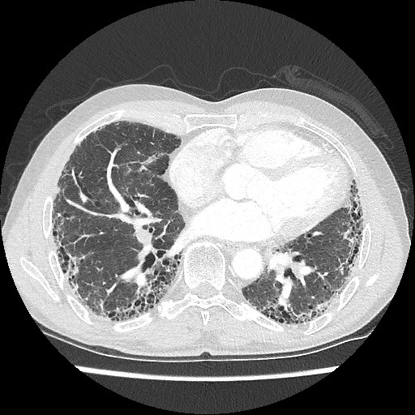
Usual Interstitial Pneumonia (UIP)¹
I3
F-ILD
Typical HRCT findings in UIP are¹:
CT-pattern
Minimal ground glass
Reticulation
Ancillary findings
Traction bronchiectasis
Honeycombing
Distribution
Basal and subpleural predominance
Absence of features that suggest an alternative diagnosis
UIP pattern*
1. Lynch DA, Sverzellati N, Travis WD, et al. Diagnostic criteria for idiopathic pulmonary fibrosis: a Fleischner Society White Paper. Lancet Respir Med. 2018;6(2):138-53; *CT scan retrieved from Radiopaedia.org, rID: 59878.

Slide 49
In the correct clinical context, a confident IPF diagnosis can be made when a definite or probable UIP pattern is seen on HRCT¹
I4
IPF
If the clinical context or CT pattern is indeterminate for IPF: consider biopsy → confident IPF diagnosis could be made after multidisciplinary evaluation
If diagnostic tissue is not available: a working diagnosis of IPF could be made after a careful multidisciplinary evaluation
All patients with an IPF diagnosis, particularly those with a working diagnosis, should have this diagnosis reviewed at regular intervals
ATS/ERS/JRS/ALAT guidelines on the definition of a UIP radiologic pattern²
UIP | Probable UIP | Indeterminate for UIP
Subpleural and basal predominant; distribution is often heterogeneous | Subpleural and basal predominant; distribution is often heterogeneous | Subpleural and basal predominant
Variants of distribution include occasionally diffuse, and may be asymmetrical. | Reticular pattern with peripheral traction bronchiectasis or bronchiolectasis | Subtle reticulation; may have mild GGO or distortion (‘early UIP pattern’)
Honeycombing with or without peripheral traction bronchiectasis or bronchiolectasis | May have mild GGO | CT features and/or distribution of lung fibrosis that do not suggest any specific etiology (‘truly indeterminate for UIP’)
1. Lynch DA, Sverzellati N, Travis WD, et al. Diagnostic criteria for idiopathic pulmonary fibrosis: a Fleischner Society White Paper. Lancet Respir Med. 2018;6(2):138-53; 2. Raghu G, Remy-Jardin M, Myers JL, et al. Diagnosis of Idiopathic Pulmonary Fibrosis. An Official ATS/ERS/JRS/ALAT Clinical Practice Guideline. American Journal of Respiratory and Critical Care Medicine. 2018;198(5):e44-e68.
Notes:
If the clinical context is indeterminate for IPF, or the CT pattern is not indicative of typical or probable UIP, biopsy should be considered to confirm the presence of a UIP histological pattern, and a confident diagnosis of IPF could then be made on the basis of a multidisciplinary evaluation.
If diagnostic tissue is not available, a working diagnosis of IPF could be made after a careful multidisciplinary evaluation.
All patients with an IPF diagnosis, particularly those with a working diagnosis, should have this diagnosis reviewed at regular intervals.

Slide 50
IPF diagnosis based on HRCT and biopsy patterns¹
I5
IPF
IPF suspected*
Histopathology pattern†
UIP
Probable UIP
Indeterminate for UIP or biopsy not performed
Alternative
diagnosis
HRCT Pattern
UIP
IPF
IPF
IPF
Non-IPF dx
Probable UIP
IPF
IPF
IPF (Likely)‡
Non-IPF dx
Indeterminate
IPF
IPF (Likely)‡
Indeterminate§
Non-IPF dx
Alternative
diagnosis
IPF (Likely)‡
Indeterminate§
Non-IPF dx
Non-IPF dx
*“Clinically suspected of having IPF” is defined as unexplained patterns of bilateral pulmonary fibrosis on chest radiography or chest computed tomography, bibasilar inspiratory crackles, and age >60 years; †Diagnostic confidence may need to be downgraded if histopathological assessment is based on transbronchial lung cryobiopsy given the smaller biopsy size and greater potential for sampling error compared with surgical lung biopsy; ‡IPF is the likely diagnosis when any of the following features are present: 1) moderate to severe traction bronchiectasis and/or bronchiolectasis (defined as mild traction bronchiectasis and/or bronchiolectasis in four or more lobes, including the lingula as a lobe, or moderate to severe traction bronchiectasis in two or more lobes) in a man >50 years old or in a woman >60 yr old, 2) extensive (>30%) reticulation on HRCT and age >70 yr, 3) increased neutrophils and/or absence of lymphocytosis in BAL fluid, and 4) multidisciplinary discussion produces a confident diagnosis of IPF; §Indeterminate for IPF 1) without an adequate biopsy remains indeterminate and 2) with an adequate biopsy may be reclassified to a more specific diagnosis after multidisciplinary discussion and/or additional consultation; Dx=diagnosis; 1. Raghu G, Remy-Jardin M, Richeldi L, et al. Idiopathic Pulmonary Fibrosis (an Update) and Progressive Pulmonary Fibrosis in Adults: An Official ATS/ERS/JRS/ALAT Clinical Practice Guideline. Am J Respir Crit Care Med. 2022;205(9):e18-e47.

Slide 51
Diagnostic algorithm for IPF¹
I6
IPF
Patient suspected of having IPF
Potential cause/associated condition
NO
YES
Chest HRCT pattern
NO
Confirmation of specific diagnosis (including with HRCT)
UIP or probable UIP*
Indeterminate for UIP of alternative diagnosis
MDD
YES
BAL† ± TBLC‡
SLB‡
MDD
IPF
Alternative diagnosis
*Patients with a radiological pattern of probable usual interstitial pneumonia (UIP) can receive a diagnosis of IPF after multidisciplinary discussion (MDD) without confirmation by lung biopsy in the appropriate clinical setting (e.g., 60 yr old, male, smoker); †BAL may be performed before MDD in some patients evaluated in experienced centers; ‡Transbronchial lung cryobiopsy (TBLC) may be preferred to surgical lung biopsy (SLB) in centers with appropriate expertise and/or in some patient populations. A subsequent SLB may be justified in some patients with nondiagnostic findings on TBLC; 1. Raghu G, Remy-Jardin M, Richeldi L, et al. Idiopathic Pulmonary Fibrosis (an Update) and Progressive Pulmonary Fibrosis in Adults: An Official ATS/ERS/JRS/ALAT Clinical Practice Guideline. Am J Respir Crit Care Med. 2022;205(9):e18-e47.
Notes:
Diagnostic algorithm for idiopathic pulmonary fibrosis (IPF), developed using consensus by discussion. *Patients with a radiological pattern of probable usual interstitial pneumonia (UIP) can receive a diagnosis of IPF after multidisciplinary discussion (MDD) without confirmation by lung biopsy in the appropriate clinical setting (e.g., 60 yr old, male, smoker). BAL may be appropriate in some patients with a probable UIP pattern. †BAL may be performed before MDD in some patients evaluated in experienced centers. ‡Transbronchial lung cryobiopsy (TBLC) may be preferred to surgical lung biopsy (SLB) in centers with appropriate expertise and/or in some patient populations. A subsequent SLB may be justified in some patients with nondiagnostic findings on TBLC.

Slide 52
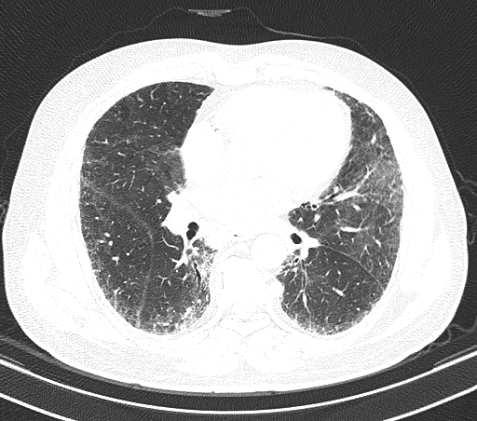
Non-Specific Interstitial Pneumonia (NSIP)¹
I7
F-ILD
Typical HRCT findings in NSIP are¹:
CT-pattern
Ground glass
Reticulation
Ancillary findings
Traction bronchiectasis
Loss of volume
Distribution
Basal and subpleural predominance, subpleural sparing
NSIP pattern*
1. Sergiacomi G, et al. High-resolu­tion computed tomography and magnetic resonance imaging protocols in the diagnosis of fibrotic inter­stitial lung disease: Overview for “non-radiologists”. Sarcoidosis Vasc Diffuse Lung Di. 2017;34(4):300-6; *CT scan retrieved from Radiopaedia.org, rID: 68599.

Slide 53
Most common HRCT-patterns in CTD-ILD¹
I10
CTD-ILD
ILD associated with | UIP​ | NSIP | Organizing pneumonia
Rheumatoid arthritis | +++ | ++ | +
SSc | + | +++
Systemic lupus erythematosus | + | ++ | +
PM/DM | + | +++ | +++
Sjögren’s syndrome | + | +++ | +
PM=Polymyositis; DM=Dermatomyositis; 1. de Lauretis A, Veeraraghavan S, Renzoni E. Review series: Aspects of interstitial lung disease: connective tissue disease-associated interstitial lung disease: how does it differ from IPF? How should the clinical approach differ? Chron Respir Dis. 2011;8(1):53-82.

Slide 54
Monitoring of FVC, extent of fibrosis on HRCT, and course of clinical symptoms is important to detect disease progression
J0
Monitoring
Measuring progression with HRCT
1. Nambiar AM, Walker CM, Sparks JA. Monitoring and management of fibrosing interstitial lung diseases: a narrative review for practicing clinicians. Ther Adv Respir Dis. 2021;15:17534666211039771.

Slide 55



HRCT is important to monitor for progression of fibrosis
J1
F-ILD
INBUILD criteria¹ Meeting >1 criteria of progression within 24 months
PPF guideline criteria² Meeting >2 criteria within the past year, with no alternative explanation
A relative decline in FVC > 10% of predicted
Worsening respiratory symptoms
Worsening of respiratory symptoms AND increased extent of fibrosis on HRCT
Physiological evidence of disease progression
Absolute decline in FVC ≥5%
Absolute decline in DL_{CO} ≥10% (corrected for Hb)
+
A relative decline in FVC between 5-10% of predicted AND either worsening of respiratory symptoms OR increased extent of fibrosis on HRCT
+
or
Radiological evidence of disease progressing
1. Flaherty KR, Wells AU, Cottin V, et al. Nintedanib in Progressive Fibrosing Interstitial Lung Diseases. N Engl J Med. 2019;381(18):1718-27; 2. Raghu G, Remy-Jardin M, Richeldi L, et al. Idiopathic Pulmonary Fibrosis (an Update) and Progressive Pulmonary Fibrosis in Adults: An Official ATS/ERS/JRS/ALAT Clinical Practice Guideline. Am J Respir Crit Care Med. 2022;205(9):e18-e47.
Notes:
Differences: INBUILD® criteria require ≥1 measure within 2 years, whereas the PPF guideline stipulates ≥2 criteria in the past year INBUILD® criteria are based on relative decline in FVC whereas the PPF guideline criteria use absolute decline in FVC
INBUILD® criteria count relative decline in FVC ≥10% predicted alone, but similar to the PPF guideline criteria, ≥5–<10% can be used when worsening respiratory symptoms or increased extent of fibrosis on HRCT are also present The PPF criteria include absolute decline in DLCO ≥10% INBUILD® criteria do not provide specific guidance on radiological progression, which is given in the PPF criteria

Slide 56
Monitoring algorithm for SSc-ILD^{1,2}
J2
CTD-ILD
Vigilant ongoing monitoring should be conducted, with HRCT repeated upon worsening of PFT scores or respiratory symptoms^{1,2}
All patients with SSc-ILD need to be followed up every 3–6 months with PFTs, and repeated HRCT as guided by clinical decision²
Screen all patients with systemic sclerosis for ILD using HRCT
FVC and DL_{co} should be done at baseline and at regular intervals
Every patient should receive an ILD-related physical examination
Negative
Decide whether pharmacological therapy is required
Some patients might not need pharmacological therapy
Factors to consider include disease severity, patient quality of life, available clinical guidelines
Pharmacological therapy
Mycophenolate mofetil
Cyclophospha-mide
Nintedanib
Assess ILD progression using multiple methods
Use HRCT (depending on clinical need), FVC, DL_{co}, exercise-induced blood oxygen desaturation, and clinical symptoms to assess ILD progression
Escalate therapy
Modify dose or choice of pharmacological treatment; mycophenolate mofetil; cyclophosphamide, nintedanib; consider rituximab
Evaluate for lung transplant
Consider autologous haemopoietic stem-cell transplantation for selected patients
Disease progression
Continue monitoring for ILD Frequency of screening and use of HRCT should be guided by risk of ILD, in combination with lung function and symptoms
Negative
Positive
Diagnose ILD using HRCT
Assess ILD severity using multiple methods
HRCT is the primary tool for diagnosis; FVC, DL_{co}, and clinical symptoms are supportive
Use HRCT, FVC, DL_{co} exercise-induced blood oxygen desaturation, clinical symptoms, and quality of life to assess ILD severity
No pharmacological therapy
Follow up closely
Inadequate treatment response
Positive
1. Hoffmann-Vold A-M, Maher TM, Philpot EE, et al. The identification and management of interstitial lung disease in systemic sclerosis: evidence-based European consensus statements. The Lancet Rheumatology. 2020;2(2):e71-e83; 2. Perelas A, Silver RM, Arrossi AV, et al. Systemic sclerosis-associated interstitial lung disease. Lancet Respir Med. 2020;8(3):304-20.
Notes:
Due to the variable and unpredictable nature of pulmonary fibrosis in SSc, vigilant ongoing monitoring should be conducted, with HRCT repeated upon worsening of PFT scores, or respiratory symptoms

Slide 57
Antifibrotic treatment started immediately after identification of PPF could help slow progression when there is the most left to preserve¹
J3
PPF
Antifibrotic therapy is considered in patients with PPF despite appropriate first-line therapy
Immediate initiation of anti-fibrotic treatment is advocated in the presence of a fibrosis extent >20% and honeycombing²
Antifibrotic therapy should be started immediately upon IPF diagnosis
SSc-ILD
RA-ILD
Sarcoidosis
Chronic hypersensitivity pneumonitis
Idiopathic NSIP
Unclassifiable ILD
IPF
Antigen activation
Consider immunomodulation treatment or observation
Glucocorticoids
Glucocorticoids
Glucocorticoids
Glucocorticoids
Glucocorticoids
MMF, CPM, TCL (AZA, RTX)
RTX, ABA, MMF
MTX (AZA, IFX, ADA)
MMF (AZA)
MMF, AZA, or other immunosuppressants
Consider antifibrotic agents (nintedanib)
Antifibrotic agents (nintedanib or pirfenidone)
Non-pharmacological treatment
Supplemental oxygen, psychosocial support, smoking cessation, rehabilitation, symptom palliation, end-of-life care
Reconsider management
Regular Follow-up
Monitoring of Disease Course
Disease progression
Stable disease
Ameliorization
*Please note that most drugs mentioned in this algorithm have not been licensed for the treatment of these fibrosing ILDs. Nintedanib is recommended for the treatment of PPF in patients which have failed standard management of fibrotic ILD. MMF=Mycophenolate Mofetil; CPM=Cyclophosphamide; TCL=Tocilizumab; AZA=Azathioprine; RTX=Rituximab; ABA=Abatacept; MTX=Methotrexate; IFX=Infliximab; ADA=Adalimumab; 1. Torrisi SE, Pavone M, Vancheri A, Vancheri C. When to start and when to stop antifibrotic therapies. Eur Respir Rev. 2017;26(145):170053; 2. De Sadeleer LJ, Goos T, Yserbyt J, et al. Towards the Essence of Progressiveness: Bringing Progressive Fibrosing Interstitial Lung Disease (PF-ILD) to the Next Stage. J Clin Med. 2020;9(6):1722; 3. Wijsenbeek M, Cottin V. Spectrum of Fibrotic Lung Diseases. N Engl J Med. 2020;383(10):958-68.
Notes:
Why is monitoring important? Because you can start antifibrotic therapy early when PPF is there. (bridge to session 3)

Slide 58
K0
Summary

Slide 59








Key messages
K1
Accurate and early diagnosis
Risk factors, signs and symptoms
Referral to specialists
Accurate and early diagnosis of ILD is crucial to optimise patient outcomes¹
Being aware of risk factors, signs and symptoms for ILD facilitates early diagnosis²⁻⁴
Clinicians should promptly refer patients with suspected ILD to specialists⁵
Monitoring for progression
MDT evaluation
HRCT patterns
A systematic approach to analyse HRCT patterns can narrow down the differential diagnosis of ILD⁷
Different diagnostic parameters need evaluation by the MDT to come to an ILD diagnosis⁶
HRCT is important to predict and detect progression^{7,8}
1. Cottin V, et al. Presentation, diagnosis and clinical course of the spectrum of progressive-fibrosing interstitial lung diseases. Eur Respir Rev 2018;27(150):180076;2. Bosello SL, Beretta L, Del Papa N, et al. Interstitial Lung Disease Associated With Autoimmune Rheumatic Diseases: Checklists for Clinical Practice. Front Med (Lausanne). 2021;8:732761; 3. Esposito AJ, Chu SG, Madan R, et al. Thoracic Manifestations of Rheumatoid Arthritis. Clin Chest Med. 2019;40(3):545-60; 4. Nambiar AM, Walker CM, Sparks JA. Monitoring and management of fibrosing interstitial lung diseases: a narrative review for practicing clinicians. Ther Adv Respir Dis. 2021;15:17534666211039771; 5. Quinn C, Wisse A, Manns ST. Clinical course and management of idiopathic pulmonary fibrosis. Multidiscip Respir Med. 2019;14:35; 6. Wijsenbeek M, Cottin V. Spectrum of Fibrotic Lung Diseases. N Engl J Med. 2020;383(10):958-68; 7. Sverzellati N. Highlights of HRCT imaging in IPF. Respir Res. 2013;14 Suppl 1(Suppl 1):S3; 8. Walsh SL, Devaraj A, Enghelmayer JI, et al. Role of imaging in progressive-fibrosing interstitial lung diseases. European Respiratory Review. 2018;27(150):180073.

Slide 60

PC-SE-103810 Oct.2023

