Slide 1


Welcome!
During this session we will be providing tools and exchanging ideas on ILD patient care

Slide 2
Patient follow-up and detection of progression

Slide 3
“When my wife first found out about it, she kept coughing and I kept telling her to go to the MD. She had a biopsy and the report said IPF. I “googled” it and what I read wasn’t what I wanted to read. We asked if we could go to the specialty center and were told that she wasn’t sick enough. She died the next month.”
- A caregiver of deceased IPF patient¹
Introduction
IPF=Idiopathic Pulmonary Fibrosis; 1. Lindell KO, Kavalieratos D, Gibson KF, et al. The palliative care needs of patients with idiopathic pulmonary fibrosis: a qualitative study of patients and family caregivers. Heart Lung. 2017;46(1):24-9.

Slide 4
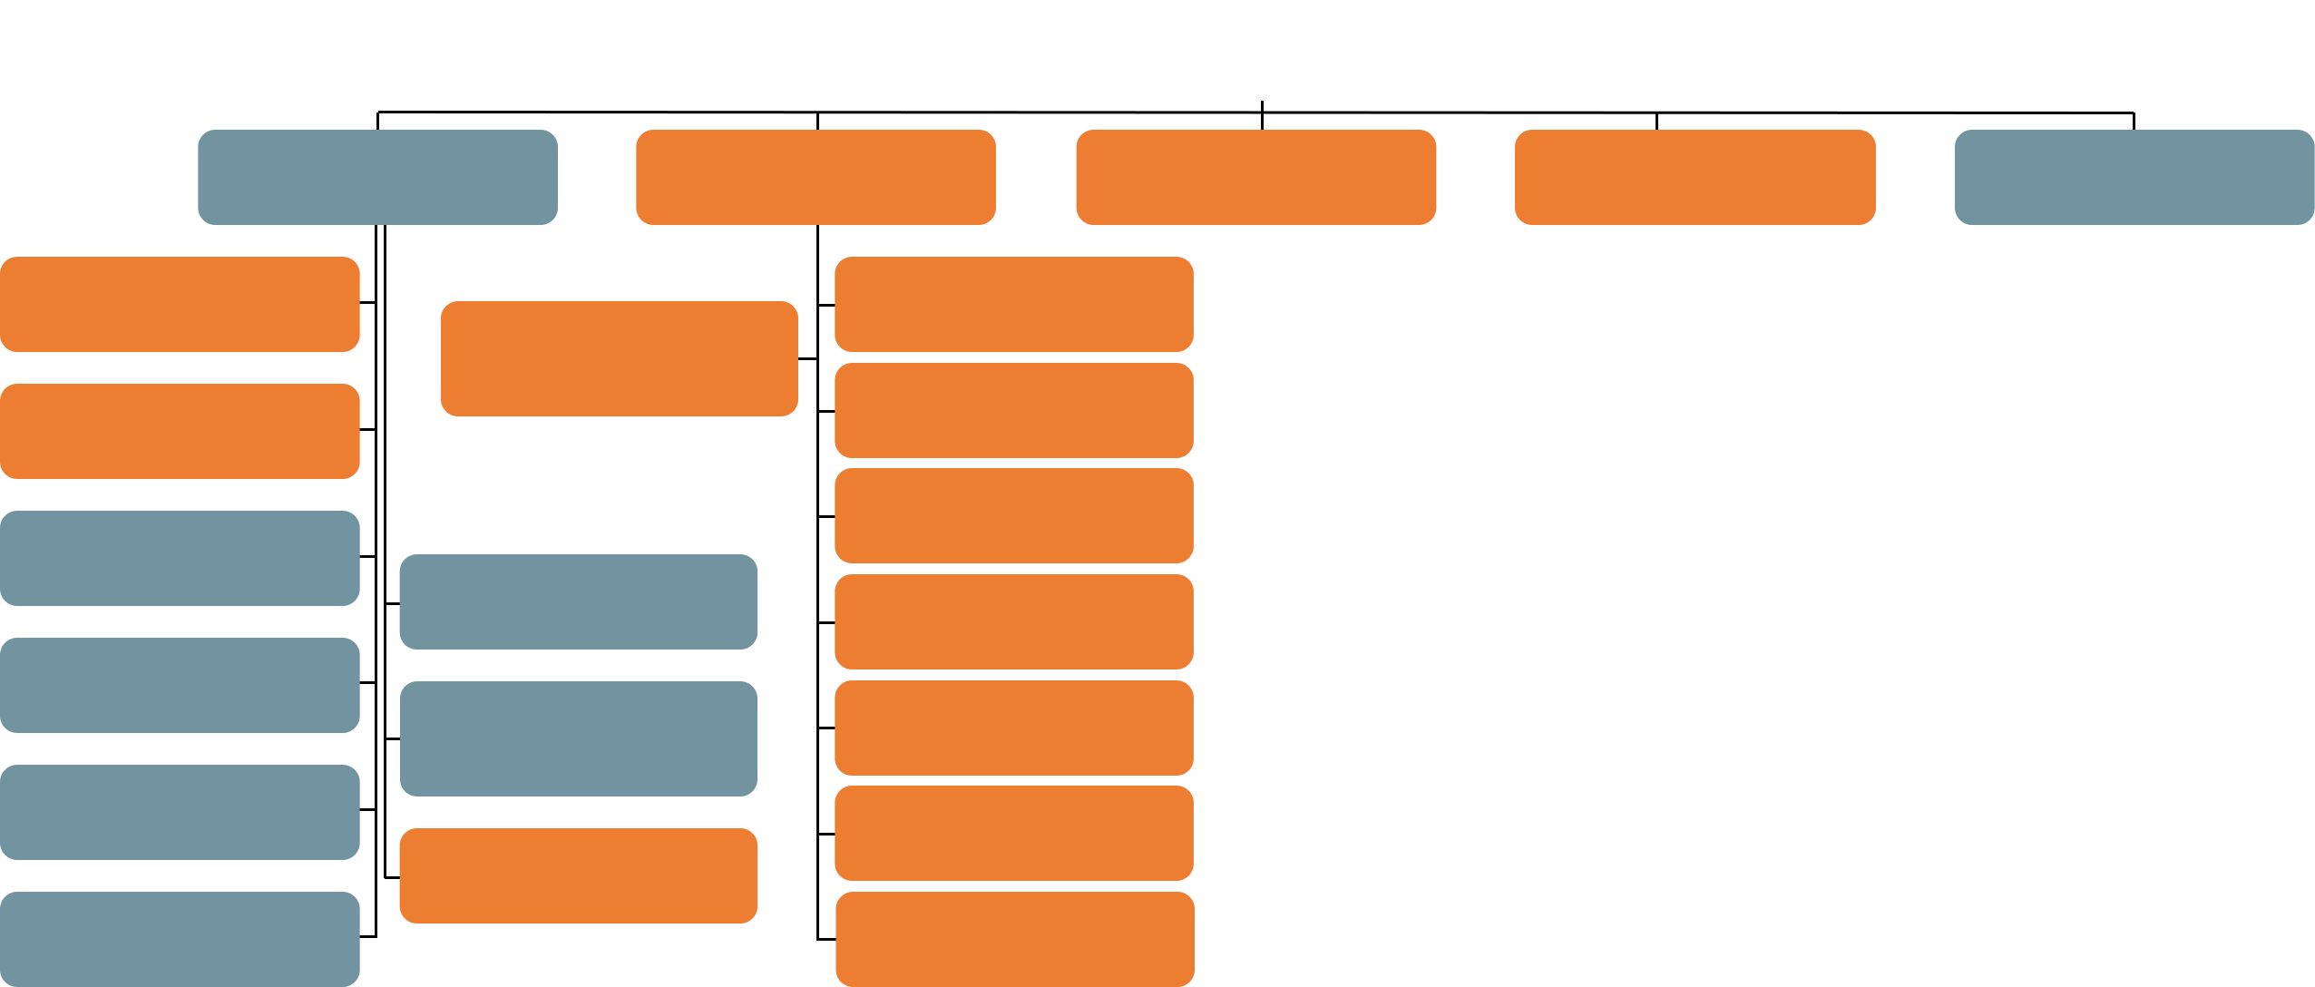

Patients with certain types of fibrosing ILDs have the potential to develop a progressive phenotype^{1,2}
A1
ILDs
ILDs
Idiopathic interstitial pneumonias
Autoimmune ILDs
Hypersensitivity pneumonitis
Sarcoidosis
Other ILDs
Idiopathic pulmonary fibrosis
Systemic sclerosis ILD
Lymphangioleiomyomatosis
Langerhans cell histiocytosis
Drug-associated ILD
Other exposure ILDs
Vasculitis/granulomatosis ILDs
Other rare ILDs
Interstitial pneumonia with autoimmune features
Idiopathic non-specific interstital pneumonia
Rheumatoid arthritis ILD
Polymyositis and dermatomyositis ILD
Respiratory bronchiolitis-interstitial lung disease
Idiopathic lymphoid interstitial pneumonia
Mixed connective tissue disease ILD
Desquamative interstitial pneumonia
Idiopathic pleuroparenchymal fibroelastosis
Sjörgen’s syndrome ILD
Cryptogenic organizing pneumonia
Systemic lupus erythematosus ILD
Unclassifiable IIPs
Acute interstitial pneumonia
Other connective tissue disease ILDs
ILD=Interstitial Lung Disease; HP=Hypersensitivity Pneumonitis; iNSIP=Idiopathic Non-Specific Interstitial Pneumonia; 1. Cottin V, Hirani NA, Hotchkin DL, et al. Presentation, diagnosis and clinical course of the spectrum of progressive-fibrosing interstitial lung diseases. Eur Respir Rev 2018;27(150):180076; 2. Cottin V, Wollin L, Fischer A, et al. Fibrosing interstitial lung diseases: knowns and unknowns. Eur Respir Rev. 2019;28(151):180100.
Notes:
Orange: fibrosing ILDs that are known to have the potential to develop a progressive phenotype^{1,2}
The progressive phenotype may also occur in other fibrosing ILDs (rare, unknown)

Slide 5
Accurate ILD diagnosis by a multidisciplinary team is crucial to inform prognosis and determine optimal management approaches
G3
ILD
F-ILD
The management of patients with fibrosing ILDs requires a multidisciplinary and individualized approach¹
Key
Manage inflammation
Identify/avoid
Manage fibrosis
EXPOSURE
INFLAMMATION
FIBROSIS
Inflammation and fibrosis
can also co-exist²
Exposure, inflammation and fibrosis profiles in fibrosing ILDs
IPF
CTD-ILD
Diagnosis enables management of non-ILD manifestations³
HP
Diagnosis enables identification and removal of the suspected inciting antigen^{3,4}
1. Nambiar AM, Walker CM, Sparks JA. Monitoring and management of fibrosing interstitial lung diseases: a narrative review for practicing clinicians. Ther Adv Respir Dis. 2021;15:17534666211039771; 2. Wells AU, Denton CP. Interstitial lung disease in connective tissue disease--mechanisms and management. Nat Rev Rheumatol. 2014;10(12):728-39; 3. Wells AU, Flaherty KR, Brown KK, et al. Nintedanib in patients with progressive fibrosing interstitial lung diseases—subgroup analyses by interstitial lung disease diagnosis in the INBUILD trial: a randomised, double-blind, placebo-controlled, parallel-group trial. Lancet Respir Med. 2020;8(5):453-60; 4. Wongkarnjana A, Scallan C, Kolb MRJ. Progressive fibrosing interstitial lung disease: treatable traits and therapeutic strategies. Curr Opin Pulm Med. 2020;26(5):436-42.

Slide 6
ILDs have shared pathology and clinical features¹
A2
In 2018, the IPF Consensus Working Group suggested that IPF and non-IPF ILDs with a progressive phenotype should be considered together as a single patient cohort, due to the shared pathology and clinical features¹
ILDs
In 2022, the ATS/ERS/JRS/ALAT guideline adopted the term PPF instead of PF-ILD because:²
CTD-ILDs
Exposure related ILDs
1) Disease progression is the result of PPF beyond the interstitial space in the lung parenchyma
HP
Progressive fibrosing ILDs
Sarcoidosis
2) Disease progression causes a clinical course similar to IPF
Non-IPF IIPs
Other ILDs
3) PPF is simple and compatible with the broadly used
term “pulmonary fibrosis” that is well known and currently used by both clinicians and patients
IPF
Incorporating the term “phenotype” was considered but implies that there is an identified genotype
Figure adapted from Kolb and Vašáková. Respir Res. 2019;20(1):57.³
CTD=Connective Tissue Disease; 1. Wells AU, Flaherty KR, Brown KK, et al. Nintedanib in patients with progressive fibrosing interstitial lung diseases—subgroup analyses by interstitial lung disease diagnosis in the INBUILD trial: a randomised, double-blind, placebo-controlled, parallel-group trial. Lancet Respir Med. 2020;8(5):453-60; 2. Raghu G, Remy-Jardin M, Richeldi L, et al. Idiopathic Pulmonary Fibrosis (an Update) and Progressive Pulmonary Fibrosis in Adults: An Official ATS/ERS/JRS/ALAT Clinical Practice Guideline. Am J Respir Crit Care Med. 2022;205(9):e18-e47; 3. Kolb M, Vašáková M. The natural history of progressive fibrosing interstitial lung diseases. Respir Res. 2019;20(1):57.
Notes:
The guideline committee considered other terms. They contemplated whether to maintain the termused in a hallmark clinical
trial, “progressive fibrosing ILD,” but opted to adopt the term“PPF” instead because 1) disease progression is the result of
PPF beyond the interstitial space in the lung parenchyma; 2) disease progression causes a clinical course similar to IPF; and 3) PPF is
simple and compatiblewith the broadly used term that is well known and currently used by both clinicians and patients, “pulmonary
fibrosis.” The committee also considered incorporating the term “phenotype” (e.g., progressive fibrotic phenotype). However,
“phenotype” implies that there is an identified genotype, but there is no known genotype associated with PPF. The
committee was not in favor of using “clinical phenotype,” because this was unlikely to be distinguished from“phenotype” bymost
clinicians.

Slide 7






Patients suffering from progressive pulmonary fibrosis continue to progress despite conventional treatment directed at the underlying diagnosis^{1,2}
A3
Physician
PPF is:
... progressive, reflected by worsening of symptoms and lung function, and increasing fibrosis on chest images^{2,3}
... self-sustaining^{3,4}
... independent of original clinical association or trigger³
... variable and unpredictable in its disease course, ranging from stable to quickly progressing^{2,4-5}
... may ultimately lead to organ malfunction, disruption of gas exchange and death from respiratory failure⁶
PPF=Pulmonary Progressive Fibrosis; 1. George PM, Spagnolo P, Kreuter M, et al. Progressive fibrosing interstitial lung disease: clinical uncertainties, consensus recommendations, and research priorities. Lancet Respir Med. 2020;8(9):925-34; 2. Raghu G, Remy-Jardin M, Richeldi L, et al. Idiopathic Pulmonary Fibrosis (an Update) and Progressive Pulmonary Fibrosis in Adults: An Official ATS/ERS/JRS/ALAT Clinical Practice Guideline. Am J Respir Crit Care Med. 2022;205(9):e18-e47; 3. Flaherty KR, Brown KK, Wells AU, et al. Design of the PF-ILD trial: a double-blind, randomised, placebo-controlled phase III trial of nintedanib in patients with progressive fibrosing interstitial lung disease. BMJ Open Respir Res. 2017;4(1):e000212 4. Nambiar AM, Walker CM, Sparks JA. Monitoring and management of fibrosing interstitial lung diseases: a narrative review for practicing clinicians. Ther Adv Respir Dis. 2021;15:17534666211039771; 5. Raghu G, Collard HR, Egan JJ, et al. An official ATS/ERS/JRS/ALAT statement: idiopathic pulmonary fibrosis: evidence-based guidelines for diagnosis and management. Am J Respir Crit Care Med. 2011;183(6):788-824; 6. Wynn TA. Integrating mechanisms of pulmonary fibrosis. J Exp Med. 2011;208(7):1339-50.
Notes:
Despite appropriate management, a proportion of patients will develop progressive and self-sustaining fibrosis in the lung, ultimately resulting in organ failure, worsening respiratory symptoms and exercise capacity, an impaired quality of life and an increased risk of death, similar to the disease course of IPF²

Slide 8
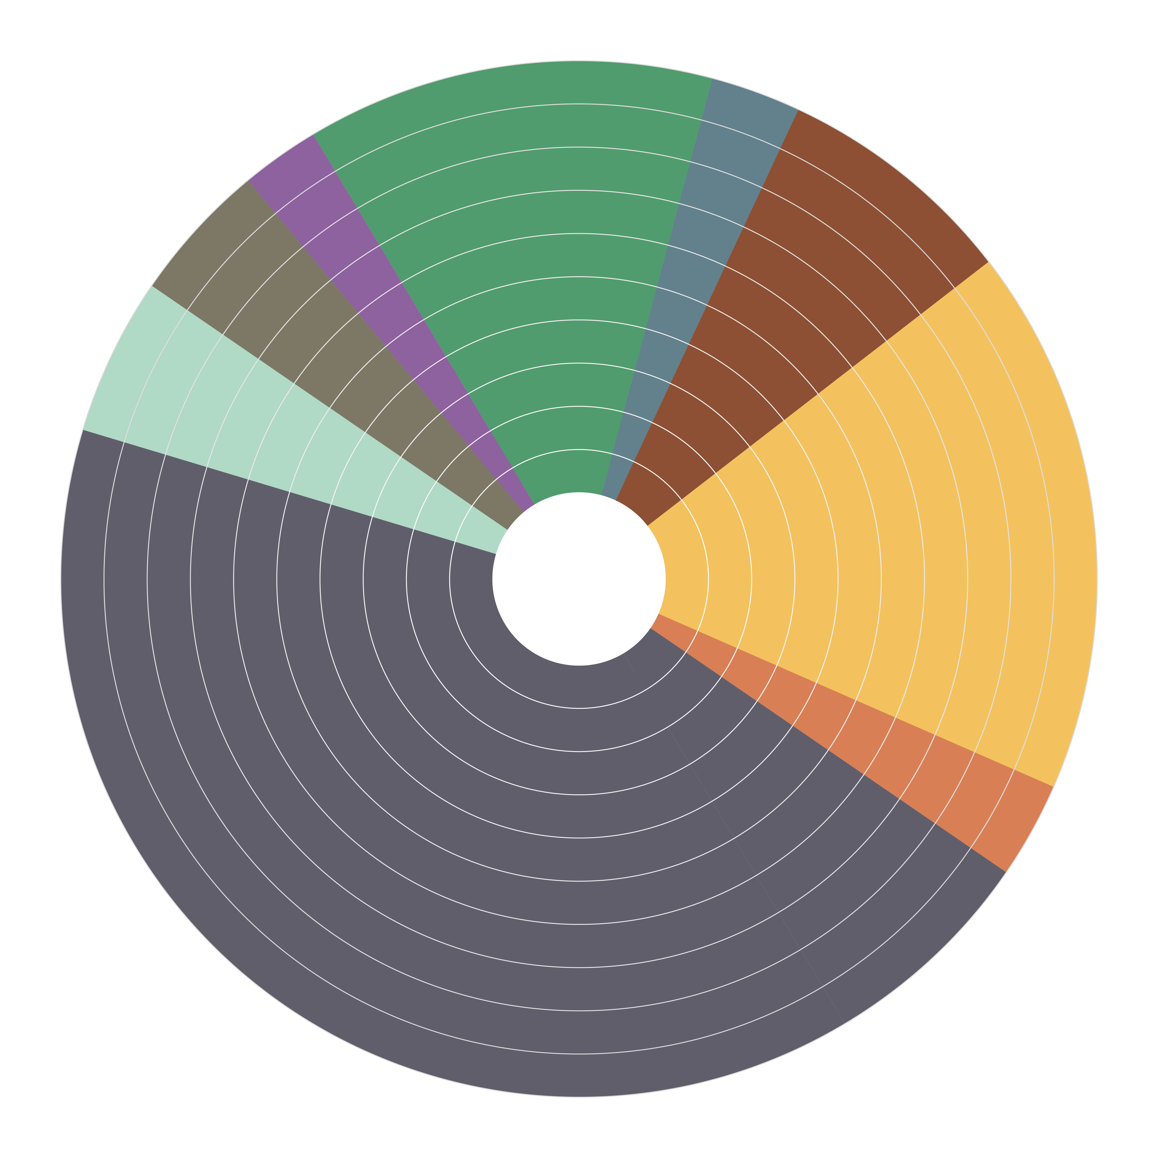
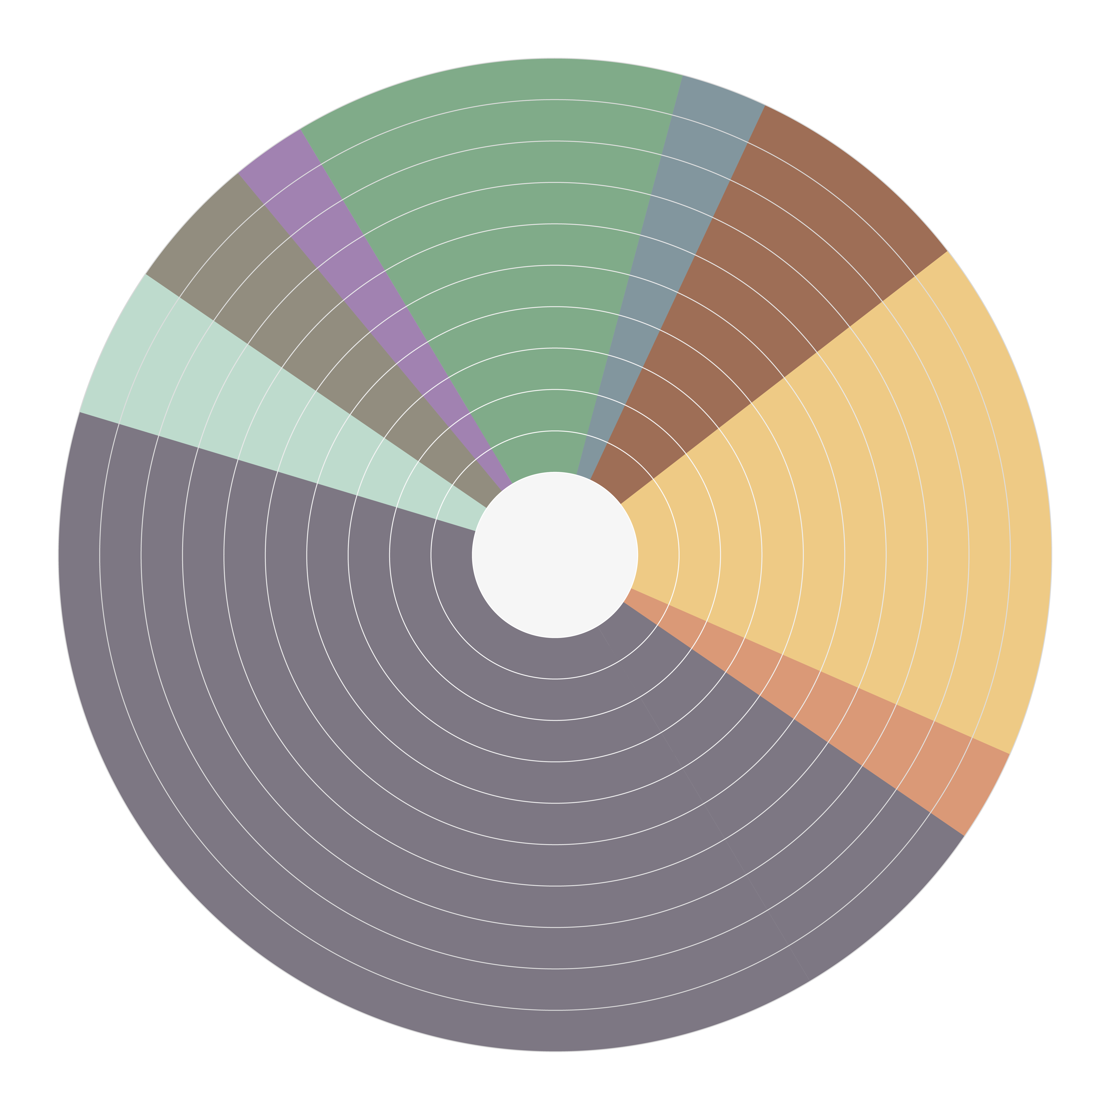
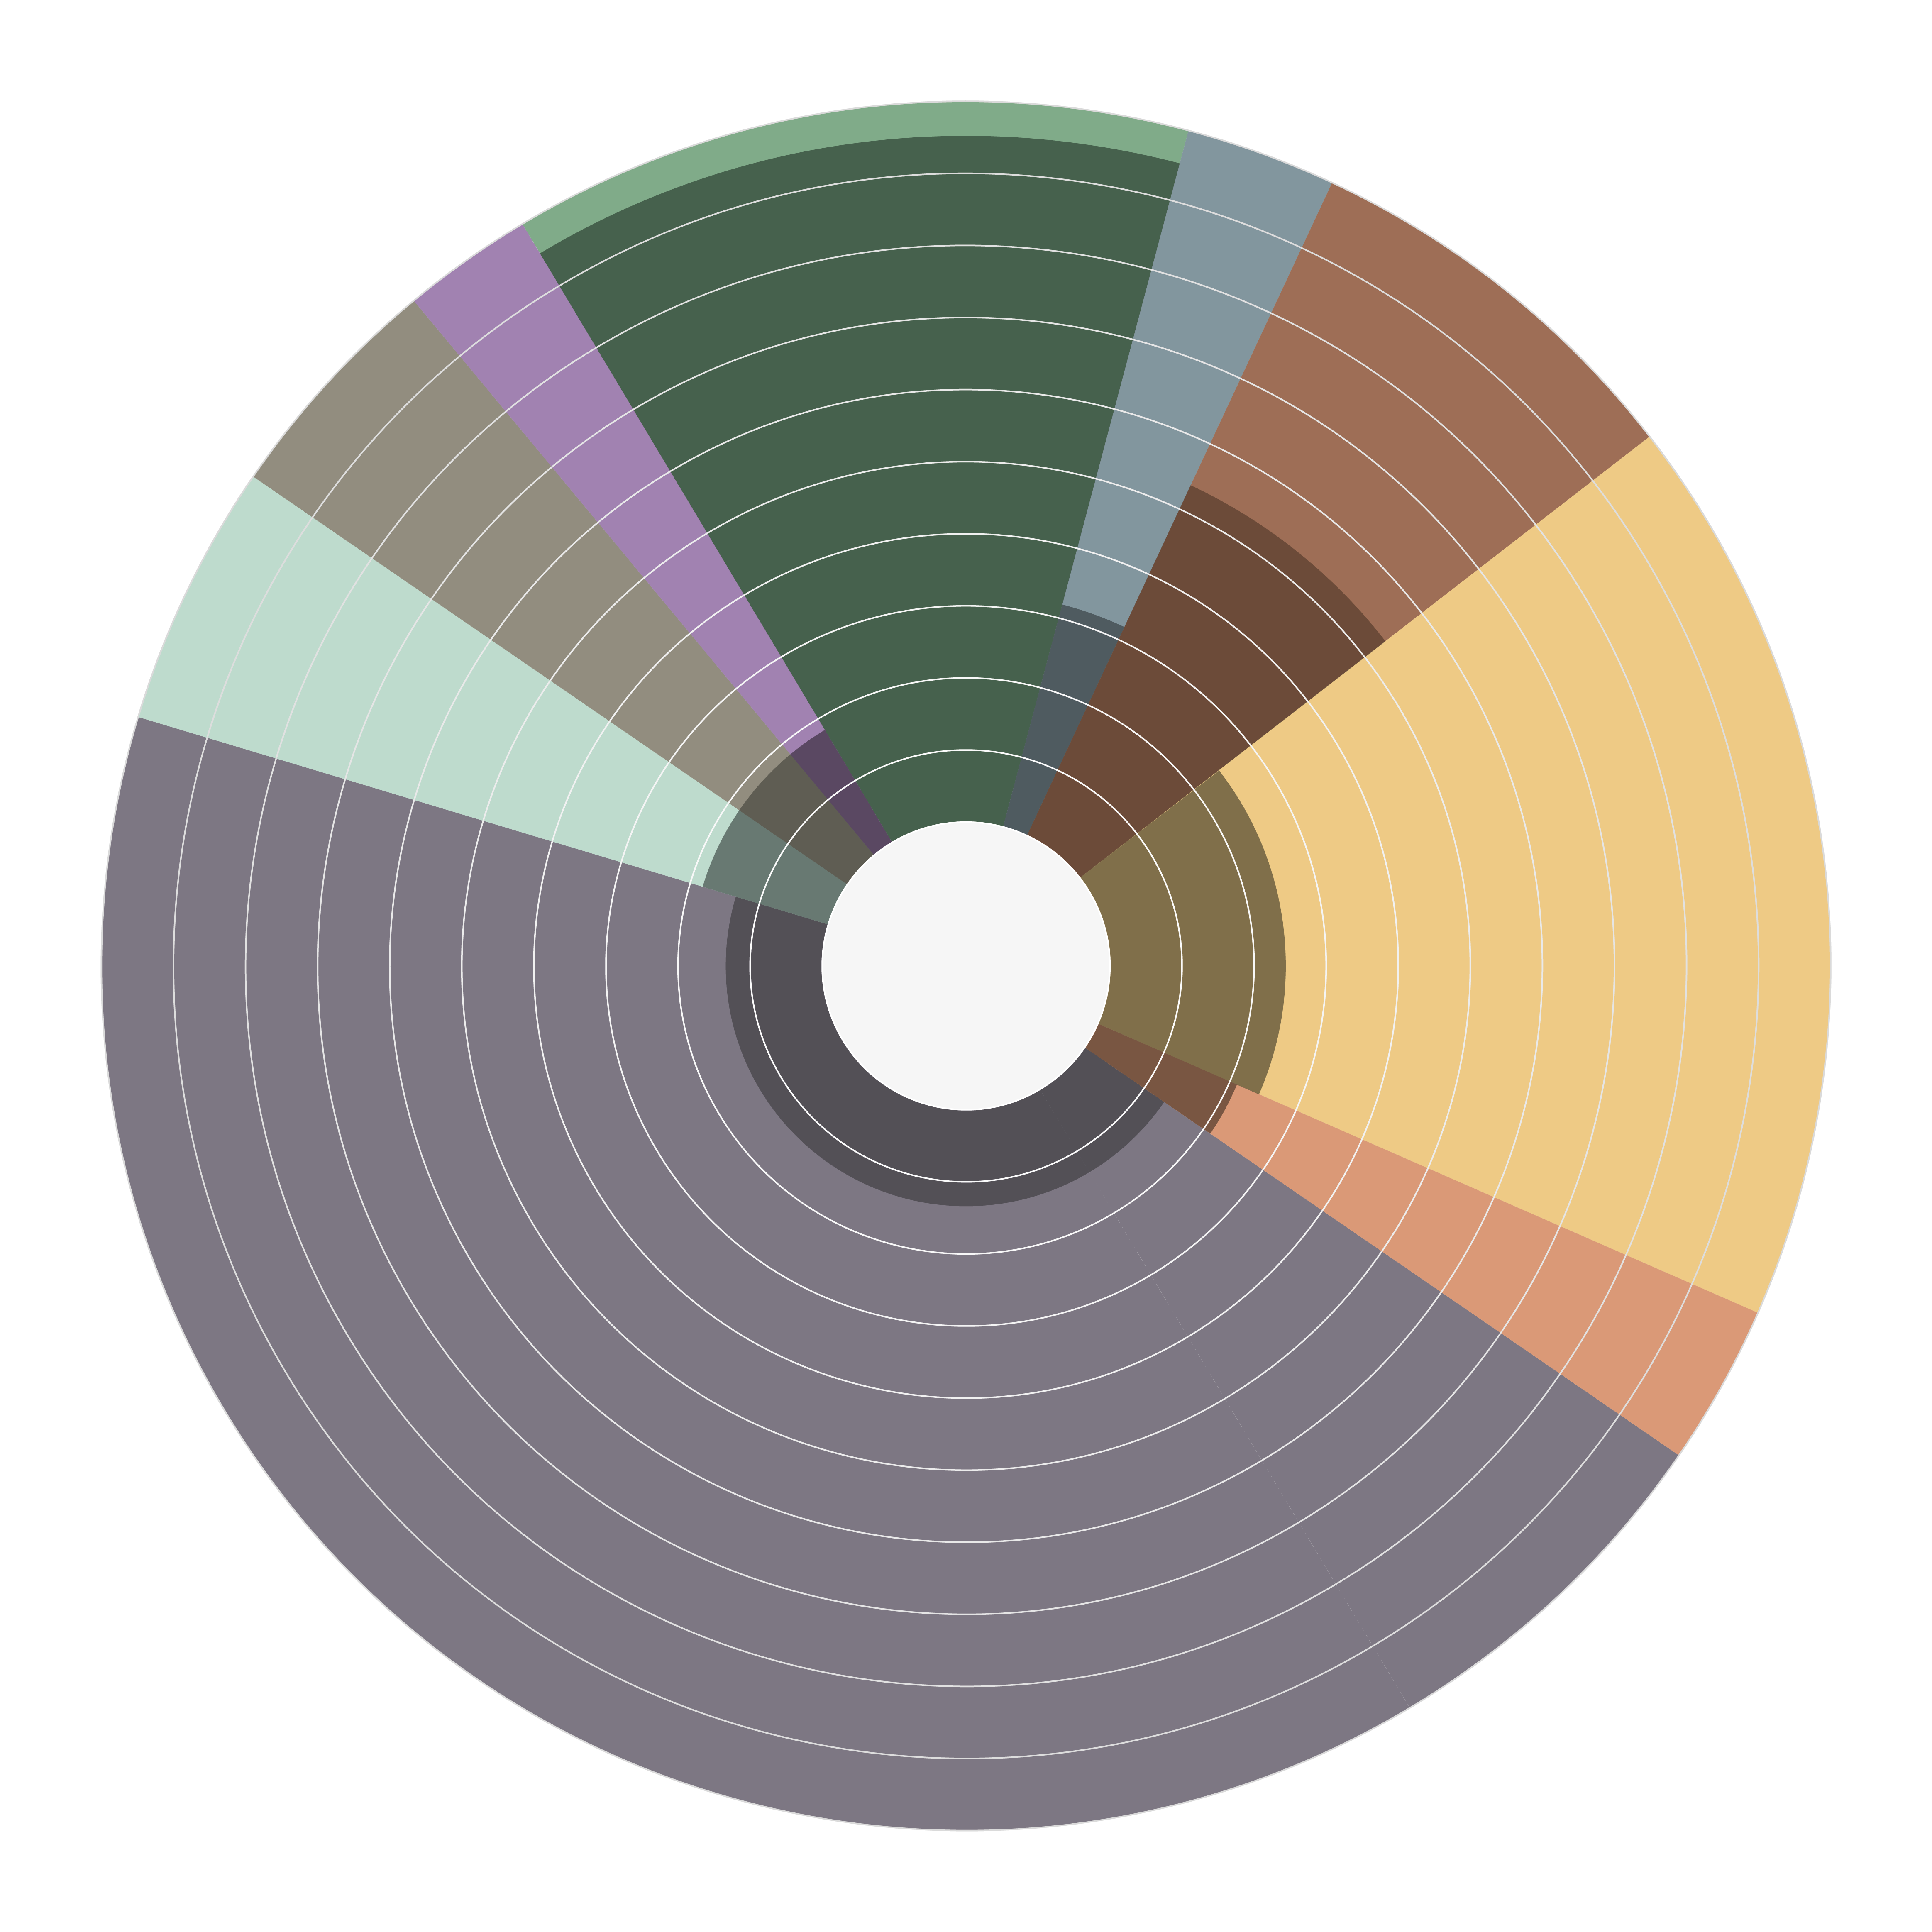
Prevalence of progressive fibrosis in most common F-ILDs^{1,2}
A7
F-ILD
It is estimated that up to 30% of patients with ILD develop a progressive phenotype^{2,3}
Other ILDs
2% | Prgr: 18%
12% | Prgr: 95%
IPF
Drug-induced ILD
4% | Prgr: 18%
Pneumoconiosis
5% | Prgr: 18%
3% | Prgr: 32%
Idiopathic NSIP
8% | Prgr: 53%
Unclassifiable
ILD
Almost 40% of SSc-ILD and RA-ILD patients develop a progressive phenotype.³
After IPF, a progressive fibrotic phenotype is most common in patients with unclassifiable ILD, CTD-ILDs and HP.^{1,2}
18% | Prgr: 24%
CTD-ILD
Sarcoidosis
45% | Prgr: 13%
3% | Prgr: 21%
cHP
These data denote the prevalence of ILDs in Europe and the USA, adapted from Wijsenbeek et al. 2020.¹ Prevalence of ILD varies and depends on the study methodology/diagnostic criteria used.
Outer circle and percentages denote prevalence of ILDs;
Inner circle and percentages denote the proportion of each ILD estimated to develop the progressive phenotype of fibrosing ILD¹
F-ILD=Fibrosing ILD; cHP=Chronic Hypersensitivity Pneumonitis; Prgr=Progression; SSc=Systemic Sclerosis; RA=Rheumatoid Arthritis; 1. Wijsenbeek M, Cottin V. Spectrum of fibrotic lung diseases. N Engl J Med. 2020;383(10):958-68; 2. Hilberg O, Hoffmann-Vold AM, Smith V, et al. Epidemiology of ILDs and their progressive-fibrosing behaviour in six European countries. ERJ Open Res. 2022;8:00597-2021; 3. Duchemann B, Annesi-Maesano I, Jacobe de Naurois C, et al. Prevalence and incidence of interstitial lung diseases in a multi-ethnic county of Greater Paris. Eur Respir J. 2017;50(2):1602419.

Slide 9
The proportion of PPF for every ILD¹
A8
ILDs other than IPF
IIP
Autoimmune-ILDs
Exposure related
ILDs with cysts and/or airspace filling
Sarcoidosis
iNSIP
COP
RA
HP
LCH
iPPFE
iLIP
SSc
Occupational
Asbestosis
Silicosis
Coal miner
Berylliosis
And many others
Lymphoproliferative
AIP
iDIP
AIP
MCTD
PAP
AFOP
Myositis†
LAM
Unclassifiable
Eosinophilic*
Sjörgens
Medication
Others
Vasculitis
Radiation
SLE
Illicit drugs
Others
Post infectious
RBILD‡
Estimated proportion of PPF
1. Raghu G, Remy-Jardin M, Richeldi L, et al. Idiopathic Pulmonary Fibrosis (an Update) and Progressive Pulmonary Fibrosis in Adults: An Official ATS/ERS/JRS/ALAT Clinical Practice Guideline. Am J Respir Crit Care Med. 2022;205(9):e18-e47; *The committee acknowledges that eosinophilic pneumonia of unknown cause was not included in the IIP classification; †Myositis includes PM/DM/antisynthetase syndrome, which may be amyopathic; ‡Although RBILD is acknowledged to be a consequence of exposure to cigarette smoke in virtually all patients with RBILD, RBILD and DIP often coexist; AFOP=Acute Fibrinous and Organizing Pneumonia; AIP=Acute Interstitial Pneumonia;
COP=Cryptogenic Organizing Pneumonia; DM=Dermatomyositis; IIP=Idiopathic Interstitial Pneumonia; iLIP=Idiopathic Lymphoid Interstitial Pneumonia; iPPFE=Idiopathic Pleuroparenchymal Fibroelastosis; LAM=Lymphangioleiomyomatosis; LCH=Langerhans Cell Histiocytosis; MCTD=Mixed Connective Tissue Disease; PAP=Pulmonary Alveolar Proteinosis; PM=Polymyositis; SLE=Systemic Lupus Erythematosus.
Notes:
Interstitial lung diseases (ILDs) manifesting progressive pulmonary fibrosis (PPF), developed using consensus by discussion. The
shaded area represents the estimated proportion of patients with various types of ILD who manifest PPF. Note that idiopathic pulmonary
fibrosis (IPF) is not included in the figure, because it is excluded from the definition of PPF. While virtually all patients with IPF will manifest
disease progression similar to PPF, the proportion of patients with ILDs other than IPF who manifest PPF is based on the consensus of
opinions and the perception of the international committee. There are no data to provide the exact or estimated proportion of patients
manifesting PPF in ILDs, other than IPF.

Slide 10


ILD journey
ILD
associated condition
Risk factors for ILD
Screening for ILD^{1,2}
Symptoms may lead to suspicion of ILD
Diagnosis of ILD
Holistic care⁴
F-ILD
ASSESS
BACKING
Risk factors for
ILD Progression
Monitoring for progression^{1,3}
Symptoms may lead to suspicion of progression
COMORBIDITIES
AND
COMFORT CARE
Disease-
modifying
treatment
Detection of progression
PPF
End-of-life
care
Progression
Monitoring progression^{1,3}
1. Nambiar AM, Walker CM, Sparks JA. Monitoring and management of fibrosing interstitial lung diseases: a narrative review for practicing clinicians. Ther Adv Respir Dis. 2021;15:17534666211039771; 2. Bosello SL, Beretta L, Del Papa N, et al. Interstitial Lung Disease Associated With Autoimmune Rheumatic Diseases: Checklists for Clinical Practice. Front Med (Lausanne). 2021;8:732761; 3. Wijsenbeek M, Kreuter M, Olson A, et al. Progressive fibrosing interstitial lung diseases: current practice in diagnosis and management. Curr Med Res Opin. 2019;35(11):2015-24; 4. van Manen MJ, Geelhoed JJ, Tak NC, et al. Optimizing quality of life in patients with idiopathic pulmonary fibrosis. Ther Adv Respir Dis. 2017;11(3):157-69.
Notes:
This series of presentations focuses on the ILD journey from screening for ILD in patients at high risk, such as patients with systemic sclerosis and rheumatoid arthritis, to screening for progression of ILD in patients who have developed fibrosing ILD to monitoring progression in patients who have progressive fibrosing ILD. Across this whole patient journey, holistic care, focusing on the needs of the patients and their caregivers, is essential. In session 4 this latter topic will be covered in detail.

Slide 11
PPF causes irreversible scarring and lung damage. Once lung function is lost, it is lost forever¹
Prognosis
PPF
1. Molina-Molina M, Aburto M, Acosta O, et al. Importance of early diagnosis and treatment in idiopathic pulmonary fibrosis. Expert Rev Respir Med. 2018;12(7):537-9.

Slide 12
The natural course of untreated IPF is characterized by progression to respiratory failure^{1,2}
B1
IPF progression to death may be…
Onset of
disease
rapid (line A)
moderate (line C)
slow (line D)
mixed (curve B)…
…with periods of relative stability interposed with periods of acute decline
(stars)³
Subclinical period
Onset of
symptoms
Pre-diagnosis period
Diagnosis
A
B
C
D
Disease progression
Post-diagnosis period
Death
1
2
3
4
5
6
Time (years)
1. Raghu G, Collard HR, Egan JJ, et al. An official ATS/ERS/JRS/ALAT statement: idiopathic pulmonary fibrosis: evidence-based guidelines for diagnosis and management. Am J Respir Crit Care Med. 2011;183(6):788-824; 2. Maher TM, Strek ME. Antifibrotic therapy for idiopathic pulmonary fibrosis: time to treat. Respir Res. 2019;20(1):205; 3. Ley B, Collard HR, King Jr TE. Clinical course and prediction of survival in idiopathic pulmonary fibrosis. Am J Respir Crit Care Med. 2011;183(4):431-40.

Slide 13
Patients with IPF have a similar decline in FVC than those with other PF-ILDs¹
B2
INPULSIS (IPF; n=417)
INBUILD (PF-ILD overall population; n=325)
INBUILD (PF-ILD with UIP-like pattern on HRCT; n=202)
INBUILD (PF-ILD with other fibrotic patterns on HRCT; n=123)
2
4
6
12
24
36
Untreated patients with progressive fibrosing ILDs in the INBUILD® trial had a similar clinical course
to untreated patients with IPF in the INPULSIS® trials, regardless of their fibrotic pattern on HRCT
FVC=Forced Vital Capacity; PF-ILD=Progressive Fibrosing ILD; HRCT=High-Resolution Computed Tomography; SE=Standard Error; UIP=Usual Interstitial Pneumonia; 1. Brown KK, Martinez FJ, Walsh SLF, et al. The natural history of progressive fibrosing interstitial lung diseases. Eur Respir J. 2020:2000085.
Notes:
The INBUILD® trial studied patients with fibrosing ILDs other than IPF, who were grouped together based on the progressive behavior of their ILD¹
Progression was defined as ≥1 of the following in the past 24 months despite conventional treatment:¹
Relative FVC decline ≥10% predicted; relative FVC decline 5–9% predicted and worsening of respiratory symptoms; relative FVC decline 5–9% predicted and increased extent of fibrosis on HRCT; worsening of respiratory symptoms and an increased extent of fibrosis
Enrolled patients had a range of underlying ILDs and fibrotic patterns on HRCT:
Hypersensitivity pneumonitis (26.1%), autoimmune ILDs (25.6%), idiopathic NSIP (18.9%), unclassifiable IIP (17.2%), other ILDs (12.2%)²
UIP-like fibrotic pattern on HRCT (62.1%), other fibrotic patterns on HRCT (37.9%)¹
Untreated patients with progressive fibrosing ILDs in the INBUILD® trial overall population had a similar clinical course to untreated patients with IPF in the INPULSIS® trials, reinforcing the clinical relevance of the progressive phenotype of fibrosing ILDs, including the commonalities with IPF³
The diagnosis of IPF is confirmed in part by the radiological pattern of UIP;⁴ other ILDs may feature one of several radiological patterns of fibrosis, and in some conditions the presence of a UIP pattern on HRCT indicates poor prognosis (eg RA-ILD, IPAF)^{5–9}
Consistent with these findings, in INBUILD®, the rate of FVC decline and mortality over 52 weeks were greater in patients with a UIP-like fibrotic pattern on HRCT than patients with other fibrotic patterns³
Nevertheless, the rate of FVC decline in patients with other fibrotic patterns was substantial and similar to the disease course of untreated IPF,³ further reinforcing the clinical relevance of the progressive phenotype of fibrosing ILD

Slide 14
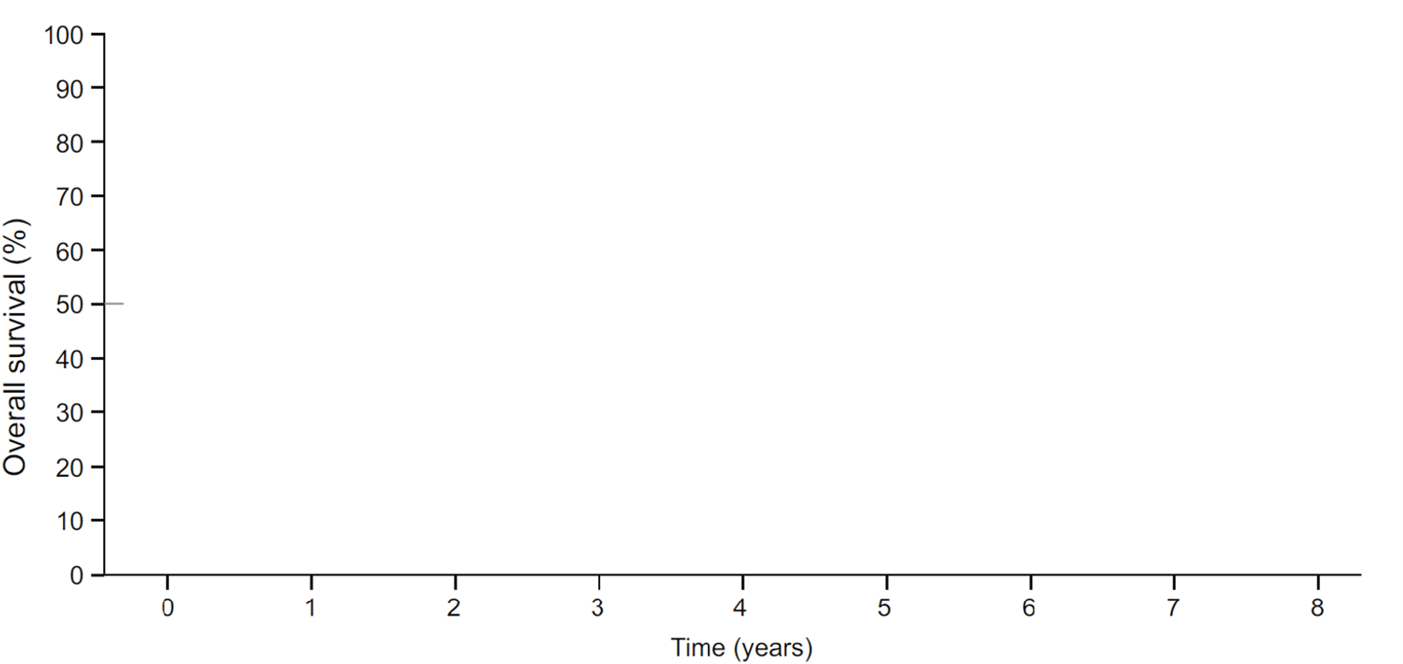
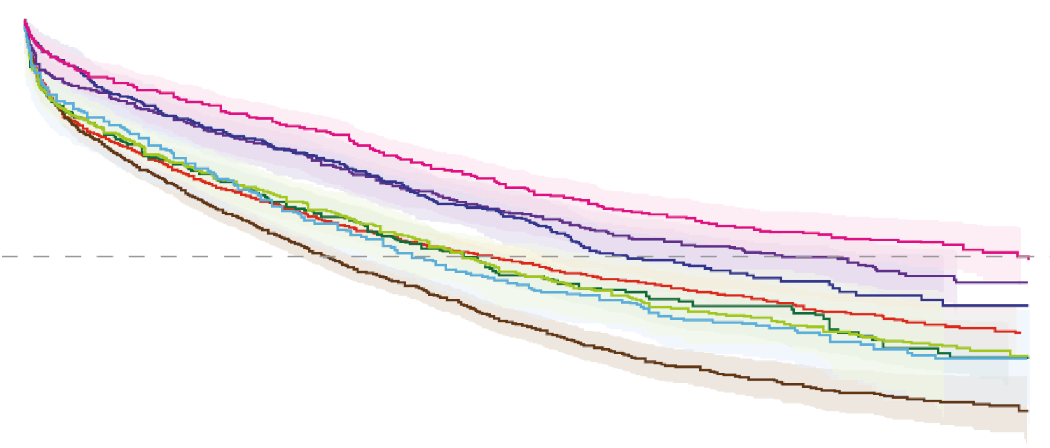
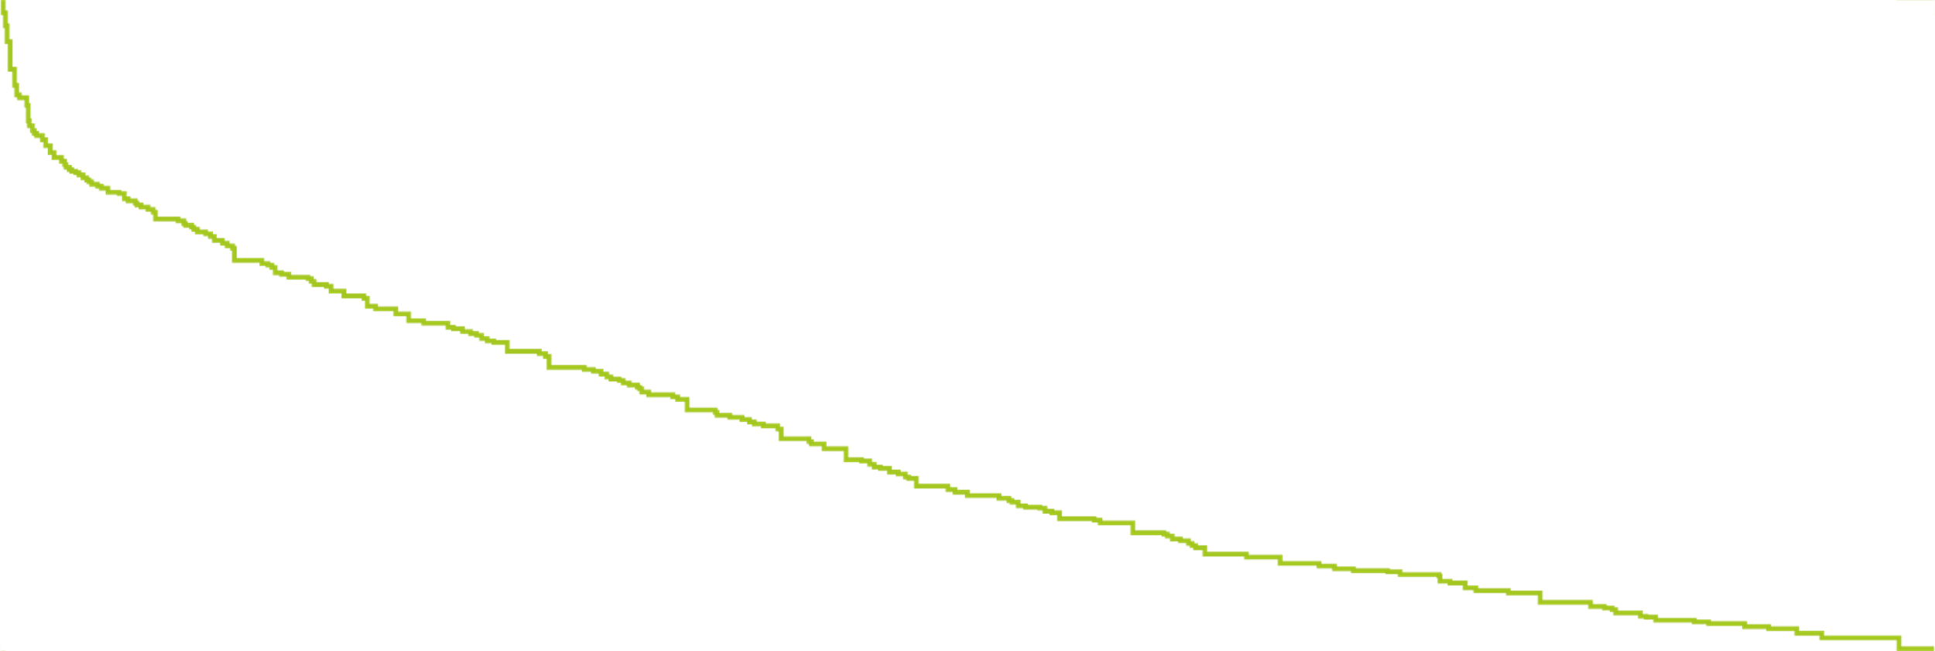
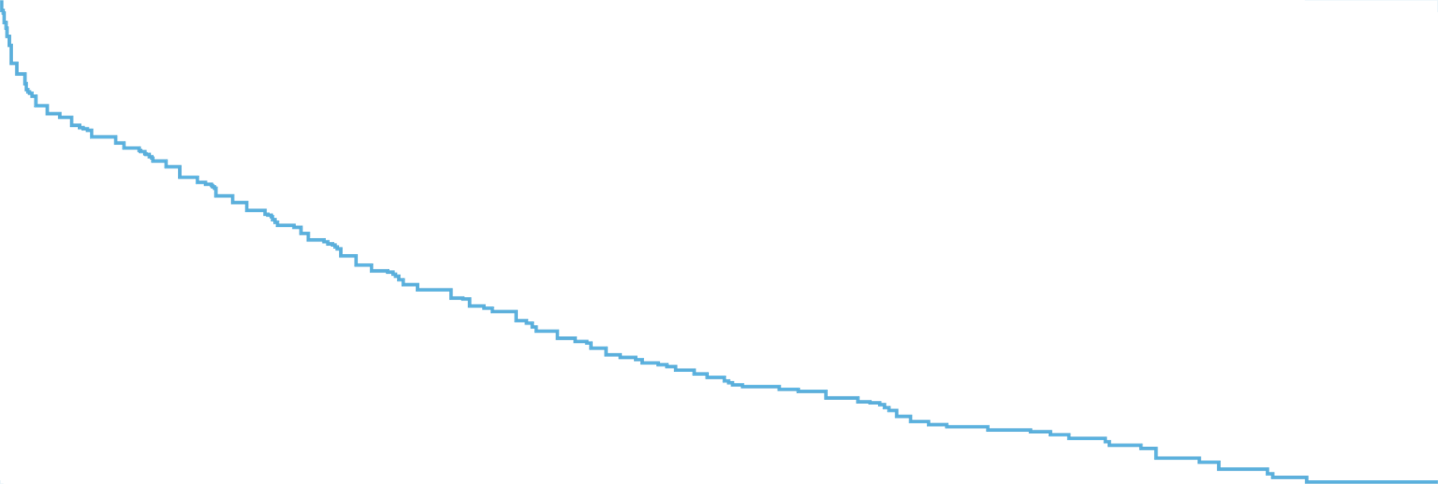
PPF is associated with poor prognosis, independent of the primary condition¹⁻³
B3
Physicians estimate that patients with
IPF and other progressive fibrosing ILDs have a mean survival of 4-5 years after initial diagnosis of ILD³
Lower FVC at baseline is an established
predictor of early mortality in
patients with progressive
fibrosing ILDs²
Survival in different progressive fibrosing ILDs*⁴
Hypersensitivity pneumonitis
Idiopathic interstitial pneumonia
MCTD-ILD
Other exposure-related ILD
Other autoimmune
RA-ILD
SSc-ILD
Sarcoidosis-ILD
*After adjusting for age, sex and smoking (HR 2.86; 95% Cl, 1.96 to 4.12; P<0.001).
1. Wells AU, Brown KK, Flaherty KR, et al. What's in a name? That which we call IPF, by any other name would act the same. Eur Respir J. 2018;51(5):1800692; 2. Kolb M, Vašáková M. The natural history of progressive fibrosing interstitial lung diseases. Respir Res. 2019;20(1):57; 3. Wijsenbeek M, Kreuter M, Olson A, et al. Progressive fibrosing interstitial lung diseases: current practice in diagnosis and management. Curr Med Res Opin. 2019;35(11):2015-24; 4. Nasser M, Larrieu S, Boussel L, et al. Estimates of epidemiology, mortality and disease burden associated with progressive fibrosing interstitial lung disease in France (the PROGRESS study). Respir Res. 2021;22(1):162.

Slide 15





Acute exacerbations can occur at any time in patients with PPF¹
B4
Acute exacerbations in PPF are associated with significant morbidity and mortality¹
The annual incidence of acute exacerbations in IPF is 5-19%
In other ILDs with PPF, the highest rates are observed in patients with a histological or radiological UIP pattern
The post-exacerbation mortality
ranges from 33-83%
The hospital mortality rate is
50-100% in CTD-ILD
75-100% in patients with hypersensitivity pneumonitis
1. Kolb M, Bondue B, Pesci A, et al. Acute exacerbations of progressive-fibrosing interstitial lung diseases. Eur Respir Rev. 2018;27(150):180071.

Slide 16
A decline in FVC is associated with worse survival^{1,2}
B5
Lower baseline FVC and Dl_{CO}, and a decline in FVC > 10% are established predictors of mortality among different ILDs with PPF, including IPF, RA-ILD and SSc-ILD¹
Also small declines in FVC have been associated with worse prognosis¹
SSc-ILD
IPF
80
100
Improved >10%
Decline 0-10%
70
80
Decline >10%
60
Survived >8 years (n=37)
FVC % predicted
Survived 4-8 years (n=19)
60
50
SURVIVAL %
“Small” annual declines in FVC may become substantial when summed over a period of years¹
40
40
30
Survived >4 years (n=25)
20
20
0
0
2
4
6
8
10
12
0
2
4
6
8
10
12
Years since diagnosis
Years since diagnosis
DL_{CO}=Diffusing Capacity of the Lungs for Carbon Monoxide; 1. Kolb M, Vašáková M. The natural history of progressive fibrosing interstitial lung diseases. Respir Res. 2019;20(1):57; 2. Ley B, Collard HR, King Jr TE. Clinical course and prediction of survival in idiopathic pulmonary fibrosis. Am J Respir Crit Care Med. 2011;183(4):431-40.
Notes:
“Small” annual declines in FVC may become substantial when summed over a period of year¹ . This is particularly relevant when considering ILDs with a relatively early age of onset.
Left figure: Decline in FVC % predicted in patients with SSc-ILD categorized by survival time from ILD diagnosis¹
Right figure: Survival in IPF patients as a function of 6-month change in FVC²

Slide 17
The ATS/ERS/JRS/ALAT Clinical Practice Guideline of 2022 describes the definition of progressive pulmonary fibrosis
Criteria
for ILD progression

Slide 18




The definition of PPF in the guidelines of 2022 is different from the previously used INBUILD criteria used to define PF-ILD^{1,2}
C2
F-ILD
INBUILD criteria¹
Meeting >1 criteria of progression within 24 months
PPF guideline criteria²
Meeting >2 criteria within the past year, with no alternative explanation
A relative decline in FVC > 10% of predicted
Worsening respiratory symptoms
Worsening of respiratory symptoms
AND increased extent of fibrosis on HRCT
Physiological evidence of disease progression
Absolute decline in FVC ≥5%
Absolute decline in DL_{CO} ≥10% (corrected for Hb)
+
A relative decline in FVC between 5-10% of predicted AND either worsening of respiratory symptoms OR increased extent of fibrosis on HRCT
+
or
Radiological evidence of disease progressing
1. Flaherty KR, Wells AU, Cottin V, et al. Nintedanib in Progressive Fibrosing Interstitial Lung Diseases. N Engl J Med. 2019;381(18):1718-27; 2. Raghu G, Remy-Jardin M, Richeldi L, et al. Idiopathic Pulmonary Fibrosis (an Update) and Progressive Pulmonary Fibrosis in Adults: An Official ATS/ERS/JRS/ALAT Clinical Practice Guideline. Am J Respir Crit Care Med. 2022;205(9):e18-e47.
Notes:
Differences:
INBUILD® criteria require ≥1 measure
within 2 years, whereas the PPF guideline stipulates ≥2 criteria in the past year
INBUILD® criteria are based on
relative decline in FVC whereas the PPF guideline criteria use absolute decline in FVC
INBUILD® criteria count relative decline in FVC ≥10% predicted alone, but similar to the PPF guideline criteria, ≥5–<10% can be used when worsening respiratory symptoms or increased extent of fibrosis on HRCT are also present
The PPF criteria include absolute
decline in DLCO ≥10%
INBUILD® criteria do not provide
specific guidance on radiological progression, which is given in the PPF criteria

Slide 19
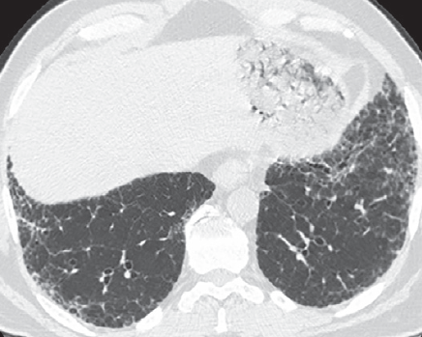
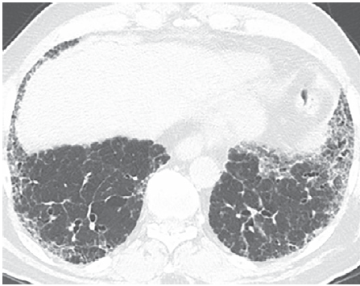
Radiological evidence of disease progression¹
C3
Radiological progression is defined as the presence of one
or more of the following criteria:
Increased extent or severity of traction bronchiectasis and
bronchiolectasis
New ground-glass opacity with traction bronchiectasis
New fine reticulation
Increased extent or increased coarseness of reticular abnormality
New or increased honeycombing
Increased lobar volume loss
Patient with IPF¹
Baseline
4 years later
Increased extent of abnormality
and traction bronchiectasis
Transverse, coronal, and sagittal contiguous HRCT sections of the initial and follow-up CT examinations should be compared side by side for assessing the percentage of lung volume containing fibrotic features¹
CT=Computed Tomography; 1. Raghu G, Remy-Jardin M, Richeldi L, et al. Idiopathic Pulmonary Fibrosis (an Update) and Progressive Pulmonary Fibrosis in Adults: An Official ATS/ERS/JRS/ALAT Clinical Practice Guideline. Am J Respir Crit Care Med. 2022;205(9):e18-e47.
Notes:
Baseline image shows moderately extensive reticular abnormality with traction bronchiectasis, with predominance in the subpleural
lower lung. Matched image 4 years later shows substantial increase in extent of abnormality and increased traction bronchiectasis

Slide 20
The presence of risk factors for ILD progression could help to inform monitoring strategy and frequency^{1,2}
Risk factors
ILD progression
1. Nambiar AM, Walker CM, Sparks JA. Monitoring and management of fibrosing interstitial lung diseases: a narrative review for practicing clinicians. Ther Adv Respir Dis. 2021;15:17534666211039771; 2. Bosello SL, Beretta L, Del Papa N, et al. Interstitial Lung Disease Associated With Autoimmune Rheumatic Diseases: Checklists for Clinical Practice. Front Med (Lausanne). 2021;8:732761.
Notes:
Nambiar AM, Walker CM, Sparks JA. Monitoring and management of fibrosing interstitial lung diseases: a narrative review for practicing clinicians. Ther Adv Respir Dis. 2021;15:17534666211039771

Slide 21


General risk factors for progressive fibrosis^{1,2}
D1
Risk factors could help predict future progression of ILD
Individual factors
Presence of a short telomere syndrome
Older age
HRCT
Fibrosis extent >20%
Honeycombing
UIP pattern of pulmonary fibrosis
Extensive traction bronchiectasis on HRCT
1. De Sadeleer LJ, Goos T, Yserbyt J, et al. Towards the Essence of Progressiveness: Bringing Progressive Fibrosing Interstitial Lung Disease (PF-ILD) to the Next Stage. J Clin Med. 2020;9(6):1722; 2. George PM, Spagnolo P, Kreuter M, et al. Progressive fibrosing interstitial lung disease: clinical uncertainties, consensus recommendations, and research priorities. Lancet Respir Med. 2020;8(9):925-34.
Notes:
Refer here to session 1

Slide 22

D2
Risk factors for a progressive phenotype in CTD-ILD
SSc-ILD
dcSSc
<7 years since diagnosis
Male sex
Black race
Anti–Scl-70 antibody positivity
Disease extent on CT >20%
Reduced FVC and DL_{CO}
Presence of reflux/dysphagia symptoms
Higher mRSS
Elevated inflammatory biomarkers
RA-ILD
Older age
Male sex
Disease extent on CT >20%
Honeycombing or a UIP pattern on CT
FVC <70%
Risk factors for progressive fibrosis
or death^{1,2}
dcSSc=Diffuse Cutaneous Systemic Sclerosis; mRSS=modified Rodnan skin score; 1. Wijsenbeek M, Cottin V. Spectrum of fibrotic lung diseases. N Engl J Med. 2020;383(10):958-68; 2. Bosello SL, Beretta L, Del Papa N, et al. Interstitial Lung Disease Associated With Autoimmune Rheumatic Diseases: Checklists for Clinical Practice. Front Med (Lausanne). 2021;8:732761.
Notes:
The risk of progressive ILD depends on the underlying autoimmune condition¹
Risk factors for progressive fibrosis or death in SSc-ILD include diffuse cutaneous involvement, a disease duration of <7 years, male sex, black race, the presence of anti–Scl-70 antibodies, a disease extent of >20% on CT and decreased lung function (ie reduced FVC and DL_{CO})¹
Risk factors for progressive fibrosis or death in RA-ILD include older age, male sex, a disease extent of >20% on CT, presence of honeycombing or a UIP pattern on CT and decreased lung function (ie FVC <70%)¹
Risk factors for progressive fibrosis or death in patients with ILD associated with idiopathic inflammatory myopathy (eg polymyositis and dermatomyositis) include anti-MDA5 antibodies and a UIP pattern on CT¹
Honeycombing on CT is a risk factor for progressive fibrosis or death in patients with ILD associated with primary Sjögren’s syndrome¹

Slide 23
Delays in detection of PPF can be deadly: a 5-10% reduction in FVC over 6 months significantly increases a patient’s risk of death¹
Monitoring for
progression
1. Cosgrove GP, Bianchi P, Danese S, et al. Barriers to timely diagnosis of interstitial lung disease in the real world: the INTENSITY survey. BMC Pulm Med. 2018;18(1):9.

Slide 24




Early and regular monitoring of ILD is important to detect the progressive fibrosing phenotype, as soon as possible
E1
It was estimated that it takes 9-12 months to
detect progressive fibrosis after it develops¹
Delays in detection of PPF can be deadly: a 5-10% reduction in FVC over 6 months significantly increases a patient’s risk of death²
Monitoring facilitates early detection of progressive fibrosis^{3,4}
Early identification allows early treatment of progressive fibrosis to slow down loss of lung function as much as possible²⁻⁸
ILD diagnosis
Identification of ILD with a
progressive phenotype as early as possible
Monitoring for progression
Appropriate treatment to stabilize or slow disease progression and irreversible loss of lung function
1. Wijsenbeek M, Kreuter M, Olson A, et al. Progressive fibrosing interstitial lung diseases: current practice in diagnosis and management. Curr Med Res Opin. 2019;35(11):2015-24; 2. Cosgrove GP, Bianchi P, Danese S, et al. Barriers to timely diagnosis of interstitial lung disease in the real world: the INTENSITY survey. BMC Pulm Med. 2018;18(1):9; 3. Nambiar AM, Walker CM, Sparks JA. Monitoring and management of fibrosing interstitial lung diseases: a narrative review for practicing clinicians. Ther Adv Respir Dis. 2021;15:17534666211039771; 4. Raghu G, Remy-Jardin M, Richeldi L, et al. Idiopathic Pulmonary Fibrosis (an Update) and Progressive Pulmonary Fibrosis in Adults: An Official ATS/ERS/JRS/ALAT Clinical Practice Guideline. Am J Respir Crit Care Med. 2022;205(9):e18-e47; 5. Cottin V, Hirani NA, Hotchkin DL, et al. Presentation, diagnosis and clinical course of the spectrum of progressive-fibrosing interstitial lung diseases. Eur Respir Rev. 2018;27(150):180076; 6. Walsh SL, Devaraj A, Enghelmayer JI, et al. Role of imaging in progressive-fibrosing interstitial lung diseases. Eur Respir Rev. 2018;27(150):180073; 7. Roofeh D, Jaafar S, Vummidi D, et al. Management of systemic sclerosis-associated interstitial lung disease. Curr Opin Rheumatol. 2019;31(3):241-9; 8. Wells AU, Flaherty KR, Brown KK, et al. Nintedanib in patients with progressive fibrosing interstitial lung diseases—subgroup analyses by interstitial lung disease diagnosis in the INBUILD trial: a randomised, double-blind, placebo-controlled, parallel-group trial. Lancet Respir Med. 2020;8(5):453-60.
Notes:
Delayed detection of progressive pulmonary fibrosis in ILDs can be deadly: patients have an estimated survival time of 2.5–4 years after detection of progressive fibrosis.
Patients with IPF should be evaluated every 3–6 months or more often for disease progression.

Slide 25
Patients with seemingly ‘stable’ ILD should continue to be monitored throughout their disease journey
E2
Absolute changes in FVC in 535 patients with SSc-ILD from the EUSTAR database over 5 years, stratified by changes in FVC over the first 12 months³
The progressive phenotype can
manifest at any time during the
disease course of fibrosing ILD¹
In IPF and SSc-ILD, periods of
relative stability in FVC do not
guarantee that FVC will remain
stable in the future^{2,3}
Overall improvement (24%)
Overall stable (39%)
Overall progression,
decline at 12 months (13%)
FVC (% predicted)
Overall progression,
no decline at 12 months (8%)
Rapid progression (no periods of stability/improvement) (3%*))
Time (years)
*8% of patients showed an overall FVC decline; EUSTAR=European League Against Rheumatism Scleroderma Trials and Research; 1. Olson AL, Gifford AH, Inase N, et al. The epidemiology of idiopathic pulmonary fibrosis and interstitial lung diseases at risk of a progressive-fibrosing phenotype. Eur Respir Rev 2018;27:180077; 2. Schmidt SL, Tayob N, Han MK, et al. Predicting pulmonary fibrosis disease course from past trends in pulmonary function. Chest. 2014;145(3):579-85; 3. Hoffmann-Vold AM, Allanore Y, Alves M, et al. Progressive interstitial lung disease in patients with systemic sclerosis-associated interstitial lung disease in the EUSTAR database. Ann Rheum Dis. 2021;80(2):219-27.
Notes:
Since many patients with fibrosing ILDs are susceptible to progression, including the development of the progressive phenotype,¹ close monitoring is recommended for all patients with a confirmed ILD diagnosis, irrespective of treatment^{1–4}
Many patients with a non-IPF fibrosing ILD will have stable disease;² nevertheless, periods of relative stability in FVC should not suggest that FVC will remain stable in the future^{5,6}
A retrospective analysis of 734 patients with IPF, using data from 1981 to 2008, demonstrated that FVC decline predicts early mortality but not future declines in physiology⁵
During the first year of follow-up, 73% of patients had stable FVC while 37% showed a decline; during the second year of follow-up, stable FVC occurred with the same frequency among both subject who had declined during year 1 and those who had been stable (84.0% and 80.7%, respectively; P=0.59)⁵
A recent analysis of the EUSTAR cohort (535 patients with SSc-ILD with serial lung function data over 5 years) showed that periods of progression rarely appeared in consecutive 12-month periods, and that progressive periods were frequently followed by stable periods; conversely, stable periods were followed by a progressive period in about 30% of cases⁶
These data reinforce the need for continued monitoring in all patients with fibrosing ILD
Abbreviations
EUSTAR, European League Against Rheumatism Scleroderma Trials and Research; FVC, forced vital capacity; ILD, interstitial lung disease; IPF, idiopathic pulmonary fibrosis; SSc-ILD, systemic sclerosis-associated interstitial lung disease

Slide 26
Algorithm for diagnosing ILDs that may present a progressive-fibrosing phenotype¹
E3
PPF
If required, invasive evaluation
Consider BAL
Biopsy
MDD
Comprehensive evaluation
Clinical assessment
PFT
HRCT
Serology
Consider BAL
Diagnosis of a given entity
Treatment
Monitoring of disease progression
(clinical assessment, serial PFTs, follow-up HRCT)
Disease progression
= PPF
ILD
Working diagnosis of an entity (provisional)
Watch and wait
No disease progression
Unclassifiable ILD
Disease
“behaviour”
MDD=Multidisciplinary Diagnosis; PFT=Pulmonary Function Test; BAL=Bronchoalveolar Lavage; 1. Cottin V, Hirani NA, Hotchkin DL, et al. Presentation, diagnosis and clinical course of the spectrum of progressive-fibrosing interstitial lung diseases. Eur Respir Rev. 2018;27(150):180076.

Slide 27





How to monitor for ILD progression?
E4
Other considerations when monitoring for ILD progression
Monitoring should involve regular assessment of physiology (including pulmonary function tests), symptoms, and, when appropriate, high-resolution computed tomography^{1,2}
PFT
Acute exacerbation of ILD can be considered an indicator of progressive fibrosis, as lung function irreversibly declines as a result²
PFTs should be performed to detect absolute decline in FVC of >5% and DL_{CO} of >10% within 1 year of follow-up²
Worsening respiratory symptoms
HRCT
Serial measurement of 6MWD can be helpful in identifying progressive fibrosing ILD, as decline in the 6MWD can provide supportive evidence for progressive fibrosis⁴
The 6MWD may be more challenging in patients with rheumatic diseases due to the impact of extra-pulmonary problems¹
HRCT is indicated at baseline for patients with high risk of PPF and repeated when there is clinical suspicion of worsening fibrosis or declined PFT scores^{2,3}
6MWD=6-Minute Walking Distance; 1. Nambiar AM, Walker CM, Sparks JA. Monitoring and management of fibrosing interstitial lung diseases: a narrative review for practicing clinicians. Ther Adv Respir Dis. 2021;15:17534666211039771; 2. Raghu G, Remy-Jardin M, Richeldi L, et al. Idiopathic Pulmonary Fibrosis (an Update) and Progressive Pulmonary Fibrosis in Adults: An Official ATS/ERS/JRS/ALAT Clinical Practice Guideline. Am J Respir Crit Care Med. 2022;205(9):e18-e47; 3. Cottin V, Hirani N, Hotchkin D, et al. Presentation, diagnosis and clinical course of the spectrum of progressive-fibrosing interstitial lung diseases. Eur Respir Rev. 2018;27(150):180076; 4. George PM, Spagnolo P, Kreuter M, et al. Progressive fibrosing interstitial lung disease: clinical uncertainties, consensus recommendations, and research priorities. Lancet Respir Med. 2020;8:925–54.

Slide 28

Monitoring should be based on an individualized approach that involves regular assessment of different factors^{1*}
E6B
Multidisciplinary discussion
Diagnosis
Individualized decision for patient, based on:
Disease severity
Evidence of progression
Risk factors for progression
Other disease manifestations
Comorbidities
Patient preferences
Multidisciplinary discussion
Initiate pharmacological therapy?
FVC every 3-6 months
DL_{CO} every 3-6 months
Symptoms and HRQL every 3-6 months
6-minute walk test every
6-12 months
HRCT every 12-18 months or as indicated
No
Yes
Monitor
Monitor
Evidence/risk of progression?
Evidence/risk of progression?
Yes
No
Yes
No
Change/escalate treatment
*The MDT for monitoring may or may not be different than the one from diagnosis; HRQL=Health-Related Quality of Life; 1. Nambiar AM, Walker CM, Sparks JA. Monitoring and management of fibrosing interstitial lung diseases: a narrative review for practicing clinicians. Ther Adv Respir Dis. 2021;15:17534666211039771.

Slide 29
Monitoring algorithm for SSc-ILD¹
E9
Vigilant ongoing monitoring should be conducted, with HRCT repeated upon worsening of PFT scores or respiratory symptoms^{1,2}
All patients with SSc-ILD need to be followed up every 3–6 months with PFTs, and repeated HRCT as guided by clinical decision¹
Negative
Screen all patients with systemic sclerosis for ILD using HRCT
FVC and DL_{co} should be done at baseline and at regular intervals
Every patient should receive an ILD-related physical examination
Decide whether pharmacological therapy is required
Some patients might not need pharmacological therapy
Factors to consider include disease severity; patient quality of life, available clinical guidelines
Pharmacological therapy
Mycophenolate mofetil
Cyclophosphamide
Nintedanib
Assess ILD progression using multiple methods
Use HRCT (depending on clinical need), FVC, DL_{co}, exercise-induced blood oxygen desaturation, and clinical symptoms to assess ILD progression
Escalate therapy
Modify dose or choice of pharmacological treatment; mycophenolate mofetil; cyclophosphamide, nintedanib; consider rituximab
Evaluate for lung transplant
Consider autologous haemopoietic stem-cell transplantation for selected patients
Continue
monitoring for ILD
Frequency of screening and use of HRCT should be guided by risk of ILD, in combination with lung function and
symptoms
Disease progression
Negative
Positive
Diagnose ILD using HRCT
Asses ILD severity using multiple methods
HRCT is the primary tool for diagnosis; FVC, DL_{co}, and clinical symptoms are supportive
Use HRCT, FVC, DL_{co} exercise-induced blood oxygen desaturation, clinical symptoms, and quality of life to assess ILD severity
No pharmacological therapy
Follow up closely
Inadequate treatment response
Positive
1. Perelas A, Silver RM, Arrossi AV, et al. Systemic sclerosis-associated interstitial lung disease. Lancet Respir Med. 2020;8(3):304-20; 2. Hoffmann-Vold A-M, Maher TM, Philpot EE, et al. The identification and management of interstitial lung disease in systemic sclerosis: evidence-based European consensus statements. The Lancet Rheumatology. 2020;2(2):e71-e83.
Notes:
Due to the variable and unpredictable nature of pulmonary fibrosis in SSc, vigilant ongoing monitoring should be conducted, with HRCT repeated upon worsening of PFT scores, or respiratory symptoms

Slide 30
“There was a consensus on the treatment goals, which were to prevent lung deterioration, prevent exacerbations, preserve quality of life, and increase survival”
- A concluding statement of the delphi study by Wuyts WA, et al. 2020¹
Treatment
1. Wuyts WA, Papiris S, Manali E, et al. The Burden of Progressive Fibrosing Interstitial Lung Disease: A DELPHI Approach. Adv Ther 2020;37:3246-64.

Slide 31









Based on the inevitably progressive nature of IPF, diagnosis may prompt immediate intervention accompanied by regular monitoring¹⁻³
F1
IPF
Guidelines are available that describe the treatment options for patients with IPF¹
Antifibrotic therapy should be immediately initiated upon diagnosis of IPF
Nintedanib or pirfenidone
Non-pharmacological
Oxygen supplementation (if hypoxemic)
Pulmonary rehabilitation
Consider comorbidities
Symptom control
Palliative care
‘Watchful waiting’ is not advised due to its inevitably progressive nature^{2,3}
Regular monitoring with PFTs is recommended⁴
1. Raghu G, Remy-Jardin M, Richeldi L, et al. Idiopathic Pulmonary Fibrosis (an Update) and Progressive Pulmonary Fibrosis in Adults: An Official ATS/ERS/JRS/ALAT Clinical Practice Guideline. Am J Respir Crit Care Med. 2022;205(9):e18-e47; 2. Maher TM, Strek ME. Antifibrotic therapy for idiopathic pulmonary fibrosis: time to treat. Respir Res. 2019;20(1):205; 3. Torrisi SE, Pavone M, Vancheri A, et al. When to start and when to stop antifibrotic therapies. Eur Resp Rev. 2017;26(145):170053; 4. Cottin V, Hirani NA, Hotchkin DL, et al. Presentation, diagnosis and clinical course of the spectrum of progressive-fibrosing interstitial lung diseases. Eur Respir Rev. 2018;27(150):180076.
Notes:
Clinical practice guidelines offer treatment recommendations for IPF, some of which support the initiation of treatment from the time of diagnosis; experts advise against watchful waiting based on the inevitably progressive nature of the condition
Regular monitoring of patients with IPF is recommended to identify disease progression, the onset of an acute exacerbation, and needs for supportive care, such as non-pharmacologic therapies or patient counselling

Slide 32
Antifibrotic treatment significantly improves survival in patients with IPF¹*
F2
1.00
Antifibrotic treatment
No antifibrotic treatment
0.75
0.50
SURVIVAL
HR=0.63
95% Cl=0.45-0.87
p=0.005
0.20
0.00
0
1
2
FOLLOW-UP IN YEARS
281
252
129
139
57
93
*The risk of mortality was analysed in patients who were treated with pirfenidone (n=139) and nintedanib (n=159); HR=Hazard Ratio; CI=Confidence Interval; 1. Behr J, Prasse A, Wirtz H, et al. Survival and course of lung function in the presence or absence of antifibrotic treatment in patients with idiopathic pulmonary fibrosis: long-term results of the INSIGHTS-IPF registry. Eur Respir J. 2020;56(2):1902279.

Slide 33
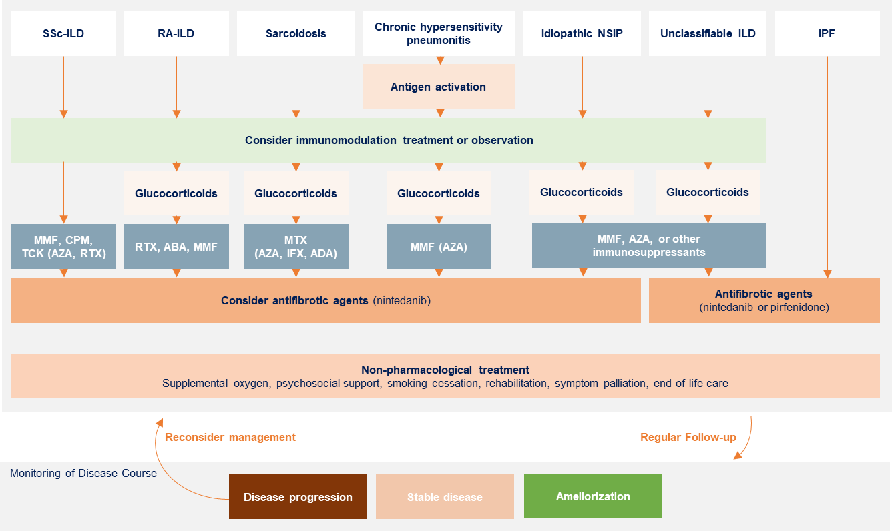
Antifibrotic treatment started immediately after identification of progressive fibrosis could help slow progression when there is the most left to preserve^{1,2}
F3
Antifibrotic therapy is considered in patients with progressive fibrosis despite appropriate first-line therapy
Immediate initiation of anti-fibrotic treatment is advocated in the presence of a fibrosis extent >20% and honeycombing³
*Please note that most drugs mentioned in this algorithm have not been licensed for the treatment of these fibrosing ILDs. Nintedanib is recommended for the treatment of PPF in patients which have failed standard management of fibrotic ILD. MMF=Mycophenolate Mofetil; CPM=Cyclophosphamide; TCL=Tocilizumab; AZA=Azathioprine; RTX=Rituximab; ABA=Abatacept; MTX=Methotrexate; IFX=Infliximab; ADA=Adalimumab; 1. Torrisi SE, Pavone M, Vancheri A, Vancheri C. When to start and when to stop antifibrotic therapies. Eur Respir Rev. 2017;26(145):170053; 2. Wijsenbeek M, Cottin V. Spectrum of Fibrotic Lung Diseases. N Engl J Med. 2020;383(10):958-68; 3. De Sadeleer LJ, Goos T, Yserbyt J, et al. Towards the Essence of Progressiveness: Bringing Progressive Fibrosing Interstitial Lung Disease (PF-ILD) to the Next Stage. J Clin Med. 2020;9(6):1722.
Notes:
Once a diagnosis of fibrotic ILD has been made, first-line therapy consists of treatment of the underlying disorder, which is often immunomodulatory therapy. Depending on the underlying condition, antifibrotic therapy is considered in cases of disease progression despite appropriate first-line therapy

Slide 34
Evidence-based consensus statements for treatment of SSc-ILD¹
F4
CTD-ILD
A critical appraisal of published evidence in SSc-ILD found high-quality evidence for the use of²:
The immunosuppressive drugs cyclophosphamide, mycophenolate and tocilizumab
Antifibrotic treatment with nintedanib
Pulmonary function testing every 3-6 months is recommended to check for progression of disease¹
Screen all patients with systemic sclerosis for ILD using HRCT
FVC and DL_{co} should be done at baseline and at regular intervals
Every patient should receive an ILD-related physical examination
Negative
Decide whether pharmacological therapy is required
Some patients might not need pharmacological therapy
Factors to consider include disease severity; patient quality of life, available clinical guidelines
Pharmacological therapy
Mycophenolate mofetil
Cyclophosphamide
Nintedanib
Assess ILD progression using multiple methods
Use HRCT (depending on clinical need), FVC, DL_{co}, exercise-induced blood oxygen desaturation, and clinical symptoms to assess ILD progression
Escalate therapy
Modify dose or choice of pharmacological treatment; mycophenolate mofetil; cyclophosphamide, nintedanib; consider rituximab
Evaluate for lung transplant
Consider autologous haemopoietic stem-cell transplantation for selected patients
Disease progression
Continue
monitoring for ILD
Frequency of screening and use
of HRCT should be guided by risk of ILD, in combination with
lung function and
symptoms
Negative
Positive
Diagnose ILD using HRCT
Asses ILD severity using multiple methods
HRCT is the primary tool for diagnosis; FVC, DL_{co}, and clinical symptoms are supportive
Use HRCT, FVC, DL_{co} exercise-induced blood oxygen desaturation, clinical symptoms, and quality of life to assess ILD severity
No pharmacological therapy
Follow up closely
Inadequate treatment response
Positive
1. Perelas A, Silver RM, Arrossi AV, et al. Systemic sclerosis-associated interstitial lung disease. Lancet Respir Med. 2020;8(3):304-20; 2. Vonk MC, Smith V, Sfikakis PP, et al. Pharmacological treatments for SSc-ILD: Systematic review and critical appraisal of the evidence. Autoimmun Rev. 2021:102978.
Notes:
All patients with severe or progressive SSc-ILD should be offered pharmacological treatment
No pharmacological treatment is an option for some patients; follow-up assessments enable identification of disease progression
Progression pace, alongside disease severity, drives decisions to escalate treatment.

Slide 35
Nintedanib started early in the disease course could help slow progression of lung function decline among different fibrotic ILDs¹⁻⁴
F5
Progressive Fibrosing ILD
IPF
SSc-ILD
INBUILD
INPULSIS -1 and -2
SENSCIS
0
-50
-80.8
-93.3
-52.4
-113.6
-100
-187.8
44%
Relative
Reduction
Adjusted annual rate of decline in FVC, mL/year
57%
Relative
Reduction
-223.5
-150
49%
Relative
Reduction
-200
-250
Placebo (n=331)
OFEV (n=332)
OFEV (n=423)
OFEV (n=287)
Placebo (n=638)
Placebo (n=638)
∆ 107.0 mL/year
95% CI=65.4, 148.5
P<0.0001
∆ 109.9 mL/year
95% CI=75.9, 144
P<0.0001
∆ 41.0 mL/year
95% CI=2.9, 79.0
P<0.04
1. Flaherty KR, Wells AU, Cottin V, et al. Nintedanib in progressive fibrosing interstitial lung diseases. N Engl J Med 2019;381(18):1718-27; 2. Richeldi L, du Bois RM, Raghu G, et al. Efficacy and safety of nintedanib in idiopathic pulmonary fibrosis. N Engl J Med 2014;370(22):2071-82; 3. Richeldi L, du Bois RM, Raghu G, et al. Efficacy of a tyrosine kinase inhibitor in idiopathic pulmonary fibrosis. N Engl J Med 2011;365(12):1079-87; 4. Distler O, Highland KB, Gahlemann M, et al. Nintedanib for systemic sclerosis-associated lung disease. N Engl J Med 2019;380(26):2518-28.

Slide 36
Pirfenidone reduced mortality and FVC decline in patients with IPF
F6
In a pooled analysis of RCTs^{ǂ} pirfenidone
reduced all‑cause and IPF-related mortality
in patients with IPF¹
In these RCTs, survival outcomes were
either exploratory (CAPACITY²) or secondary
(ASCEND³) endpoints
Pooled CAPACITY & ASCEND trials^{1†}
HR 0.52 (95% CI 0.31, 0.87)
P=0.0107
HR 0.35 (95% CI 0.17, 0.72)
P=0.0029
Proportion of patients
who died over 52 weeks
All-cause mortality
Pirfenidone (N=623)
Placebo (N=624)
ǂCAPACITY 004, CAPACITY 006 and ASCEND 016; †Caution should be taken not to over interpret the results of the IPF-related mortality outcomes. Although these outcome analyses were prespecified, variability and errors in accurate adjudication of these events are a possibility (deaths in CAPACITY were adjudicated by site investigators, whereas in ASCEND they were adjudicated by an independent committee); RCTs=Randomized Controlled Trials; 1. Nathan SD, Albera C, Bradford WZ, et al. Effect of pirfenidone on mortality: pooled analyses and meta-analyses of clinical trials in idiopathic pulmonary fibrosis [published correction appears in Lancet Respir Med. 2017;5(1):e7]. Lancet Respir Med. 2017;5(1):33-41; 2. Noble PW, Albera C, Bradford WZ, et al. Pirfenidone in patients with idiopathic pulmonary fibrosis (CAPACITY): two randomised trials. Lancet. 2011;377(9779):1760-69; 3. King TE Jr, Bradford WZ, Castro-Bernardini S, et al. A phase 3 trial of pirfenidone in patients with idiopathic pulmonary fibrosis [published correction appears in N Engl J Med. 2014;371(12):1172]. N Engl J Med. 2014;370(22):2083-92.

Slide 37
Pirfenidone reduced mortality and FVC decline in patients with IPF
F7
Pirfenidone (ASCEND)³
In a pooled analysis of RCTs^{ǂ} pirfenidone
reduced all‑cause and IPF-related mortality
in patients with IPF¹
In these RCTs, survival outcomes were
either exploratory (CAPACITY²) or secondary
(ASCEND³) endpoints
Pirfenidone reduced FVC decline compared with
placebo in two out of three Phase III trials^{2,3}
15.3%
P≤0.001
Pirfenidone
2403 mg/day
(N=278)
Placebo
(N=277)
Pirfenidone (CAPACITY 1 and 2)²
CAPACITY 1 (006)
CAPACITY 2 (004)
Mean change from baseline in
FVC % predicted at week 72
Pirfenidone 2403 mg/day
Placebo
ǂCAPACITY 004, CAPACITY 006 and ASCEND 016; *P=0.001; 1. Nathan SD, Albera C, Bradford WZ, et al. Effect of pirfenidone on mortality: pooled analyses and meta-analyses of clinical trials in idiopathic pulmonary fibrosis [published correction appears in Lancet Respir Med. 2017;5(1):e7]. Lancet Respir Med. 2017;5(1):33-41; 2. Noble PW, Albera C, Bradford WZ, et al. Pirfenidone in patients with idiopathic pulmonary fibrosis (CAPACITY): two randomised trials. Lancet. 2011;377(9779):1760-69; 3. King TE Jr, Bradford WZ, Castro-Bernardini S, et al. A phase 3 trial of pirfenidone in patients with idiopathic pulmonary fibrosis [published correction appears in N Engl J Med. 2014;371(12):1172]. N Engl J Med. 2014;370(22):2083-92.

Slide 38

Pirfenidone is not licensed for use in SSc-ILD and other CTD-ILDs but it has been studied in unclassifiable progressive fibrosing ILDs^{1,2}
F8
In the uILD trial the predicted mean change from baseline in FVC to week 24 was significantly lower with pirfenidone than with placebo*¹
The RELIEF-trial showed that the mean absolute change from baseline in FVC % predicted is similar between pirfenidone and placebo from week 12²
Trial prematurely halted due to futility.
~50% of patients had imputed values
2
1
Predicted mean (95% CI) change from baseline in FVC (mL)
measured by site spirometry
0
Mean (SE) absolute change from baseline in FVC % predicted†
-1
-2
-3
Pirfenidone (N=64)‡
Placebo (N=63)‡
Unreliablility of home spirometry prevented full statistical analysis of 1 endpoint
-4
0
12
24
36
48
Week
*In the uILD trial, variability and unreliability of home spirometry prevented full statistical analysis of the primary endpoint; †Smallest sum of squared differences imputation method; ‡Dashed lines indicate trend for decline in FVC over time; uILD=unclassifiable ILD; 1. Maher TM, Corte TJ, Fischer A, et al. Pirfenidone in patients with unclassifiable progressive fibrosing interstitial lung disease: a double-blind, randomised, placebo-controlled, phase 2 trial. Lancet Respir Med. 2020;8(2):147-57; 2. Behr J, Prasse A, Kreuter M, et al. Pirfenidone in patients with progressive fibrotic interstitial lung diseases other than idiopathic pulmonary fibrosis (RELIEF): a double-blind, randomised, placebo-controlled, phase 2b trial. Lancet Respir Med. 2021;9(5):476-86.
Notes:
Outcomes: The primary endpoint of mean predicted change in FVC from baseline over 24 weeks could not be analyzed due problems with the home spirometry method employed

Slide 39




Non-pharmacological interventions are effective in the management of fibrosing ILDs¹
F9
Avoid exposure¹
Smoking cessation
Avoid triggers, e.g. pollutants
Stop medication that cause ILD
Lung transplant²
May be an option to patients younger than 65 years without relevant comorbidities
Vaccination²
To avoid infections that may worsen pulmonary fibrosis
Supporting therapies^{1,2}
Oxygen therapy
Physiotherapy
Pulmonary rehabilitation
Advance care planning/palliative care¹
1. Nambiar AM, Walker CM, Sparks JA. Monitoring and management of fibrosing interstitial lung diseases: a narrative review for practicing clinicians. Ther Adv Respir Dis. 2021;15:17534666211039771; 2. Cottin V, Crestani B, Valeyre D, et al. Diagnosis and management of idiopathic pulmonary fibrosis: French practical guidelines. Eur Respir Rev. 2014;23:193-214.
Notes:
Stess that these topics will be further explored in a different session.

Slide 40
Summary

Slide 41





Key messages
Poor outcomes
for PPF¹
Similar decline in FVC
INBUILD® criteria and
new PPF guidelines
Patients with progressive fibrosis have poor survival and face a high burden of disease^{1,2}
The decline in FVC is similar between IPF and other types of PPF³
New guidelines have recently been published, which build on the criteria used in the landmark INBUILD® trial
Early and regular monitoring of progression
Antifibrotic treatment
Early and regular monitoring of ILD progression facilitates early detection of PPF^{4,5}
Antifibrotic treatment can slow down lung function decline in patients suffering from ILDs when PPF is detected⁶⁻⁹
1. Kolb M, Vašáková M. The natural history of progressive fibrosing interstitial lung diseases. Respir Res. 2019;20(1):57; 2. Wijsenbeek M, Kreuter M, Olson A, et al. Progressive fibrosing interstitial lung diseases: current practice in diagnosis and management. Curr Med Res Opin. 2019;35(11):2015-24; 3. Nasser M, Larrieu S, Boussel L, et al. Estimates of epidemiology, mortality and disease burden associated with progressive fibrosing interstitial lung disease in France (the PROGRESS study). Respir Res. 2021;22(1):162; 4. Nambiar AM, Walker CM, Sparks JA. Monitoring and management of fibrosing interstitial lung diseases: a narrative review for practicing clinicians. Ther Adv Respir Dis. 2021;15:17534666211039771; 5. Molina-Molina M, Aburto M, Acosta O, et al. Importance of early diagnosis and treatment in idiopathic pulmonary fibrosis. Expert Rev Respir Med. 2018;12(7):537-9; 6. Flaherty KR, Wells AU, Cottin V, et al. Nintedanib in progressive fibrosing interstitial lung diseases. N Engl J Med 2019;381(18):1718-27; 7. Richeldi L, du Bois RM, Raghu G, et al. Efficacy and safety of nintedanib in idiopathic pulmonary fibrosis. N Engl J Med 2014;370(22):2071-82; 8. Richeldi L, du Bois RM, Raghu G, et al. Efficacy of a tyrosine kinase inhibitor in idiopathic pulmonary fibrosis. N Engl J Med 2011;365(12):1079-87; 9. Distler O, Highland KB, Gahlemann M, et al. Nintedanib for systemic sclerosis-associated lung disease. N Engl J Med 2019;380(26):2518-28.

Slide 42

Ofev® (nintedanib) mjuk kapsel 100 mg och 150 mg, Rx, F. Proteinkinashämmare. Indikationer: Avsett för behandling av idiopatisk lungfibros (IPF), andra kroniska fibrotiserande interstitiella lungsjukdomar (ILD-sjukdomar) med en progressiv fenotyp och systemisk sklerosassocierad interstitiell lungsjukdom (SSc-ILD) hos vuxna. Kontraindikationer: Graviditet. Överkänslighet mot nintedanib, jordnötter eller soja. Varningar och försiktighet: Diarré kan förekomma och ska behandlas vid första tecken. Kontrollera leverfunktionen före insättning och under behandling, med täta kontroller under de första tre månaderna. Blödning och tromboemboliska händelser. Amning ska avbrytas. Boehringer Ingelheim AB, tel: 08-721 21 00. För ytterligare information samt pris se www.fass.se. Datum för översyn av produktresumén: 07/2023
PC-SE-103810 Oct.2023

